Slide 1
Cylindrical orthogonal collision risk management in spacecraft formations
SSDL Lab Meeting
Guggenheim 442
Ulises Núñez (presenter)
15 November 2022

Slide 2
What is spacecraft formation flying (SFF)?
Definition:
“A set of more than one spacecraft whose dynamic states are coupled through a common control law”
Implication:
At least one member of the formation must “track” a desired state relative to another member of the set
Ran et. al (2017)
Notes:
Picture SFF [accessed 12 March 2018]:
https://www.sciencedirect.com/science/article/pii/S0094576517301789
SFF:
This work is motivated by interest in realizing sustainable, practical spacecraft formation flight. So I always like to begin these presentations by defining what spacecraft formation flight is.
Read definition of Scharf, Hadaegh and Ploen
Now, that last bit about tracking a relative state with respect to another spacecraft is crucial, because it implies that agents in formation, although physically distinct, are dynamically “joined“. That‘s what makes spacecraft formations a different concept from constellations.
(Side note: The word “connected“ has a graph theoretical meaning, so it is not appropriate. The word “linked“ has a telecommunications meaning, so it is not appropriate. “Coupled“ has other dynamics implications, e.g. Coupled dynamics modes. “Associated“ is too weak. “Related“ is confusing.)

Slide 3
Spacecraft formation flying (SFF) Examples
Rendezvous & Docking (e.g. with ISS)
Formation keeping (e.g. MMS mission)
NASA (2016)
Schiff et. al. (2011)
Notes:
Picture ISS docking [accessed 16 September 2020]:
https://www.nasa.gov/offices/nesc/articles/space-rendezvous
Picture MMS [accessed 16 September 2020]:
https://ntrs.nasa.gov/citations/20180000025
https://www.semanticscholar.org/paper/Monte-Carlo-Simulations-of-the-Formation-Flying-for-Schiff-Dove/192a560326c61a6c11e10d0af1904ea69e70dca6

Slide 4
Spacecraft formation flying (SFF) NOT Examples
Individual spacecraft (e.g. Hubble Space Telescope)
Constellations (e.g. GPS)
NASA (2020)
GPS.gov (2011)
Notes:
Picture HST docking [accessed 16 September 2020]:
https://www.nasa.gov/feature/goddard/2020/hubble-team-wins-2020-michael-collins-trophy
Picture GPS [accessed 16 September 2020]:
https://www.gps.gov/systems/gps/space/

Slide 5
Spacecraft formation flying (SFF) Benefits
Improved systems engineering attributes (“-ilities”)
Improved system flexibility
Modularity
Adaptability
Maintainability
Improved system robustness
Fault tolerance
Reliability
Ran et. al (2017)
Notes:
Picture SFF [accessed 12 March 2018]:
https://www.sciencedirect.com/science/article/pii/S0094576517301789

Slide 6
Spacecraft formation flying (SFF) Benefits (scientific applications)
Occultation methods
New Worlds Observer team (2017)
Notes:
Picture NWO/Starshade docking [accessed 16 September 2020]:
https://apps.dtic.mil/dtic/tr/fulltext/u2/a539240.pdf

Slide 7
Spacecraft formation flying (SFF) Benefits
Scientific applications
Synthetic aperture radiometry
Astrophysics
Gravitational wave detection
Exoplanet detection
Earth science
Weather forecasting
Climate monitoring
Heliophysics
High resolution surface imaging
El Maghraby et. al. (2016)
Notes:
Picture SAR [accessed 12 March 2018]:
https://eprints.soton.ac.uk/408042/1/IAC_16_B1_2_8_x33950.pdf

Slide 8
Spacecraft formation flying (SFF) Sources of collision risk
External kinetic threats (i.e. debris)
Internal collision risk
ESA (2019)
Wang et. al. (2018)
Notes:
Picture Earth debris environment [accessed 16 September 2020]:
https://www.esa.int/Safety_Security/Space_Debris/Recognising_sustainable_behaviour
Picture relative orbit [accessed 16 September 2020]:
https://www.sciencedirect.com/science/article/pii/S0273117718305696

Slide 9
Outline
Definition of collision events
Motivating new collision regions
Cylindrical orthogonal collision region
Norm-ball properties
Stochastic collision risk feasibility
Quantitative relationships in stochastic collision risk
Q&A

Slide 10
Topological notion of collision
a) No-collision condition
b) Collision condition
Notes:
Background.Definition of collision
Bear in mind: these balls are surrogates for the size of the object, they are not position pdfs.
Note (11/14/2022): Euclidean balls. Isotropic, and allow for a formulation of collision events that is abstract from relative geometry and relative attitude.

Slide 11
Obstacle avoidance problem in SFF Contrast vs. standard obstacle avoidance in robotics
Uncluttered environment
Relative orbital dynamics
Unstable natural modes in any linearization
Affected strongly by unmodeled forces / model uncertainty
Relative state must be estimated
Significant estimation errors
Limited onboard resources
Propellant
Computing power
Notes:
Discussion by Weiss and Dr. Kolmanovsky [weiss2015]
Can’t really be modeled as single integrators; dynamics are rapidly changing in Cartesian space
%as opposed to standard avoidance problem in robotics
Maneuvers constrained by pointing

Slide 12
Obstacle avoidance problem in SFF Implications
Collision risk must account for relative state uncertainty
Mitigation in terms of collision risk indicators
Appropriate choice of risk thresholds
Collision risk must be managed in an ongoing basis
Quantification for monitoring
Assessment whether collision risk warrants corrective actions in view of chosen risk thresholds
If needed, planning and executing maneuvers
Notes:
Can’t really be modeled as single integrators; dynamics are rapidly changing in Cartesian space
Collision risk must be managed in an ongoing basis
Quantification for monitoring
Assessment whether collision risk warrants corrective actions in view of chosen risk thresholds
If needed, planning and executing maneuvers

Slide 13
(Spherical) Collision avoidance constraint satisfaction Computational issues (conceptual)
Uncountable constraints
NP-Hard
Restrictive assumptions
Mueller et. al. (2013)

Slide 14
(Spherical) Collision avoidance constraint satisfaction Approximations
Approaches
Euclidean vs. Box ($L^{∞}$) ball-collision regions
Approximating the same constraint
Sequential convexification
Model-predictive control (MPC)
Artificial potential function
Avoiding a different collision region
Box-type regions
2D cylinders

Slide 15
Clohessy-Wiltshire (CW) relative orbital dynamics Cross-track plane (radial/cross-track); Sky plane (along-track/cross-track)

Slide 16
Clohessy-Wiltshire (CW) relative orbital dynamics Cross-plane marginally safe trajectory families

Slide 17
Clohessy-Wiltshire (CW) relative orbital dynamics In-plane marginally safe trajectory families
Encircling unsafe region
Not encircling unsafe region

Slide 18
Motivation for 3D constraints: Projection IPCs overestimate true IPCs
Theorem
Every projection IPC is an overestimate of the true IPC
Applies to any plane choice
If $\text{support}\left({\text{pdf}}_{{\underline{\text{R}}}_{i,j}\left(t\right) }\right)=ℝ^{3}$, then the overestimation is strict
This applies to normally distributed relative positions
Núñez Garzón et. al (2022)
Notes:
Theory.Projection KPC theory
Explain
Projection pdfs
Projections KPCs
Collision risk as perceived in 2D projections is an overestimate of “true” collision risk as perceived in the full 3D condition. So we definitely want to handle 3D constraints nonconservatively.

Slide 19
Constructing a cylindrical orthogonal collision region
Balancing concerns in simplifications
Safety
Constraint satisfaction tightness
Assumption: 2D solutions are readily available

Slide 20
Constructing a cylindrical orthogonal collision region
What if we satisfied at least one of these constraints at a time?
XY plane (in-plane)
XZ plane (cross-plane)
YZ plane (sky-plane)
Putting them together
OR-logic

Slide 21
Research Questions
#1: what kind of space would we avoid when we do this?
Is that region well defined?
What are the properties of those spaces?
What are the advantages to using this region?
#2: Does it make sense to do collision risk management with it?
Are stochastic measures of collision risk based on this OR-logic constraint relaxation 1) defined, and 2) computable?
#3: How do collision risk measures based on new region compare to those used in the community?
Notes:
How do measures of collision risk compare to other measures (joint-time and instantaneous) that are already used in the community (Euclidean and box-type balls)

Slide 22
Cylindrical orthogonal norm in $ℝ^{3}$ $\left({\left\|∙\right\|}_{\text{co}}\right)$ Definition
Let $\underline{\text{r}}={\left[x,y,z\right]}^{T}$ in $ℝ^{3}$
Cylindrical orthogonal (c.o.) norm
$${\left\|\underline{\text{r}}\right\|}_{\text{co}}=\max\left(\begin{aligned}\sqrt{x^{2}+y^{2}}, \\ \begin{aligned}\sqrt{x^{2}+z^{2}}, \\ \sqrt{y^{2}+z^{2}}\end{aligned}\end{aligned}\right)$$
This is a norm in $ℝ^{3}$
Non-negativity
Homogeneity (or scalar multiplication)
The Triangle Inequality
Uniqueness (of the zero vector)

Slide 23
Cylindrical orthogonal norm in $ℝ^{3}$ $\left({\left\|∙\right\|}_{\text{co}}\right)$ Connection to collision risk management
Construction
Resulting avoided volume

Slide 24
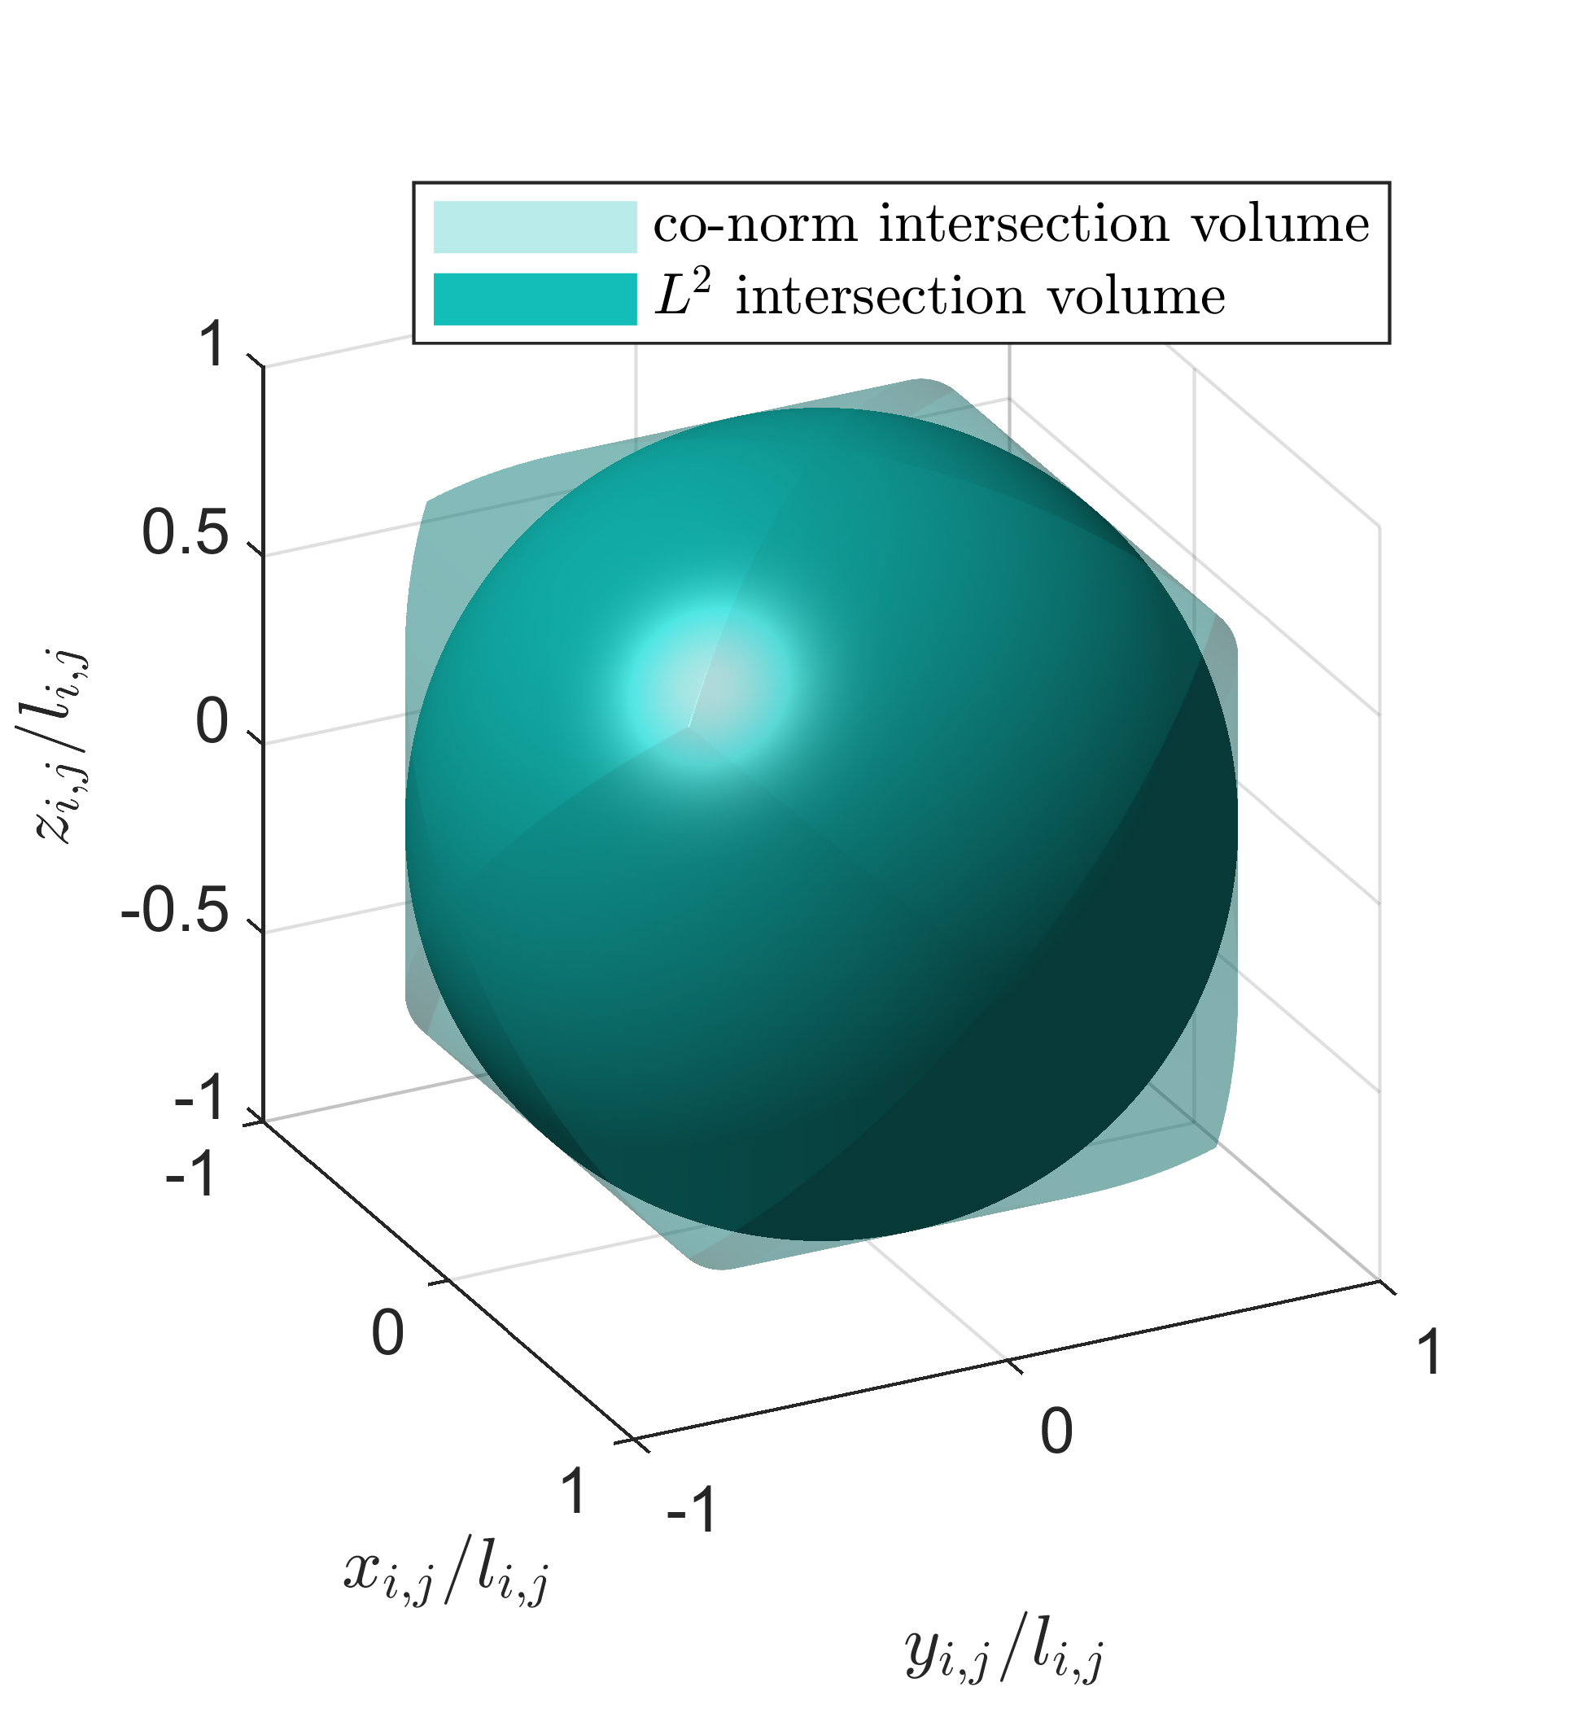
Cylindrical orthogonal collision region Properties
Cylindrical orthogonal collision region is an open set
Comparison to spherical ball
It is a measurable set
Volume is defined
Probability measures are computable (esp. via pdfs)
It is a convex set (since it’s a ball)
Conservative (but not much) compared to spherical ball
Volumetrically: +11.9%
Linearly: +22.5% (worst case)

Slide 25
Cylindrical orthogonal collision region Properties
Deterministic Benefits
Comparison to spherical ball
Conservative (but not much) compared to spherical ball
Volumetrically: +11.9%
Linearly: +22.5% (worst case)
Features:
Reduced conservatism
Collision safety is kept
Easy to compute
What about stochastically?

Slide 26
Probabilistic collision risk indicators Joint-time collision event (JTC)
Notes:
JTC: Happens in relative state space: that is, space of relative position and relative velocity. We have to account for how uncertainty evolves over time (changes shape and location) and therefore we need to account for relative velocity also

Slide 27
Result #1: Joint-time collision risk is *defined*
Assumptions:
If we define an instantaneous collision condition as an open ball with respect to any 3D vector norm
If the projection from relative position to relative state space is continuous (and onto)
If the flow function (that propagates points in relative state space from $t_{0}$to $t$) is continuous
Then:
The joint-time collision set is open (and hence measurable) in initial relative state space
Consequences:
Probability of collision is well defined under these assumptions

Slide 28
Result #2: Joint-time collision risk is “computable”
Assumptions (in addition to 1-3):
Hard-body radius varies continuously for $t$ in $\left[t_{0},t_{f}\right]$
Then:
Probability of collision can be approximated as a limit of finite timestep approximations
Consequences:
Probability of collision is practically computable

Slide 29
Cylindrical orthogonal collision probabilities Bounds
Rationale
Bounds (instantaneous + joint-time cases)
Follows from equivalence of finite-dimensional vector norms
Reflect collision set inclusion/exclusion relationships
Compared norm | Lower bound (multiple of $l_{i,j}$) | Upper bound (multiple of $l_{i,j}$)
Euclidean ($L^{2}$) | $$1$$ | $$\sqrt{3/2}$$
Box ($L^{∞}$) | $$\sqrt{1/2}$$ | $$1$$

Slide 30
CW Monte Carlo sample distribution (Initial time)
Notes:
Theory.Validation
Validate through MC analysis (320 million particles) why so many? Adapting the req of preq = 1E-7

Slide 31
CW dynamic cases (normal initial state distribution)
Initial state expectations
Initial state covariance
Cases | With ${\left[z\right]}_{H}$ motion | Comments | $α_{0}$ [deg]
3D.001 | No |  | 0
3D.002 | Yes | ${\left[x\right]}_{H}$ and ${\left[z\right]}_{H}$ motion in phase | 0
3D.$c (c∈\left\{3,…, 26\right\})$ | Yes | ${\left[x\right]}_{H}$ and ${\left[z\right]}_{H}$ motion out of phase | 15(c $−$ 3) ($α_{0}$ $∈$ {0,15, $…$ ,345})
Diagonal
Standard deviation | ${\left[x\right]}_{H}$ | ${\left[y\right]}_{H}$ | ${\left[z\right]}_{H}$
Relative position (m) | 10 | 5 | 0.5
Rel. position rate (m/s) | 0.25 | 0.75 | 0.05
Notes:
Implementation.CW dynamic cases
Rationale: we are incorporating multiple things here – the indicator definitions + sampling, the probabilistic formulations, + the dynamic models. As this is the beginning of a very long investigation (hopefully), we chose to simplify the relative orbital dynamics involved.

Slide 32
Computational validation Example 3D.001 (similar for all examples)
Comp. to Euclidean norm ($L^{2}$)
Comparison to box norm ($L^{∞}$)

Slide 33
Applicability of Results #1, #2
Transfer and Planetary Orbits
Libration point orbits
Parker (2011)
Swenson (2019)

Slide 34
Applicability of Results #1, #2 to other norms Extrusions of 2D shapes
Polygons (e.g., hexagon)
Extruded circle

Slide 35
Applicability of Results #1, #2 to other norms Proper 3D shapes
Rectangular cone
Ellipsoid

Slide 36
Applicability of Results #1, #2 to other norms Truncations of 3D shapes
Truncated rectangular cone
Truncated ellipsoid

Slide 37
Examples of non-spherical collision regions in the literature
Ellipsoid (with norm structure)
Ellipsoid+ball (does not have norm structure)

Slide 38
Conclusion
Cylindrical orthogonal collision region
Motivated
Definition
Deterministic properties
Stochastic collision risk theoretical results
Stochastic collision risk inequality relationships
Computational validation

Slide 39
Questions?

