Slide 1
Multi-Spacecraft Cislunar Space Domain Awareness Optimization
SSDL Presentation
Visonneau Lois
07/02/2023

Slide 2
Presentation Outline I. Introduction II. Problem Statement III. Methodology IV. Results V. Extension

Slide 3
Motivation
Increase in interest for lunar space exploration in the recent years
Artemis, China Lunar Sample, India’s Chandrayaan-2 rover, Russia’s Luna-25
Resulting greater traffic and congestion in the cislunar space
Earth Space Domain Awareness (SDA) techniques not always applicable
Dynamic forces different and chaotic motion of spacecrafts
Cislunar space is too vast and too far away for reliable Earth-based observation
Moon brightness creates a “cone of shame” where tracking objects becomes infeasible

Slide 4
Problem Statement
How to design an architecture capable of filling the current gaps in Cislunar SDA and provide continuous space object detection?

Slide 5
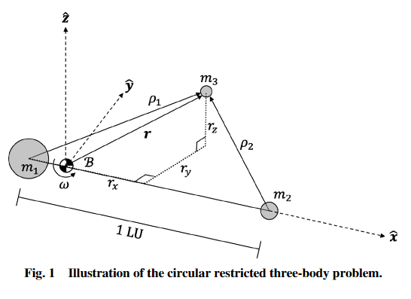
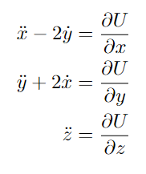
Dynamics
Circular Restricted Three Body Problem is the simplest way to model the trajectory of spacecrafts in cislunar space

Slide 6
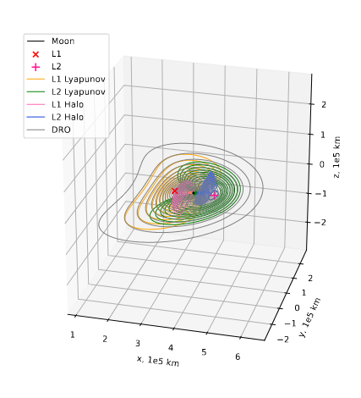
Candidates Spacecraft Allocations
Low Lunar Orbits
Lunar Surface
Lunar Periodic Orbits
Repeating trajectories in the rotating frame
Separated in families
Offer good geometric coverage of the cislunar space
In general, synodic resonant orbits may offer good observation measures given the light conditions

Slide 7
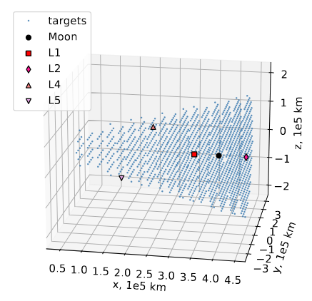
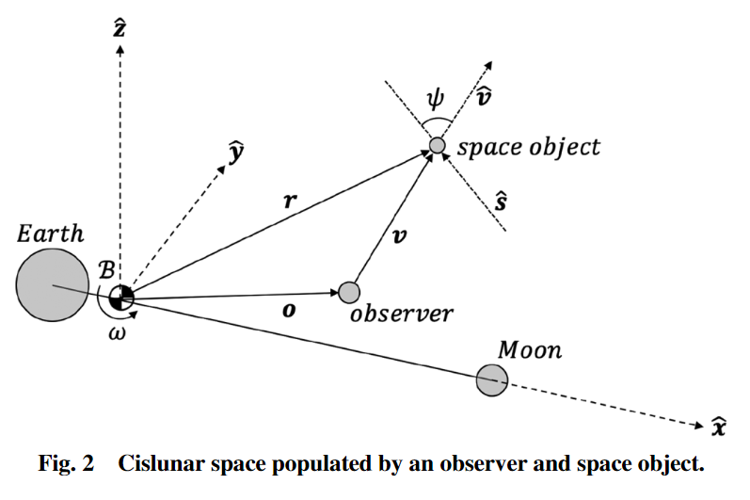
Metrics Considered
I. Observation Metric
Define a grid of targets in a shape of a cone that covers cislunar space
From Earth GEO to L2
Compute the apparent magnitude of each target using:
where Ψ is the solar phase angle and $p_{diff}$ is the diffuse phase angle
For multiple spacecraft, apparent magnitude is the highest achieved by any spacecraft
Repeat for all time steps over the mission duration
Metric is then defined as the percentage of the grid that is seen below a cutoff magnitude $m_{cutoff}$ for over a percentage α of the time

Slide 8
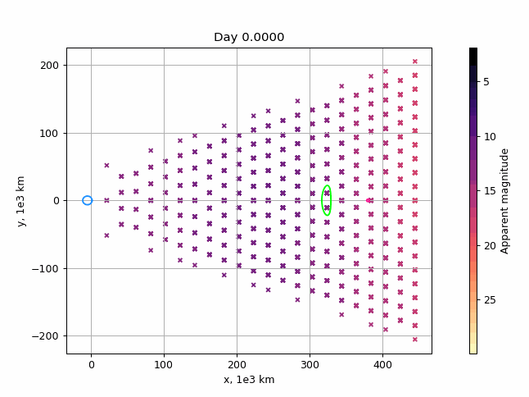
Metrics Considered
I. Observation Metric

Slide 9
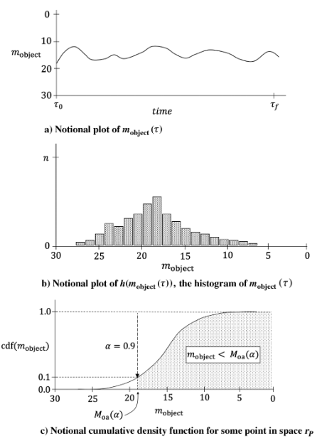
Metrics Considered
Observation Metric
The mean magnitude$M_{oa}\left(\text{α}\right)$is defined as the separation of cumulative density function of the apparent magnitude at single target point into α percent of time and 1 - α percent of time
A target for which the mean magnitude is below/brighter the cutoff magnitude is defined as visible:
The percentage of visible target is the observation metric:

Slide 10
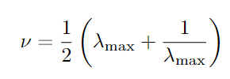
Metric Considered
II. Cost Metric
Main characteristic of LPO:
We can then define the stability index ν as our second metric:
where${ λ}_{max}$ is the largest eigenvalue of the STM at t=P
Finally, we also define the number of spacecraft as a metric to minimize
Some LPO have low stability index but poor observational capabilities

Slide 11
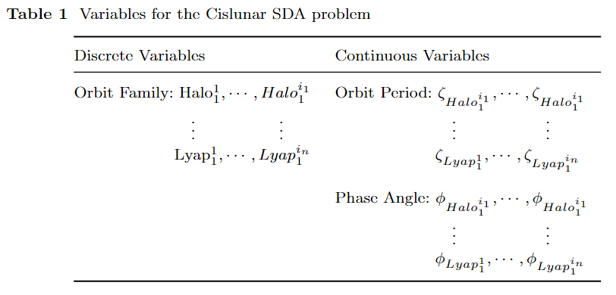
Optimization Formulation
Multi-objective optimization formulation:
Discrete variables directly influencing the number of continuous variables:
Fixing the number of spacecraft will either diminish the scope of the work or become too computationally intensive
We have a Variables-Size Design Space where the total number of variables evolves
Traditional algorithms not suited

Slide 12
Hidden Gene Genetic Algorithm
Hidden Gene Genetic Algorithm (HGGA) are meta-heuristic algorithms that allow for a variable length chromosome
First used to solve the MGA trajectory optimization problem
Main idea:
Define the longest possible chromosome of length $L_{max}$
Assign tag to each gene
If tag is 0: gene is not considered in objective function
All genes with a tag equal to 1 constitute the “actual” chromosome
Tags change over each iteration of the algorithm using common genetic algorithms

Slide 13
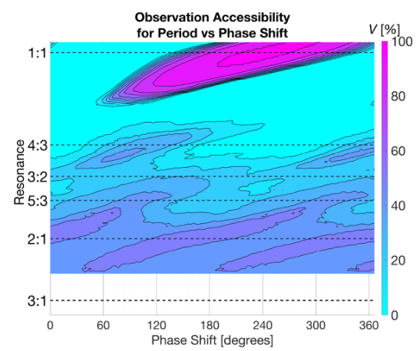
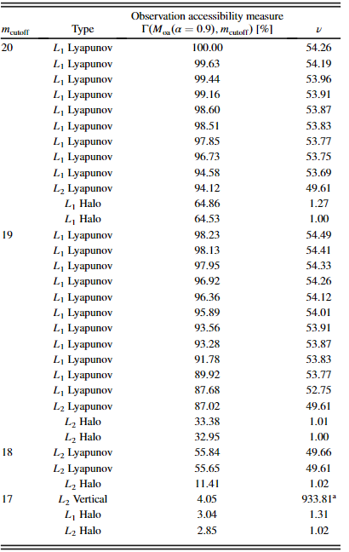
Results for single spacecraft
Synodic resonant period for LPO showed great results for single spacecraft observation

Slide 14
Results for multi-spacecraft
Simulation Parameters
Optimization Parameters
Use of modified NSGA-II multi-objective genetic algorithm to account for hidden genes
Simulated Binary Crossover
Polynomial Mutation
Number of Generations:
100
Number of Chromosomes per generation
100
Tags genetic operations probability:
Crossover: 0.8
Mutate: 0.2
Families considered:
L1 Halo, L2 Halo, L1 Lyapunov, L2 Lyapunov, DRO
Period range:
Depend on the family
Initial Phase Angle range:
$\left[0;2π\right]$
Maximum number of spacecraft:
15 (3 per orbit family)

Slide 15
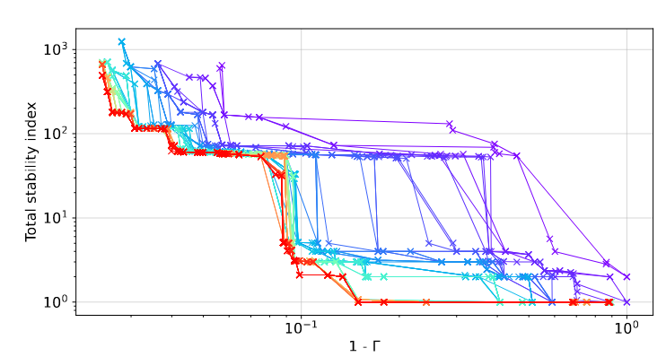
Results for multi-spacecraft
Runtime of around 10 to 30 hrs on a single core

Slide 16
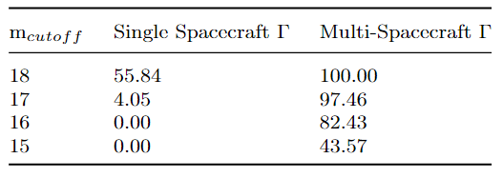
Results for multi-spacecraft
Comparison to single spacecraft
However, for lower${ m}_{cutoff}$, number of spacecraft and associated stability index tend to increase exponentially
For ${ m}_{cutoff}$ = 16, best gamma is obtained for 12 spacecraft and a cumulative stability index of 476.50
Other good solutions:
Gamma = 79.80 achieved for 8 spacecraft and ν = 363.87
Gamma = 72.46 achieved for 5 spacecraft and ν = 165.45

Slide 17
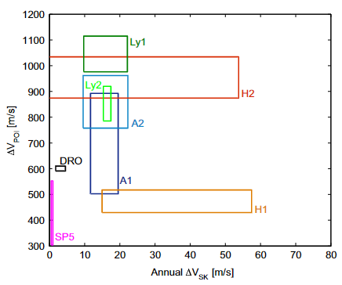
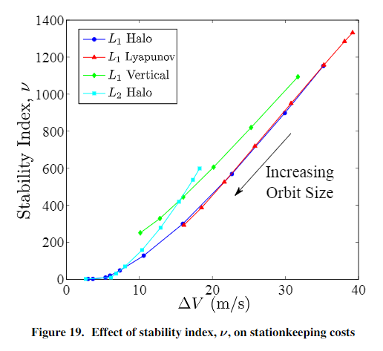
Extensions
Transfer from low earth orbit cost estimates
Direct transfer with two impulsive burns to the initial position of the spacecraft along the considered
Conic arc corrected in the CR3BP using multiple shooting method
Possibility to later consider multiple-burns transfers, lunar flybys and manifold connection
Station Keeping cost estimate
Surrogate model linking station keeping cost to stability index as there is a direct correlation
Short- or Long-term station keeping strategy possible
Include telescope characteristics optimization to lower even more the ${ m}_{cutoff}$ accessible

Slide 18
References
Vendl, J.K., Holzinger, M.J.: Cislunar periodic orbit analysis for persistent space object detection capability. Journal of Spacecraft and Rockets 58, 1174–1185 (2021)
O. Abdelkhalik and S. Darani, “Evolving hidden genes in genetic algorithms for systems architecture optimization,” Journal of Dynamic Systems, Measurement and Control, Transactions of the ASME, Vol. 140, No. 10, 2018, pp. 1–11
Folta, David & Pavlak, T.A. & Haapala, Amanda & Howell, Kathleen. (2013). Preliminary design considerations for access and operations in Earth-Moon L1/L2 orbits. Advances in the Astronautical Sciences. 148. 2073-2092
David C. Folta, Natasha Bosanac, Davide Guzzetti, Kathleen C. Howell, An Earth–Moon system trajectory design reference catalog, Acta Astronautica, Volume 110, 2015, Pages 341-353

Slide 19
Thank you ! Questions ?

