Slide 1

Concept of Operations for the VISORS Mission:
A Two Satellite CubeSat Formation Flying Telescope
William Rawson
Georgia Institute of Technology
VIrtual Super-resolution Optics with Reconfigurable Swarms (VISORS)

Slide 2












Institutions

Slide 3
Outline
Introduction
  Mission Overview
  Science Objectives and GNC Requirements
Mission Modes
  Formation Relative Orbits
  State Machine
Operational Timelines
Conclusion

Slide 4
Introduction

Slide 5
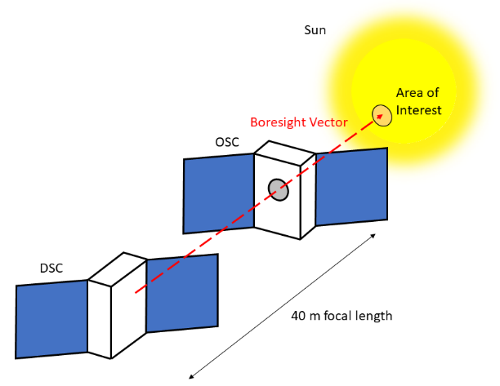
Mission Overview/Background
National Science Foundation funded CubeSat mission created from CubeSat Ideas Lab in February 2019
VISORS strives to further knowledge of the solar corona via a 2 x 6U CubeSat distributed telescope in LEO
  Optics Spacecraft (OSC) serves as a sunshield and hosts diffraction optics
  Detector Spacecraft (DSC) hosts the detector instrument
Launch planned during solar maximum in Q1 2024 – mission has cleared CDR
Notes:
“Mission Overview” first paragraph
Ideas Lab
Science and technology goals
Distributed telescope implementation
Bus/payload division
Launch in 2024

Slide 6
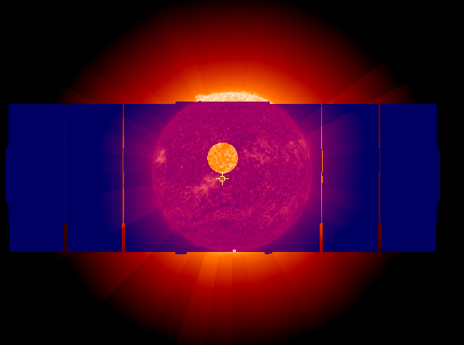
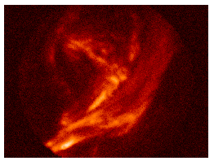
Mission Objectives and Goals
Minimum Mission Success Science Goal:
  Downlink a single image of the solar corona in the He II 304 Å line with a resolution of at least 0.2 arcseconds
Achieving this goal will:
  Allow observation and study of heat release regions in the corona
  Demonstrate key formation-flying technologies
    Photon Sieve Optics
    Near-Full-Sky-Coverage Inter-satellite Link (XLINK)
    GNC Algorithms for precise formation control
Above: OSC & EUV corona
Left: Simulated 0.2 s exposure of the targeted 62” region, including direct EUV background.
Image Credit: NASA Goddard SFC

Slide 7
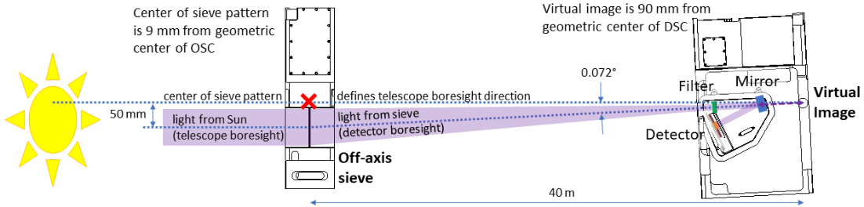
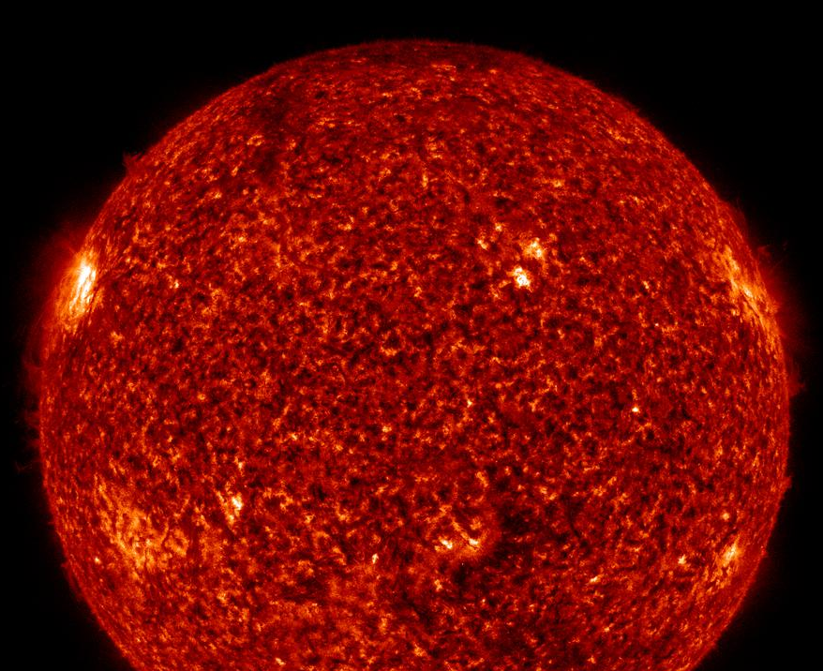
Science Objectives
Minimum mission success science goal: downlink single image of the solar corona in the EUV spectrum with a resolution of 0.2 arcseconds
  Imaging in Extreme Ultraviolet (EUV) requires a 40-meter inter-spacecraft separation (focal length)
  Images must be: in-focus, on-target, unsmeared
Several novel (low TRL) technologies will be demonstrated in pursuit of this goal:
  Photon Sieve Optics
  Near-Full-Sky-Coverage Inter-satellite Link (XLINK)
  GNC Algorithms for precise formation control
EUNIS
2021
SDO/AIA 304
Notes:
“Mission Overview” second paragraph
Brief statement about science goal/hypothesis
Motivation for distributed instrument
Alignment requirements
Minimum mission success goal

Slide 8
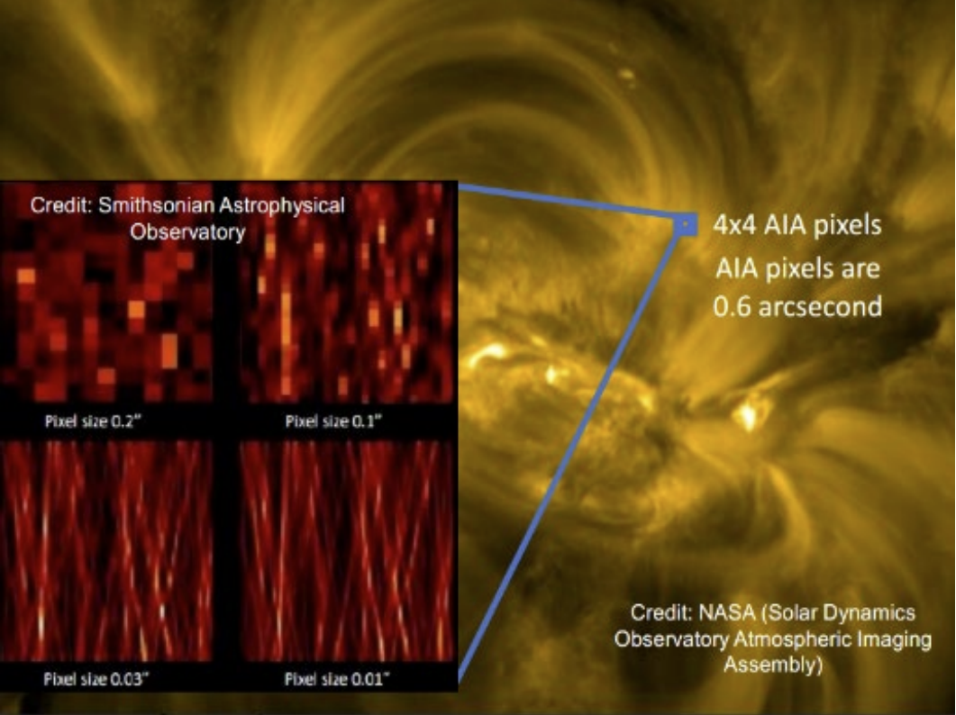
Science Objective
Question: how is the corona heated?
  Hypothesis: Heating focused in narrow current sheets where energy can be dissipated
Goal: observe theorized energy release regions in the solar corona
  Scale of 100 km
  Angular Resolution of 0.15 arcseconds (1/24000th of a degree)
Challenge: this resolution is beyond capability of current solar/coronal imaging

Slide 9
Photon Sieve Optics
EUNIS
2021
EUV
Visible
Corona
Challenge: mirror-based optics cannot achieve diffraction-limited resolution in EUV
  Manufacturing/cost limitations
Photon Sieve – novel form of diffractive optic
  Allows for diffraction-limited resolution (~0.10”) in the EUV range
  Scalable technology based on Fresnel plate
  Silicon wafer fabricated using microlithography
Challenge: EUV photon sieve has a 40 m focal length – too large for single spacecraft
SDO/AIA 304

Slide 10
Distributed Telescope
Question: how can we create an instrument with a 40 m focal length in Earth orbit?
Solution: two-spacecraft distributed telescope
  Optics Spacecraft (OSC) with photon sieve
  Detector Spacecraft (DSC) with detector instrument
Challenge: spacecraft must fly in precise formation to properly align for images
  Focus – separation during imaging must be within 15 mm of nominal 40 m
  Targeting – alignment of detector and optics boresights must remain within 17.5 mm of target
  Blur – spacecraft must have less than 2 mm/sec relative velocity cross-boresight to prevent smearing

Slide 11
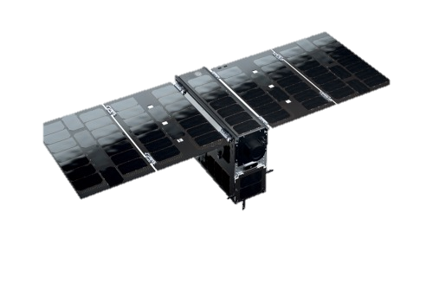
GNC requirements
Require >20% chance of achieving GNC alignment requirements during each science observation
Collision risk addressed on 2 fronts:
  Relative orbit passively safe in the presence of perturbations
    Sufficient cross-track separation for > 2 orbit passive safety margin
  Active collision avoidance function
    Monitor minimum separation for collision risk
    Compute collision avoidance maneuver when necessary
Formation
pointing
stability
(over 10s)
Active region requirement
± 17.5 mm
± 2 mm
OSC
± 15 mm
40 m
90 arcsec
DSC
< 2 mm/s
Cross-boresight relative velocity
Notes:
“Relevant Requirements” Section of paper
Virtual chief-deputy architecture
Science alignment requirements -> GNC requirements
Success rate

Slide 12
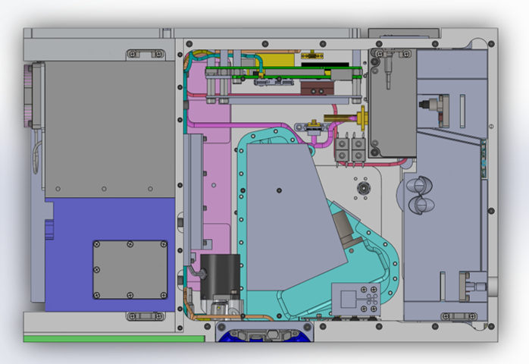
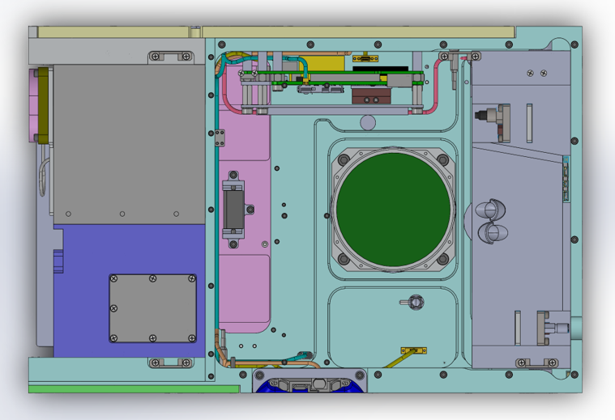
Spacecraft Design
UHF Antenna
Propulsion System
OSC
XLINK Patch Antenna (1 of 6)
Photon Sieve
Avionics Stack
GNSS Antenna
Detector Chamber
BCT Avionics Box
DSC
Notes:
Figures from “Spacecraft Design” Section and highlighting important payload systems
Overview of DSC/OSC
Highlight subsystems
Bus/Payload delineation

Slide 13
Operations Design – Mission Modes

Slide 14
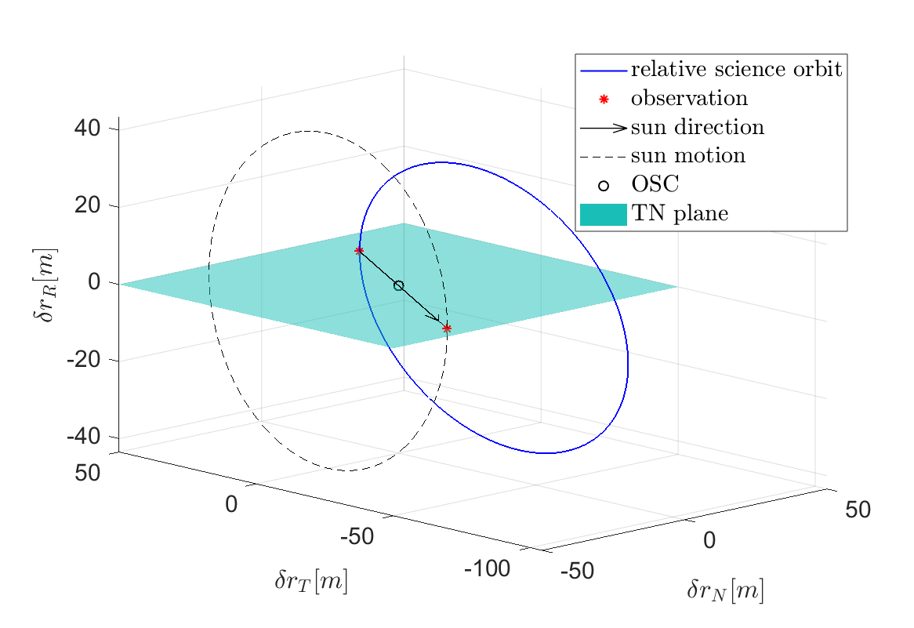
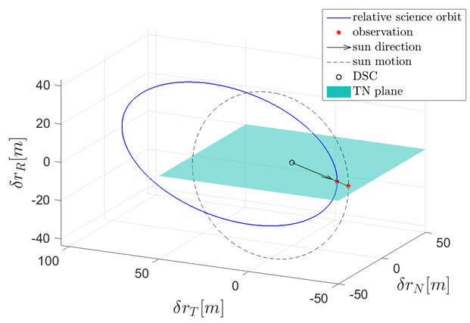
Science Mode
Relative orbit designed to meet science & safety requirements
  Alignment to Sun with 40 m inter-spacecraft separation
  <0.2 mm/s relative velocity perpendicular to telescope boresight
  Passively safe for > 2 orbits
Notes:
Relative orbit is designed to provide required alignment towards the Sun while meeting the requirement for zero relative acceleration in the _____ direction and <_____ mm/s lateral relative velocity
Requirement for 2 orbits of passive safety restricts cross-track separation to 20 m minimum. This limits the Beta angles at which observations can be taken while maintaining passive safety (preference for SSO with desirable beta angle)

Slide 15
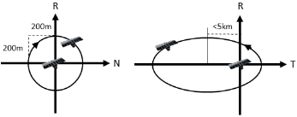
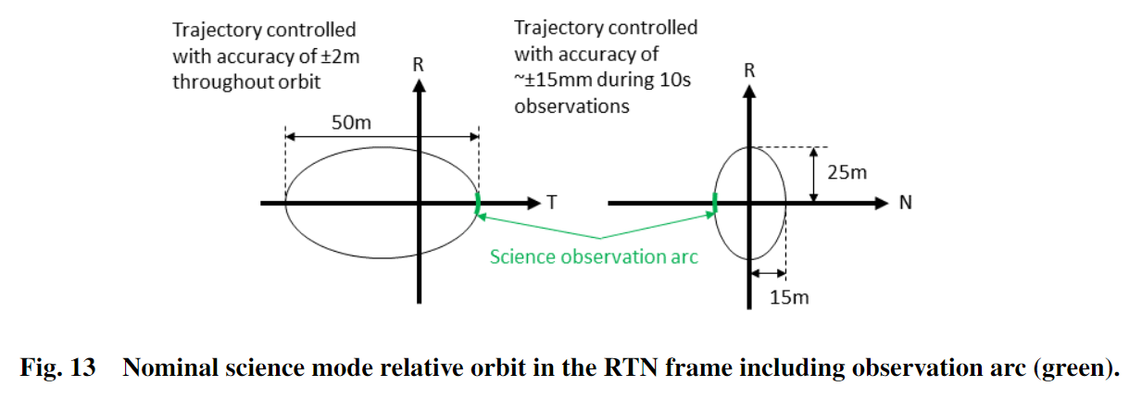
Standby Mode - Motivation
Undesirable to maintain Science formation for extended periods
  High rate of propellant consumption to control precise alignment
Solution: introduce a “Standby” orbit with larger separation
 | Standby | Science
Avg. Delta-V Consumption | 46 mm/s per wk | 3.55 mm/s per orbit
Min. Cross-Track Separation | 200 m | 20 m
Passive Safety Margin | Several Days | 2 orbits

Slide 16
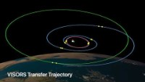
Transfer Mode - Animation
Video Credit:
Toby Bell
Space Rendezvous Lab
Stanford University
Notes:
Here we will discuss some of the specifics about transfer mode and how it is designed
Can also address comparisons between the modes in terms of passive safety and pointing

Slide 17
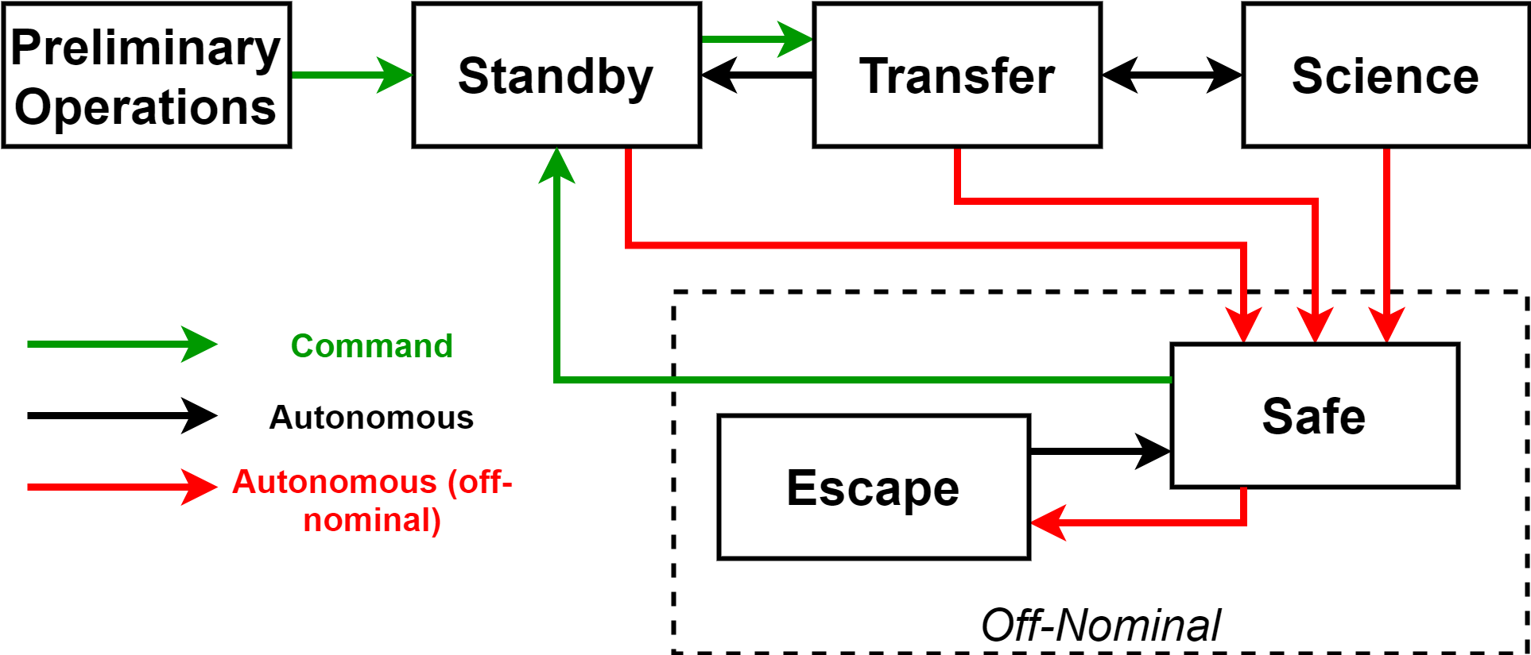
Payload State Machine
Science Mode
  Maintain relative orbit and pointing necessary to form distributed telescope and take observations
  Collect and store the science observation data
Transfer Mode
  Transition from Standby Mode to Science Mode by reconfiguring relative orbit geometry
Standby Mode
  Downlink state of health telemetry and science data
  Larger passive safety margin = more time to resolve anomalies
  Reduced propellant consumption = extended mission duration

Slide 18
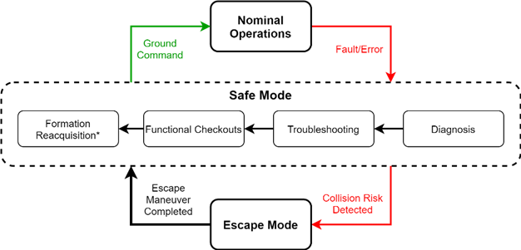
Safe Mode & Escape Mode
Autonomous entry into Safe Mode from Standby, Transfer, or Science when a fault is detected
If the detected fault is a collision risk, autonomous entry into Escape Mode to plan and execute a maneuver
Return to nominal operations
requires a ground command

Slide 19
Mission Operations - Timelines

Slide 20
Baseline Mission Timeline
Mission begins with preliminary operations (commissioning + formation acquisition)
Science Operations makes up the rest of the nominal mission
  Science Campaigns are the main unit of operations
  Downlink of science data nearly continuous after first observation
Notes:
Goal of the baseline 6-month minimum mission is to meet the minimum mission success science goal by downlinking at least one in-focus image and to demonstrate the precision formation-flying required to form the distributed instrument
Following deployment, the mission begins with commissioning of the spacecraft and payload followed by acquisition of the Standby relative orbit via a maneuver sequence computed on the ground
The remainder of the mission consists of science operations. The main unit of science operations is a science campaign consisting of a transfer to Science mode, 10 observation attempts, and a transfer back to standby mode.
The exact timing of science campaigns depends on the level of science interest in current solar activity.
At least 10 science campaigns are accommodated in the operational plan and delta-V budget allowing the approach to be tuned through the mission to obtain better performance.
A data prioritization strategy, which will be discussed later, is used to manage science data downlink via the relatively slow UHF link throughout the mission.

Slide 21
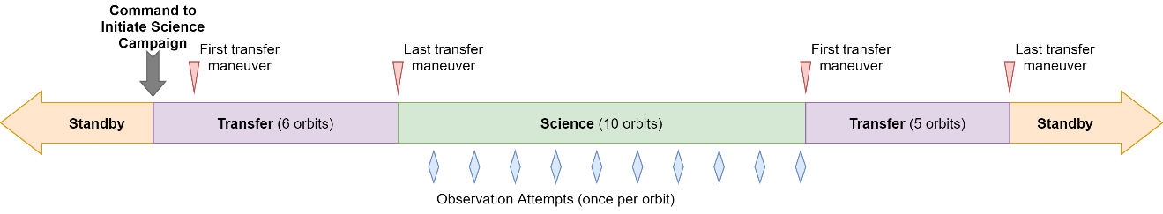
Science Campaign Timeline
Standby Mode: downlink data, wait for observation opportunity, larger passive safety margin
Command to Initiate Science Campaign:
Transfer
10 Orbits in Science Mode
Transfer
  Data transfer and downlink
High-Level Timeline
Notes:
After completion of preliminary operations, the rest of the mission consists of science operations. This phase consists of science campaigns separated by periods in Standby Mode for data downlink and to wait for desirable observation opportunities.
The ground command to initiate a science campaign triggers the transition into Transfer mode. This command includes the desired target area on the Sun and the number of frames to take in each observation attempt.
From this point on, maneuver and data collection proceed autonomously until the two spacecraft complete the campaign and return to standby mode or an anomalous condition causes once spacecraft to enter Safe mode.
After completing the Transfer to Science Mode, 10 orbits are performed in Science Mode with one observation attempt each orbit.
Once the software and operations have been refined to account for biases such as uncertainty in the locations of the spacecraft center of mass and the GNSS antenna phase center and maneuver execution errors, the success rate for observations is expected to be about 20% providing a 90% chance of at least one successful observation per campaign.
After completing the last science orbit, the formation automatically enters Transfer mode and transitions back to Standby mode.

Slide 22
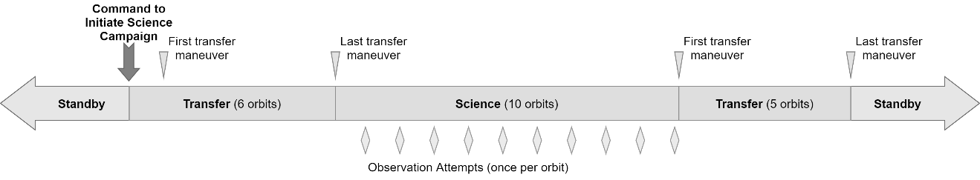
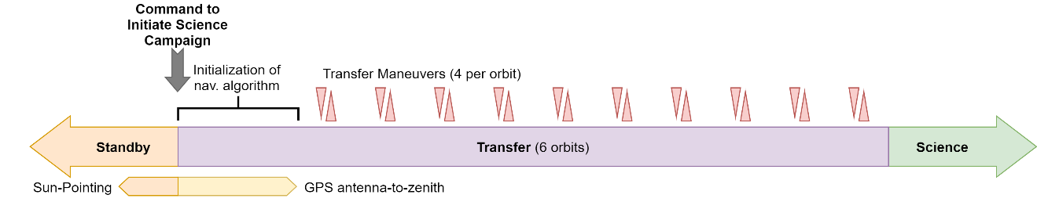
Transfer Timeline
Science Campaign Timeline
Fixed ΔV cost for Transfer divided across 5-10 orbits to mitigate reaction wheel saturation
~1 orbit required to initialize high-fidelity navigation algorithm
Subsystem State Changes in Transfer:
Pointing: GNSS antenna to Zenith becomes primary constraint
Crosslink (XLINK): constant link required to verify safety
Propulsion: more frequently active
  2-4 maneuvers per orbit
Notes:
This slide shows more detail on the transfer from Standby Mode into Science Mode
Once the ground command is received, the primary pointing constraint switches from sun-pointing to GNSS antenna-to-zenith to provide the continuous navigation data necessary to initialize the differential carrier-phase navigation algorithm which takes about an orbit.
At this point the GNC software begins autonomously planning maneuvers to execute a transfer trajectory into Science mode. The XLINK connection is critical through Transfer and Science modes as it enables navigation data to be exchanged between the spacecraft to verify formation safety and enable autonomous maneuver planning.
The transfer has a fixed cost of about 0.3 m/s. This total cost consists of along-track maneuvers to adjust the relative eccentricity and cross-track maneuvers to adjust the relative inclination. Each type of maneuver can be performed once or twice per orbit and the transfer can be performed over any number of orbits without increasing the fixed delta-V cost.
This flexibility is used to construct a transfer trajectory that maintains 2 orbits of passive safety and which has small enough maneuvers to avoid saturating the reaction wheels. The timeline above shows the current design which uses 4 maneuvers per orbit over 5 orbits to complete the transfer. The maneuvers will decrease in size as the transfer concludes since smaller maneuvers have lower executions errors which improves the initial tracking error in Science Mode.
Once the last transfer maneuver is completed and the science relative orbit has been attained, the two spacecraft enter Science Mode and begin the series of 10 observation attempts. A timeline for Science Mode is shown on the next slide

Slide 23
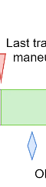
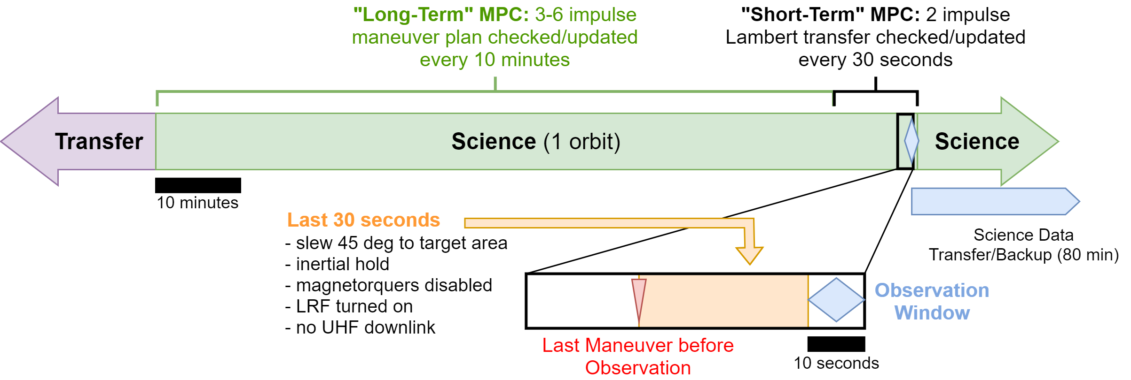
Science Mode Timeline
Science Campaign Timeline
Subsystem State Changes in Science:
GNC: switch to Stochastic Model-Predictive Control (MPC) for maneuver planning
Instrument: collect data during observation window and then transfer/backup data
Notes:
SMPC long-term and short-term descriptions
-motivation, goals (division)
-timing
-number of maneuvers
-checking, frequency
-MC Sim results
Other changes
-inertial pointing, magnetorquers
-slew magnitude
10 sec observation window w/ multiple frames -> 10 observation attempts per campaign -> delta-V budget designed to provide 10 campaigns in baseline mission
Tuning of parameters: alignment

Slide 24
Delta-V Budget
10 science campaigns in Baseline Minimum Mission
  10 additional campaigns in extended mission
Worst-case values used for Standby and Science modes
Baseline Mission uses only 52% of total available delta-V
  6 campaigns can still be completed with only the smaller DSC propulsion system
Maneuver Type | delta-V (mm/s) | Frequency |  | Contingency (%)
 |  | Baseline Mission | Extended Mission
Formation acquisition | 1000 | 1 | n/a | 50
Standby mode station-keeping | 110/wk | 19 weeks | 25 weeks | 10
Transfer (Standby to Science) | 300 | 10 | 10 | 10
Science mode station-keeping | 8.14 | 100 | 100 | 20
Transfer (Science to Standby) | 300 | 10 | 10 | 10
Collision Avoidance (Escape) | 150 | 1 | 1 | 10
Standby mode reacquisition | 300 | 1 | 1 | 10
Total Max Expected delta-V for Baseline Mission (m/s) |  |  | 11.8708
Spacecraft delta-V Capacity (DSC/OSC) (m/s) |  |  | 23 (8.4 / 14.6)
Unallocated (Baseline Minimum Mission) (m/s) |  |  | 11.1292 (48.4%)
Additional delta-V for Extended Mission (m/s) |  |  | 11.0986
Unallocated (Baseline + Extended Mission) (m/s) |  |  | 0.0306 (0.13%)
Notes:
Sources for estimates, reason for margin/uncertainty
Implications: baseline/extended mission breakdown
Redundancy/contingency
Talk about standby formation-keeping sequence/frequency

Slide 25
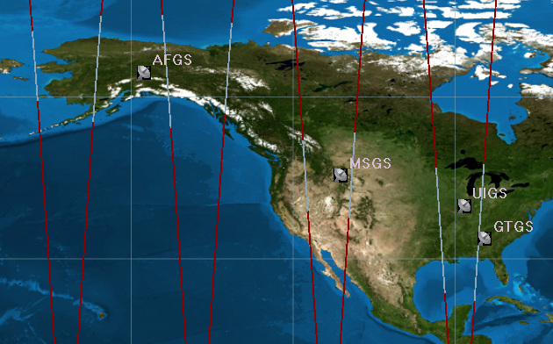
Downlink Strategy
Data throughput of UHF link improved via distributed ground station network
Tiered approach to image selection and downlink
  GNC data and 16x16 rebinned “thumbnails”
    Assess targeting, focus, drift
    Determine whether alignment requirements have been met
  Images downlinked from most promising observation attempts
    Flexibility to select sub-frames, 8-bit compression, 2x2 binning
  All full-resolution images are backed for the life of the mission
    1-2 days to downlink a single full-resolution frame
Notes:
One of the primary activities conducted during Standby mode is the downlink of images obtained during science campaigns. Due to cost constraints, the mission was restricted to the use of UHF radios with a relatively low data rate of 19.2 kbps. Data throughput is improved by the use of a distributed network of four ground stations to increase contact time, shown in Figure 19 with a full day of ground track and line-of-sight coverage highlighted in white. Despite this, the downlink of a single full-resolution frame still requires roughly 1 to 2 days. In order to work around this bottleneck, a tiered approach to image selection and downlink is implemented using several different data products. Three types of image files are generated from the data collected in Science mode: full resolution images, 2x2 binned images for faster downlink, and 16x16 binned “thumbnails”. Thumbnails for a handful of frames from each observation attempt provide a highly compact data product that can be easily downlinked to assess the quality of the observation alignment. All image files are sent from the CSIE to non-volatile memory on the BCT Bus. The thumbnails are used along with GNC data about the relative orbit during the observation on the ground to determine which image files stored on the Bus may yield the best science return and should be downlinked. Evaluation of this data seeks to verify whether the requirements presented in the Relevant Requirements section for a successful observation attempt have been met. Due to storage limitations on the bus, all image files are also backed up to non-volatile memory on the PAIB for long-term storage so that science data collected throughout the mission remains available for downlink at any time.

Slide 26
Extended Mission
Pursue additional science goals and experiments
  Target different regions of the Sun, different solar activity
  Image in different EUV band by expanding separation at alignment
Formation-ending maneuver eliminates need for station-keeping maneuvers to avoid collision
  Continued science data downlink even after propellant is exhausted
Notes:
Extended mission operations provide the opportunity to pursue a range of additional science goals and demonstrations after completion of the baseline mission. Science campaigns and data downlink will continue throughout the extended mission to increase the quantity of data available to the science team. These observations will target different regions of the Sun and seek to gather data during a variety of environmental conditions. Another possible experiment would slightly increase the formation separation at alignment to obtain images in a different part of the EUV spectrum.
As shown in Figure 20, it may eventually be desired to execute a formation-ending maneuver to permanently disband the formation based on remaining propellant consumption. When there is no longer enough propellant to conduct another science campaign, this eliminates the need for continued formation-keeping maneuvers, allowing science data downlink to continue for as long as possible without risk of spacecraft collision. Based on the nominal mission delta-V budget presented earlier in Table 4, this formation-ending maneuver is expected to occur in the twelfth month of operations.

Slide 27
Fault Analysis and Risk Mitigation
Risk categorization
  Primary mission risk to be mitigated: inter-satellite collision
  Risk priority number based on severity, likelihood, and observability
Failure Mode Effects and Criticality Analysis (FMECA) Matrix
  Complex combinations of temporary faults that result in collision risk analyzed
“Two-agent” fault handling approach
  Collision risk can be resolved by either spacecraft, reducing points of failure
  This necessitates timely and precise diagnosis of faults, as well as consistent and highly autonomous formation-level response
Notes:
Fault-handling must be a part of autonomous operations, aka operational procedures need to be devised to handle real time faults in the formation since the group will not immediately be able to help
Formation Flying Functionalities
Due to redundancy and interchangeable roles of spacecraft

Slide 28
Concluding Remarks
Software must be developed to implement the Payload State Machine (PSM) design
  Integrate GNC software algorithms and operate payload and bus hardware
  Enables autonomous operations and conducts fault-handling per FMECA
Fault analysis will be used to inform test case development for unit testing of PSM software and hardware-in-the-loop testing
  Ensure software logic framework is representative of the VISORS ConOps
  Verify comprehensiveness of the source code in ability to respond to any given off-nominal scenario

Slide 29
Takeaways
VISORS will enable groundbreaking resolution in coronal imagery
  Observe energy release regions in order to better understand coronal heating
  Success will demonstrate key formation-flying technologies
Demonstrate ability to meet ambitious goals within a limited budget
  Lower cost -> lower risk -> more ambitious goals -> more interesting science
VISORS has cleared Critical Design Review
  Testing will begin later this Spring with engineering units of subsystems
  On schedule for launch in Q1 2024

Slide 30
Other resources on the VISORS Mission
“Concept of Operations for the VISORS Mission: A Two CubeSat Formation Flying Telescope”
  44th Annual Rocky Mountain AAS GN&C Conference
“Formation Flying Orbit and Control Concept for the VISORS Mission”
  AIAA Scitech 2021 Forum
“Design of the 3-D Printed Cold Gas Propulsion Systems for the VISORS Mission”
  44th Annual Rocky Mountain AAS GN&C Conference
Acknowledgements:
This material is based upon work supported by the National Science Foundation under grant No. 1936576. Any opinions, findings, and conclusions or recommendations expressed in this material are those of the author(s) and do not necessarily reflect the views of the National Science Foundation.

Slide 31
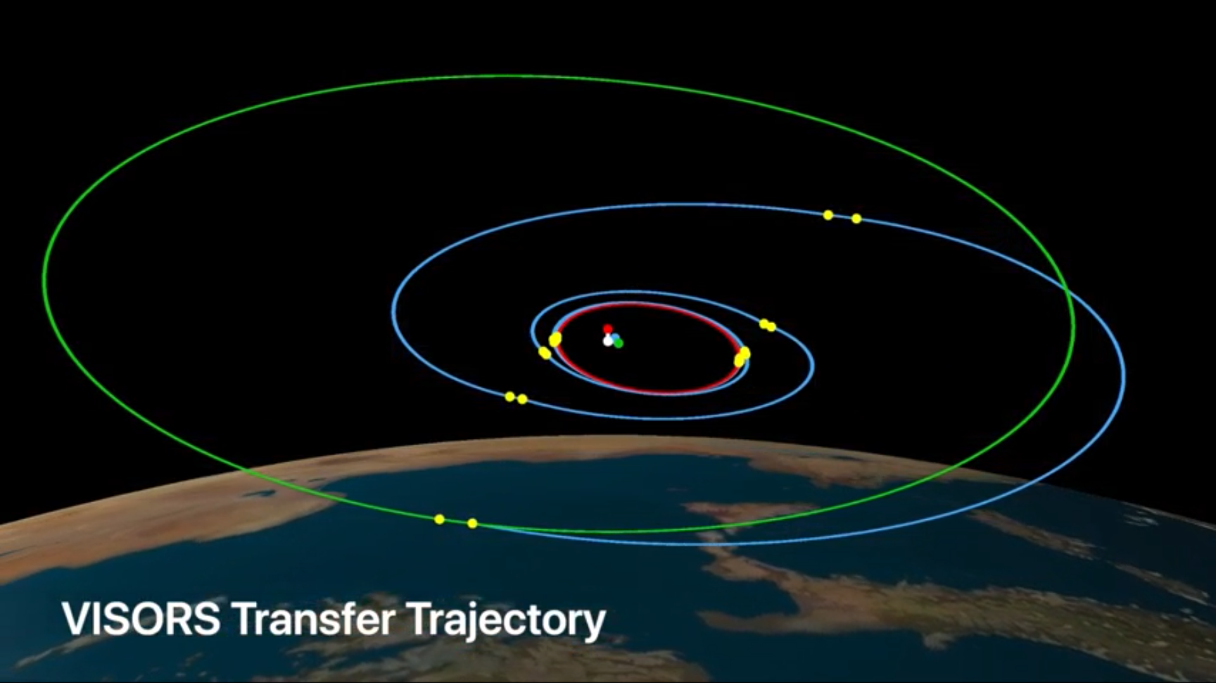
Thank you! Questions?

Slide 32
Backup

Slide 33
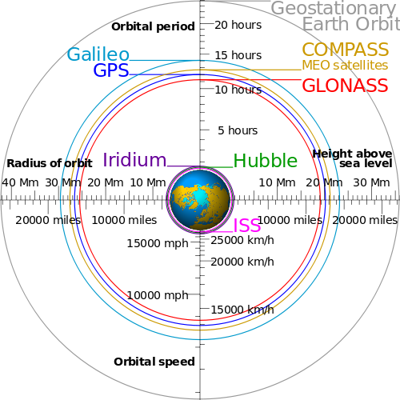
Relative Navigation
Question: How do I determine my position and velocity?
Solution: GPS – still works in LEO

Slide 34
Relative Navigation
Question: How do I determine my position and velocity?
Solution: GPS – still works in LEO
Challenge: GPS “only” provides meter level accuracy
  Distributed telescope requires mm-level control of relative position

Slide 35
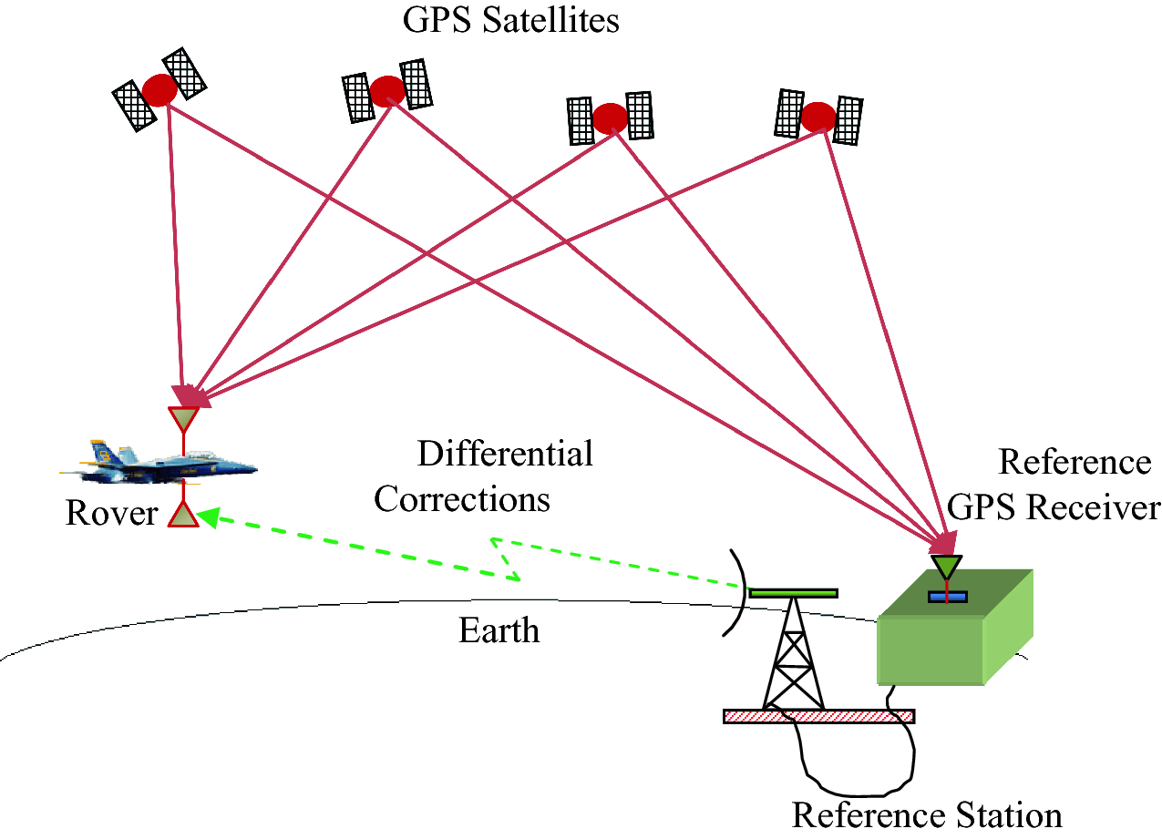
Relative Navigation
Question: How do I determine my position and velocity?
Solution: GPS – still works in LEO
Challenge: GPS “only” provides meter level accuracy
  Distributed telescope requires mm-level control of relative position
Solution: relative navigation – determine my position and velocity relative to another satellite
  “differential” GPS – mm-level accuracy in position and velocity
Image Credit: Krishna et al

Slide 36
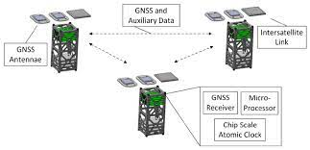
Relative Navigation &
Intersatellite Link
VISORS uses DiGiTaL – a relative navigation algorithm developed at Stanford
Challenge: spacecraft must autonomously exchange information to know one another’s position (relative navigation)
Image Credit: Stanford SLAB

Slide 37
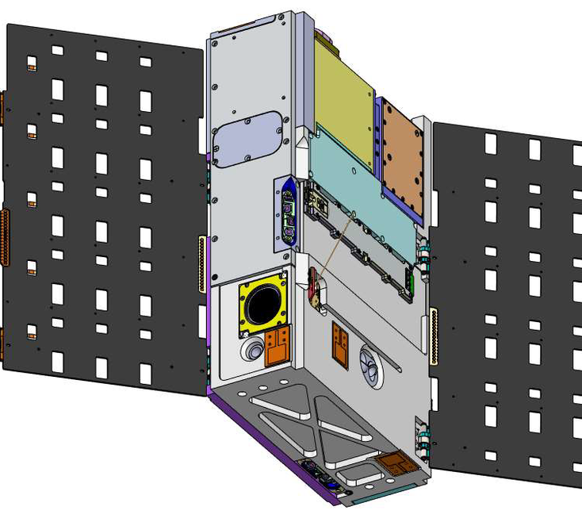
Relative Navigation &
Intersatellite Link
VISORS uses DiGiTaL – a relative navigation algorithm developed at Stanford
Challenge: spacecraft must autonomously exchange information to know one another’s position (relative navigation)
Solution: omni-directional intersatellite link (XLINK)
VISORS uses a system of patch antennas and a dedicated radio to provide full-sky link coverage for separations up to 10 km
Patch Antennas

Slide 38
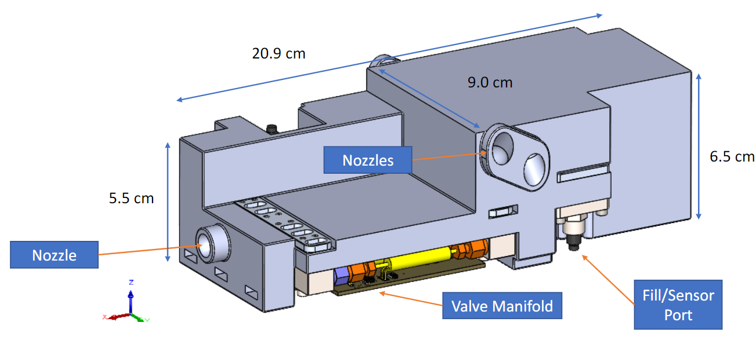
Control (Actuation)
Control: How do I execute my maneuver plan?
Solution: Thrusters
Challenge: conventional propulsion systems are large and heavy
VISORS uses a 3D printed cold gas thruster designed and manufactured at Georgia Tech
  Non-toxic “cold gas” propellant (no combustion)
  Can fit into small, irregular volume
  Made from lightweight plastics

Slide 39
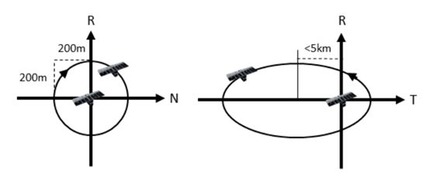
Relative Orbits Summary
Relative Orbit | Description | Conditions to Use the Orbit
Standby Orbit | Minimum cross-track separation of 200 m, large passive safety margin (several days) | Low formation-keeping costs for Standby or Safe mode and data downlink
Science Orbit | Minimum cross-track separation of 20 m, 2-orbit passive safety margin, relative orbit maintained very precisely (propellant-expensive) | Used during Science mode to provide necessary alignment for observations
Transfer Orbit | Relative orbit trajectory reconfigures formation over 5-10 orbits, fixed delta-V cost can be flexibly divided to prevent reaction wheel saturation | Transition between Standby and Science orbits while maintaining passive safety

Slide 40
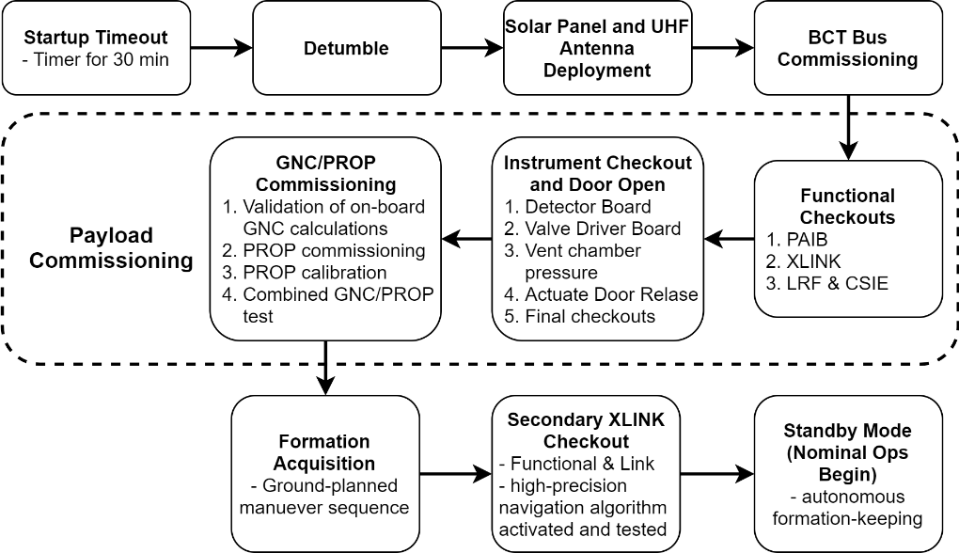
Preliminary Operations Sequence
High-Level Timeline
Notes:
Following deployment from the launch vehicle, the spacecraft wait to power up and then autonomous detumble and deploy their solar arrays and UHF antenna and begin beaconing. The first phase of the commissioning is dedicated to the BCT bus which contains the EPS, CDH, ADCS, and UHF comm subsystems.
Once the bus is fully commissioned and operational, the payload will be commissioned. This process is a progressive sequence that moves through each of the payload subsystems in turn beginning with the PAIB which is the data and power interface between the BCT bus and all payload subsystems.
The XLINK is commissioned next due to its low TRL and critical role in the functioning of the GNC software.
Next the LRF and CSIE are commissioned simultaneously since they are on different spacecraft.
The next phase of commissioning is for the instrument. The chamber valve board monitors the pressure of the nitrogen in the vacuum sealed detector chamber and will vent the chamber pressure on command. Once the nitrogen has been vented, a non-explosive actuator will be triggered to release the chamber door
…

Slide 41
Coronal Structures and Simulated Image
targeted region
Above: OSC & EUV corona
Left: Simulated 0.2 s exposure of the targeted 62” region, including direct EUV background.
Below: Days/week with observable targets from prior solar cycle (AIA).

Slide 42
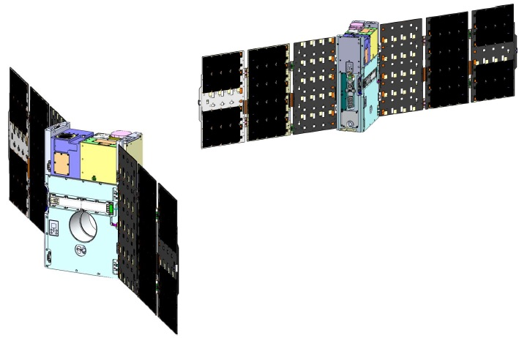
Spacecraft Orientation for Alignment

Slide 43
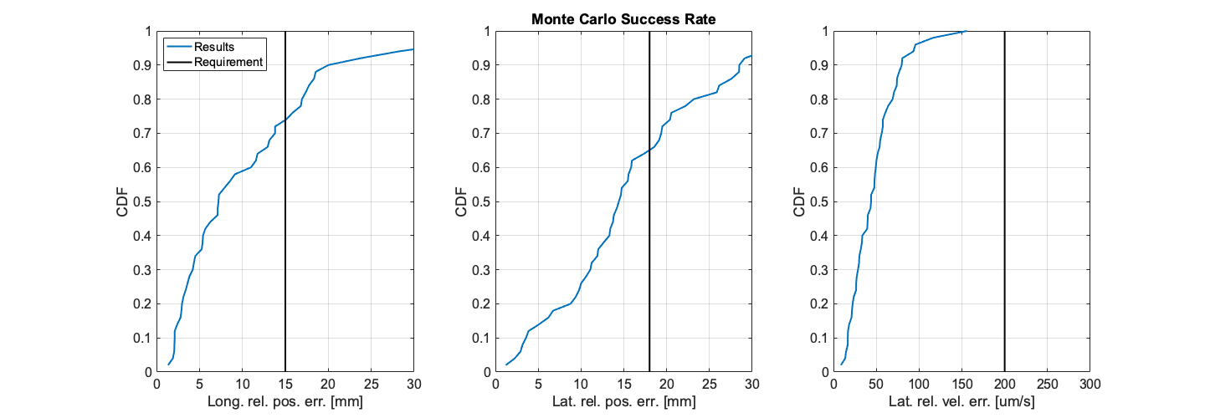
Formation
pointing
Stability
(over 10s)
Sun
± 17.5 mm
± 2 mm
Optics
Spacecraft
± 15 mm
CoM alignment performances
100 Monte Carlo’s
Observation success rate = 52%
Relative velocity requirement met in 100% of sims
40 m
90 arcsec
Detector
Spacecraft

Slide 44
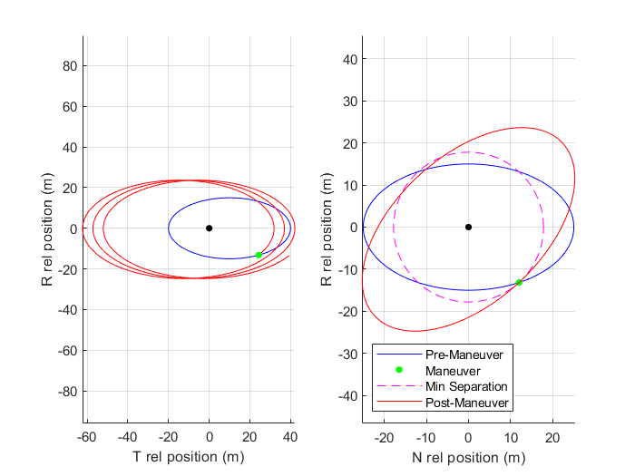
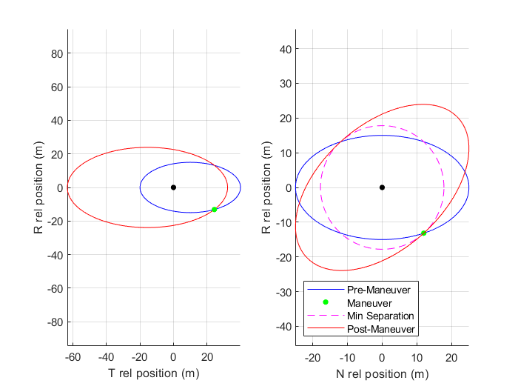
RTN with State Uncertainty and Maneuver Execution Error
Science mode relative orbit in RT and RN

