Slide 1
Design and Test of Spectre Propulsion System Controller
SSDL Biweekly Meeting
Kaushik Manchikanti
11/16/2021

Slide 2
Outline
Introduction & Motivation
Background
Design
Testing
Future Work
Summary

Slide 3
The Spectre System
Next step in SmallSat propulsion
Using green propellant for
Chemical Propulsion: 1 N Thrust
Electric Propulsion: 3500s Isp

Slide 4
The Spectre System
Allows for CubeSat mission to do more
Enable missions from Earth orbit to lunar, and interplanetary missions
Enhance small spacecraft pointing accuracy capability, enabling high stability platforms for payloads
Science missions including in geophysics, heliophysics, planetary science, and exploration.

Slide 5
Background
Spectre was inspired by the work done with the Lunar Flashlight Propulsion System
Multi-Institutional Project
GT, MIT, NASA-MSFC, …
Bimodal Propulsion System
Leverages a lot of the development work from LFPS

Slide 6
Controller Capabilities
Controller must be able to:
Actuate valves
Actuate heaters
Feed the propellant from the tank to the thrusters
Send relevant telemetry
Accept commands
Communicate with electrospray PPU

Slide 7
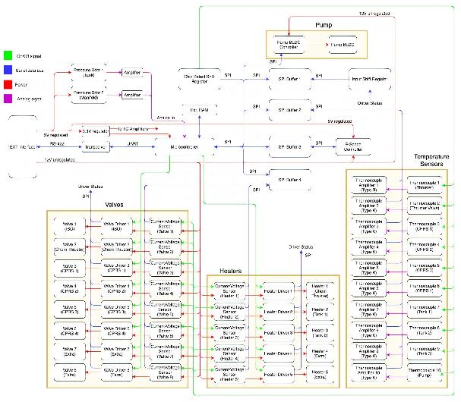
Spectre Controller Design

Slide 8
Spectre Controller Form Factor

Slide 9
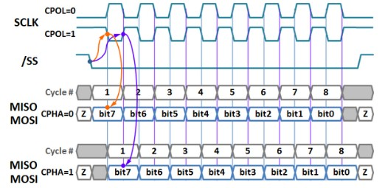
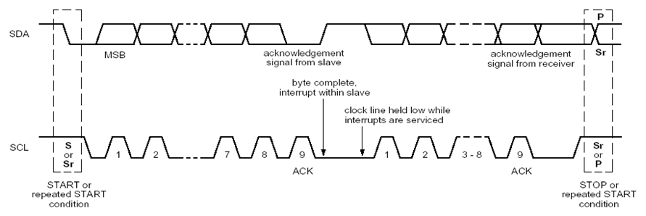
Specific Features of Interest
Actuating valves directly
Changing IO expansion from I2C to SPI
This also motivates changing the main communication interface to SPI

Slide 10
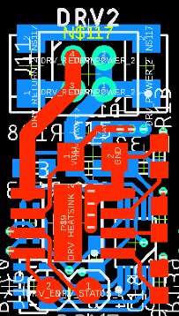
Specific Features of Interest
Generalizing Valve/Heater Channels

Slide 11
Specific Features of Interest
Generalizing TC reader ICs

Slide 12
Approach
Testing components incrementally
- first looking at individual functionality
- then looking at integrated functionality

Slide 13
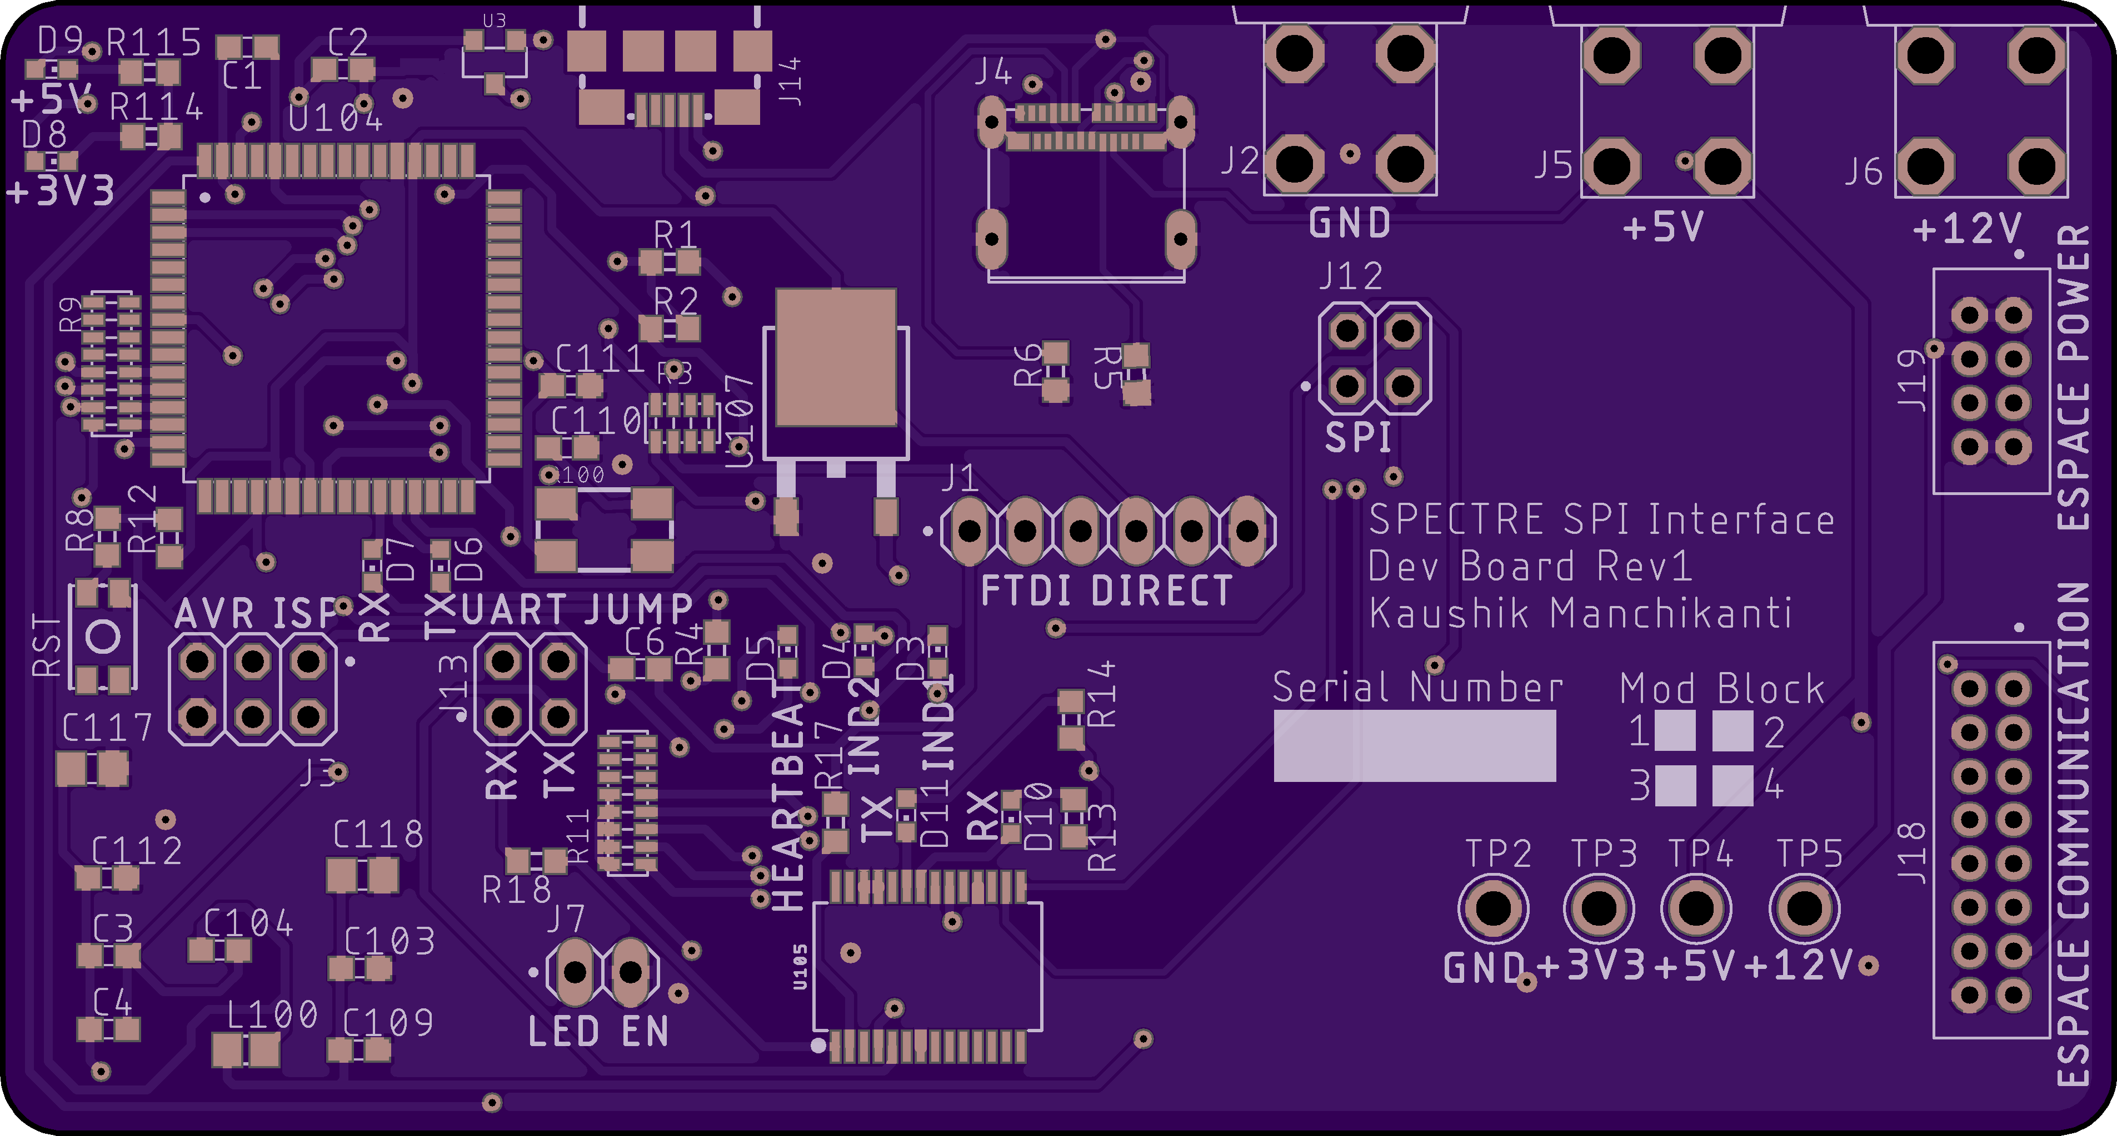
Testing the PPU Interface
The biggest new interface that needs to be tested on Spectre is the electrospray thrusters PPU

Slide 14
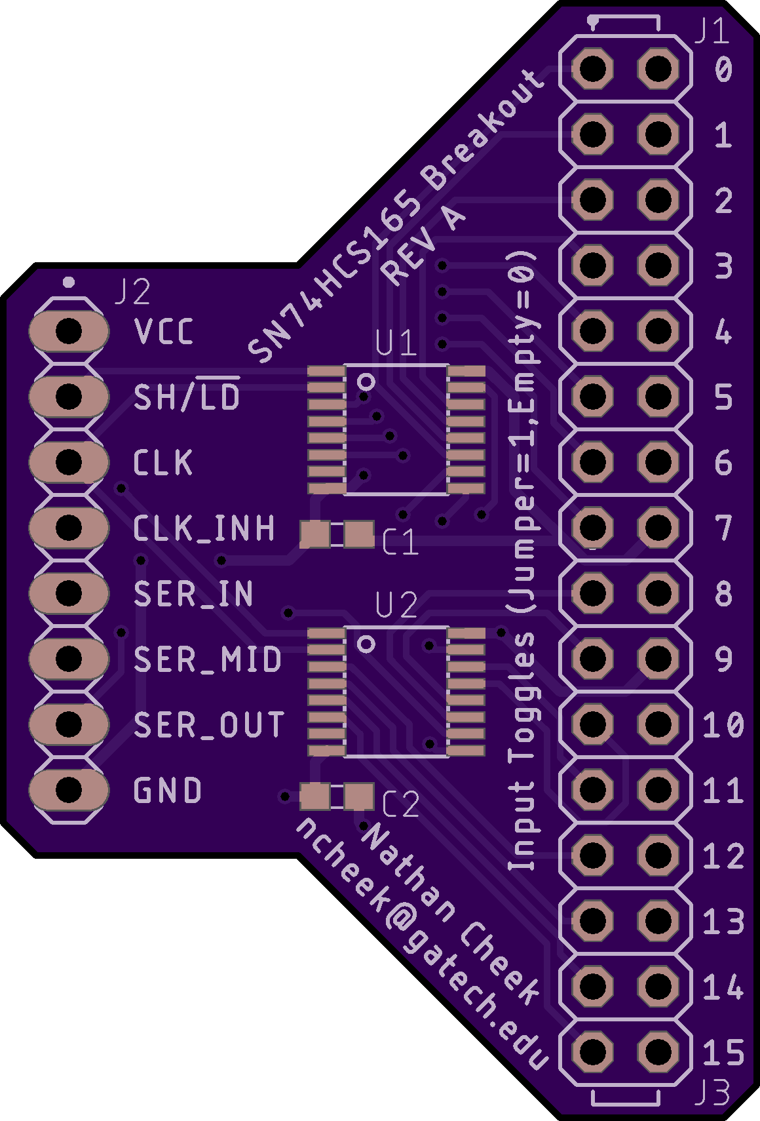
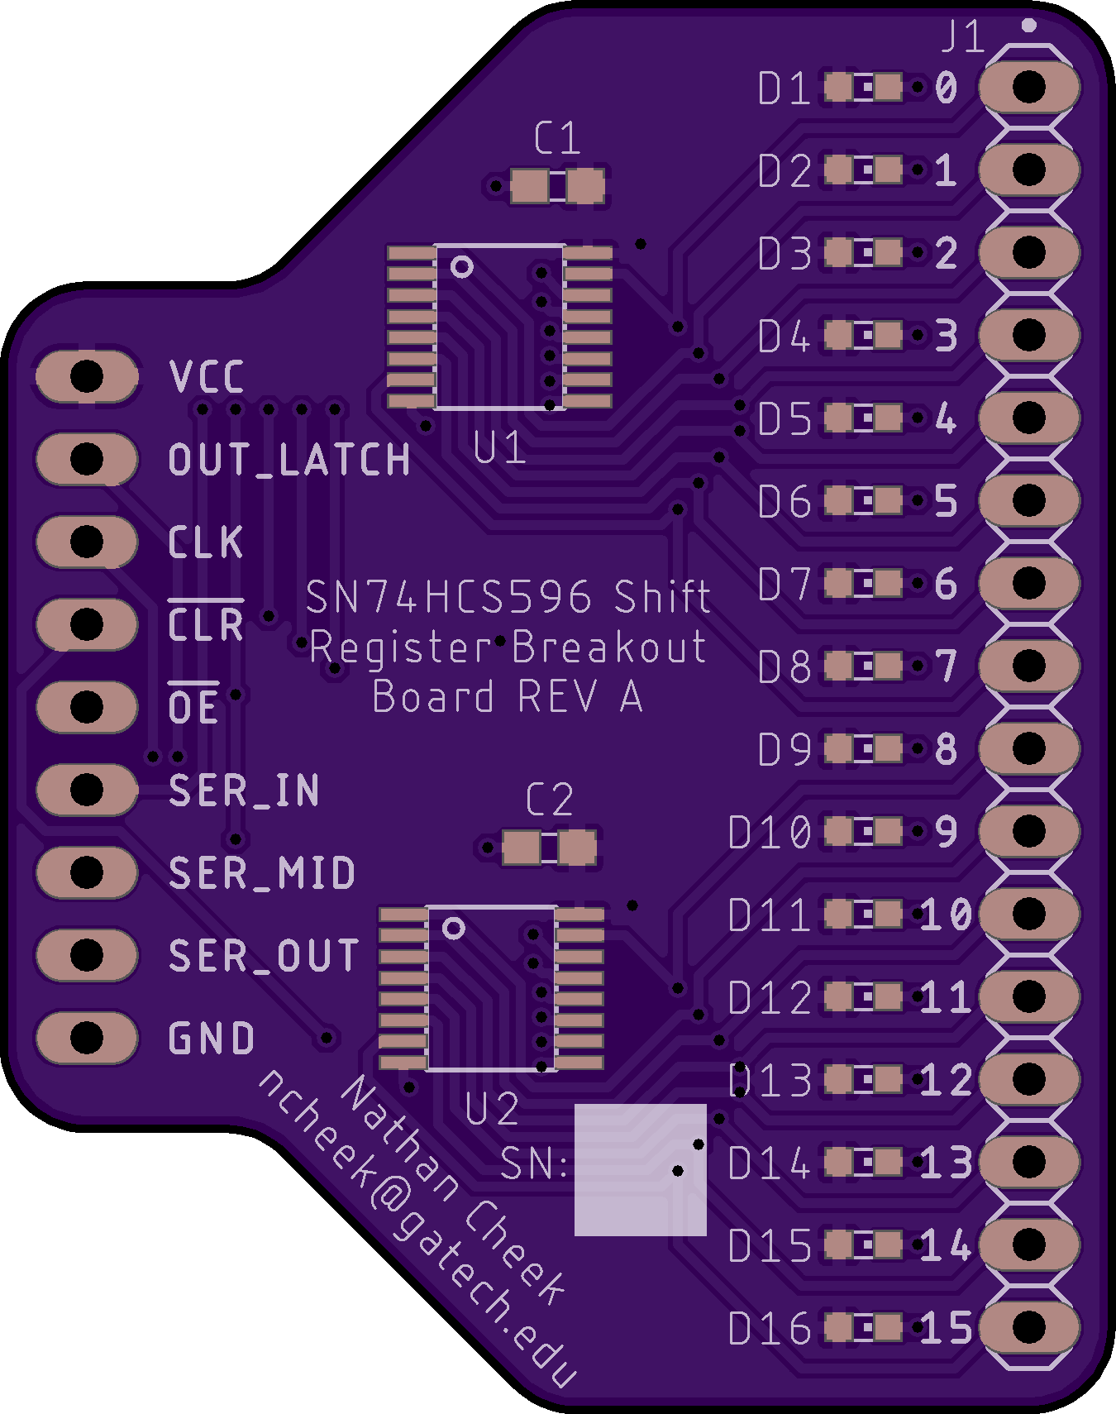
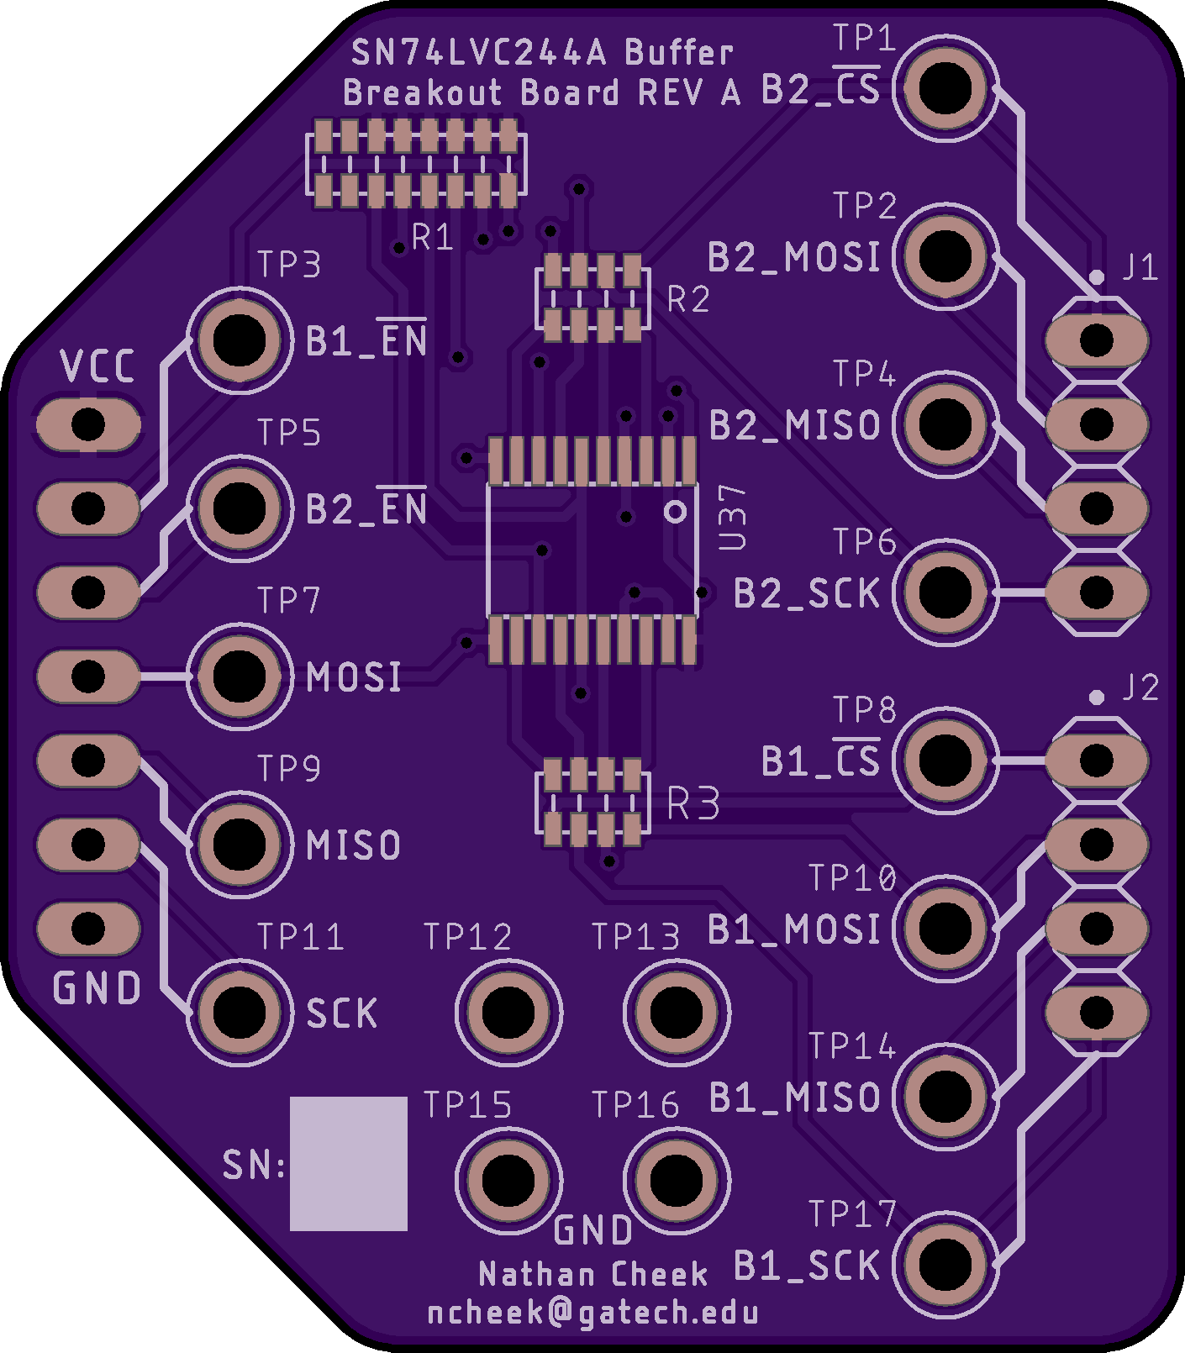
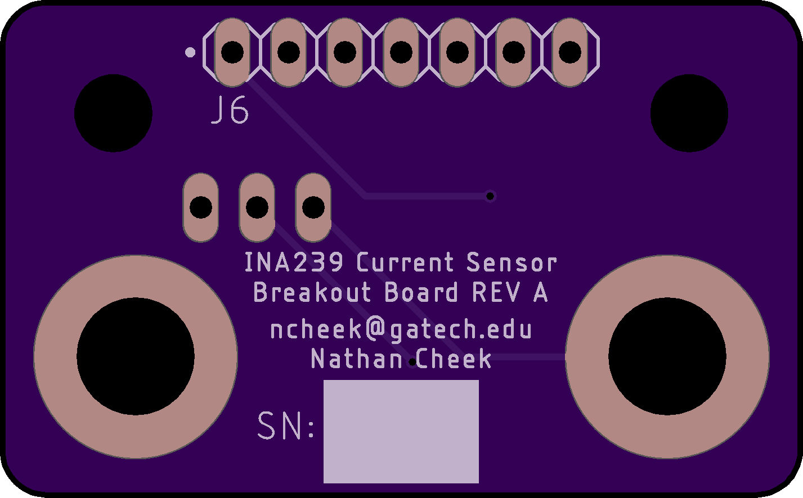
Testing the new SPI interfaces
Spectre pivoted from using IO expanders with I2C to shift registers and buffers with SPI

Slide 15
Next Steps
Currently working on a comprehensive test program for a controller EDU board
Also need to implement new flight software

Slide 16
Summary
Took a current design (LFPS) as a baseline and changed it to accommodate new needs
Started unit and subsystem level functional testing
Working towards a full EDU functional test
Need to create a flight software release for the controller

Slide 17
Questions?

Slide 18
Baseline Controller Design

Slide 19
Baseline Controller Form Factor
Notes:
TODO: add dimensions

Slide 20
Spectre changes
The controller still needs to
- actuate valves and heaters
- measure currents, pressures and temperatures
- communicate with upstream fc
- drive pressurization pump
But it also needs to
- communicate with an electrospray PPU
Controller form-factor:
- no longer driven by a specific mission

