Slide 1


GT-1: Flight Software Development and Mission Operations
Ebenezer Arunkumar
Notes:
I’ll be talking to you today about the FSW Development and Mission Operations of GT-1 and the Highs and Lows that we as at team went through
My background on the project was that I was the Flight Software Lead and am also currently leading the Mission Ops for GT-1

Slide 2


Mission Background
First in a series of 4 1U CubeSats
Demonstrates rapid cradle-to-grave lifecycle of a university level CubeSat
Timeline
  Development began Aug 2019
  COVID-19 stopped all development from Feb 2020-Aug 2020
  Delivery in September 2021
  Launch on Dec 21st
  Deployment on Feb 3rd
Notes:
- Iteratively build off of each previous satellite in the series , in every aspect so Hardware , Software, Avionics, etc.

Slide 3
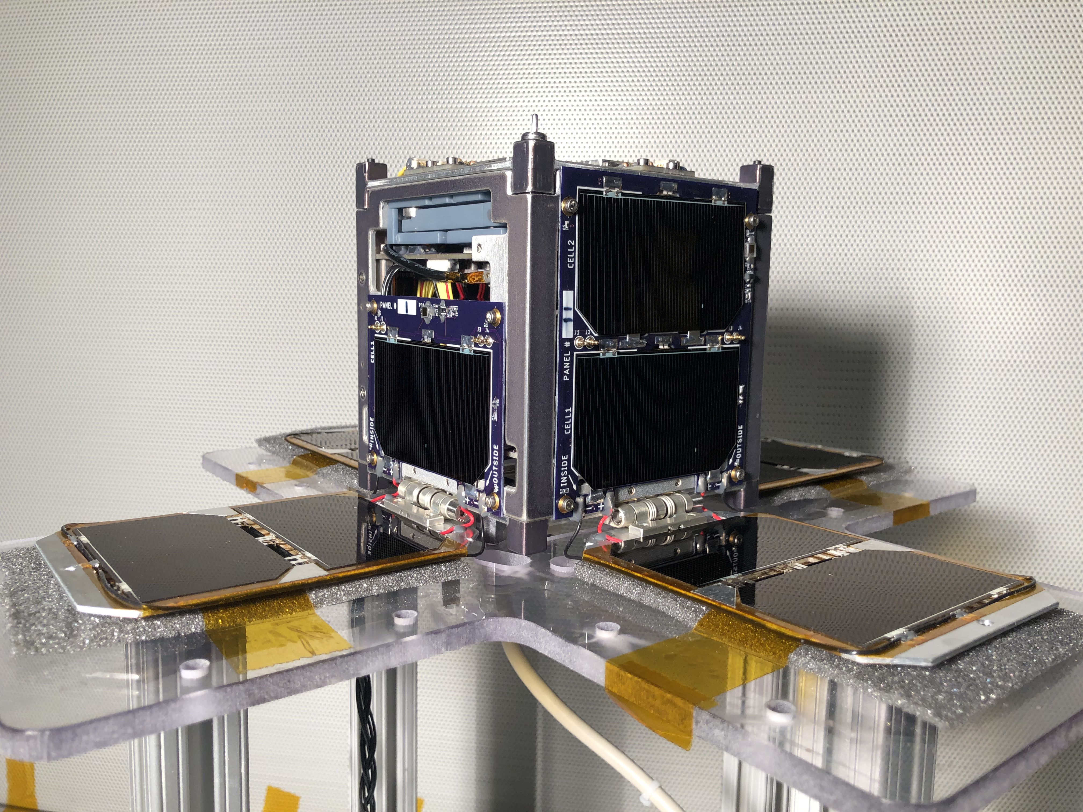
Agenda
Flight Software
Communications
Mission Operations

Slide 4

Flight Software: Architecture
NASA Jet Propulsion Laboratory released Fprime in late 2018
Core features:
  Reusability
  Rapid Development
  Portability
  High Performance
  Analyzability
Notes:
Core Features:
Decomposing flight software into discrete components with well-defined interfaces
C++ framework providing underlying core capabilities like message queues and threads
Modeling and code auto-generation tools
Collection of ready-to-use components
Testing tools for unit and integration testing

Slide 5
Flight Software: Design
GOAL: Design a FSW framework that was forward looking(reusable and modular) while meeting current requirements
Minimalistic approach
  Only one payload: ROBOT Repeater
    Widely known exchange used by Amateur Radio Operators around the world
  All other components were for CDH, ACS, COMS, and Internal Health Monitoring
Two microprocessors
  ATmega 128: Main processor that performs communication & command and data handling tasks
    Baremetal OS
  Onion Omega: Secondary processor that controls attitude control algorithm and handles the software payload
    Linux OS
    Technology demonstration

Slide 6
Flight Software: Constraints
Lack of Fprime documentation
  Newly released framework
  Public adoption was low
  Learning curve was steep
Limited time
Limitations of processor
  Atmega128: 8-bit AVR based microcontroller
  128 KB of of program memory
Lack of software experience
  Team ranged from 4-7 people
  Almost exclusively ‘amateur’ programmers (including myself)
Notes:
Before we even started, we had some constraints on the development

Slide 7
Flight Software: Development
ATMEGA DEPLOYMENT
ONION DEPLOYMENT
Assert Reset
EePrmDb
Hardware Rate Driver
Active Rate Group
5 major areas of development
  COMS
    KISS and AX.25 Protocol
    Beacon TLM
  State Machine
  Misc Components
    Sensors and Actuators
    Software Payload
    CDH
  ACS
    B Dot Controller
  Inter Processor Communication
    ’Hub’
Active Rate Group
Rate Group Driver
Hardware Rate Driver
Ground Interface
Active Logger
Active Rate Group
CMD Dispatcher
Ground Interface
Time
File Manager
File Downlink
File Downlink Buffer Manager
Rate Group Driver
Tlm Chan
Linux Time
ATmega GPIO Driver
Linux Serial Driver
Robot File I/O
Robot
Robot Response Calculator
ATmega Internal ADC Driver
ATmega Serial Driver
Deplo-yables
Magnet-ometer
Hub
Bdot Controller
EPS
Thermis-tor
Magne-torquer
State Machine Driver
Startup Timeout State
Deploy State
Safe State
Steady State
Payload Active State
OpenLST Driver
KISS
AX.25
Authen-ticator
Shift Register
Beacon
OTA
Architecture specific component
Shared Component
Core Fprime
Watch-dog
Hub
Notes:
- Talk about different colors

Slide 8
Flight Software: Results
Descoped multiple components
  The entire Onion Deployment(and thus ACS)
  Necessary to overcome time and personnel constraint
Condensed multiple components together
  Necessary to overcome program memory constraint
ATMEGA DEPLOYMENT
Assert Reset
EePrmDb
GT1 CDH
Rate Group Controller
Architecture specific component
Hardware Driver Controller
Deployables
Condensed Coms
GT1 Sensors
Core Fprime
State Machine Controller
Beacon
Shift Register
ATmega Robot
Notes:
In order to meet schedule constraints and be able to complete robust testing, we had to descope about 25% of the planned components
Majority was Onion deployment
Of the remaining components we condensed them all into 12 discrete components
Goes against the modularity that we desired, but still

Slide 9
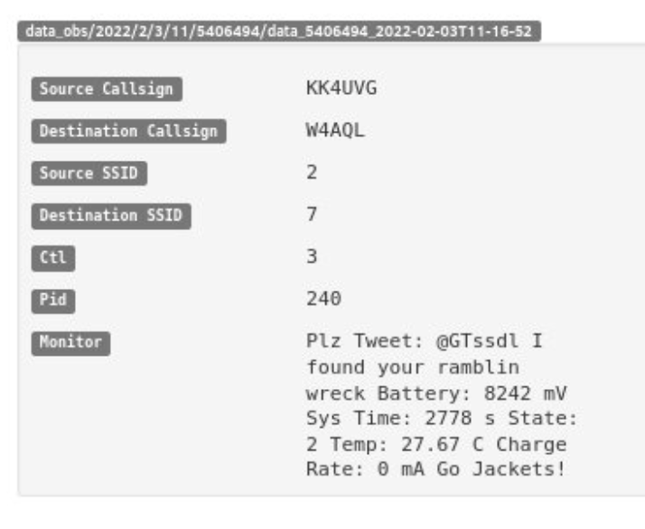
Communications: Overview
  OpenLST Radio
    Open source radio by Planet Labs
    Custom modified firmware to adhere to KISS and AX.25 radio protocol
  Transmit(TX)
  SHA-256 encrypted
  Fprime specific CMD format
  Receive(RX)
  No encryption
  3 beacon packets
    Spacecraft Health Data
    EPS Health Data
    ‘Tweet’
  ROBOT Repeater
  CQCQCQ msg
KISS Layer
AX.25 Layer
Data

Slide 10





Communications: Testing
  Simulated Communications (SimCom)
    With the Flatsat and GT-1 itself
1
Groundstation
1
OpenLST
RX
TX
1
2
Software Defined Radio(SDR)
2
RX
TX

Slide 11


Mission Operations: Overview
  Two-Pronged Approach
  GT Groundstations
Two GT owned and operated facilities
  Van Leer Building
    With support from the Amateur Radio Club
  Montgomery Knight Building
Mission Operations Center(MOC)
  ESM 301
GOAL: To display data received by GT Groundstations and send commands with a dedicated computer in the MOC in real-time
  World Groundstations
  Crowdsource data collection
  Beacon packet structure made publicly available
  Users can upload data packets to SatNOGS, where the data is automatically decoded and put into a custom dashboard

Slide 12
Mission Operations: Roadblocks
Mission Operations Center not fully linked to Groundstation
  Current set up does not have data being forwarded to the MOC for real time displays, only post processing of data to BOX Cloud Server
  Real Time commanding only possible from Groundstation Radio Shack, not MOC
Have rarely received data from GT-1 on GT Groundstations
  Only Van Leer Groundstation is currently semi-operational
    Hardware issues at VL
Unable to send commands to GT-1

Slide 13
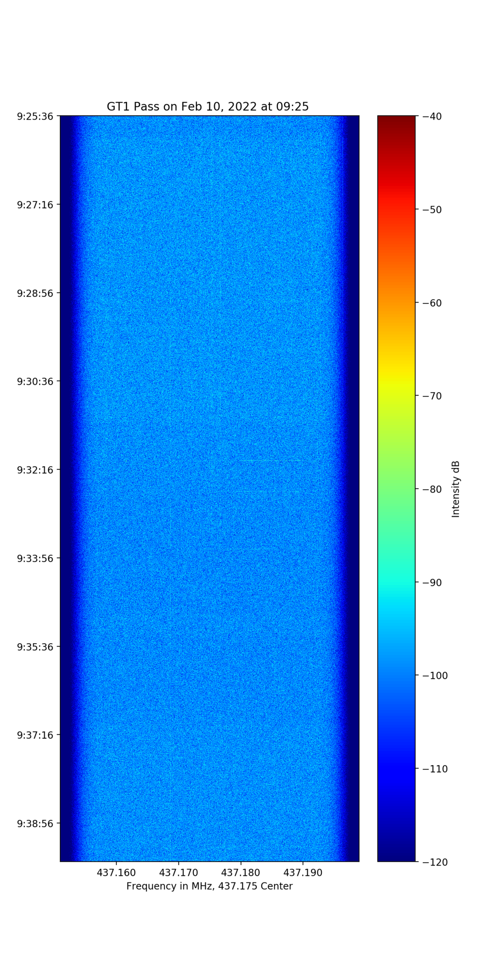
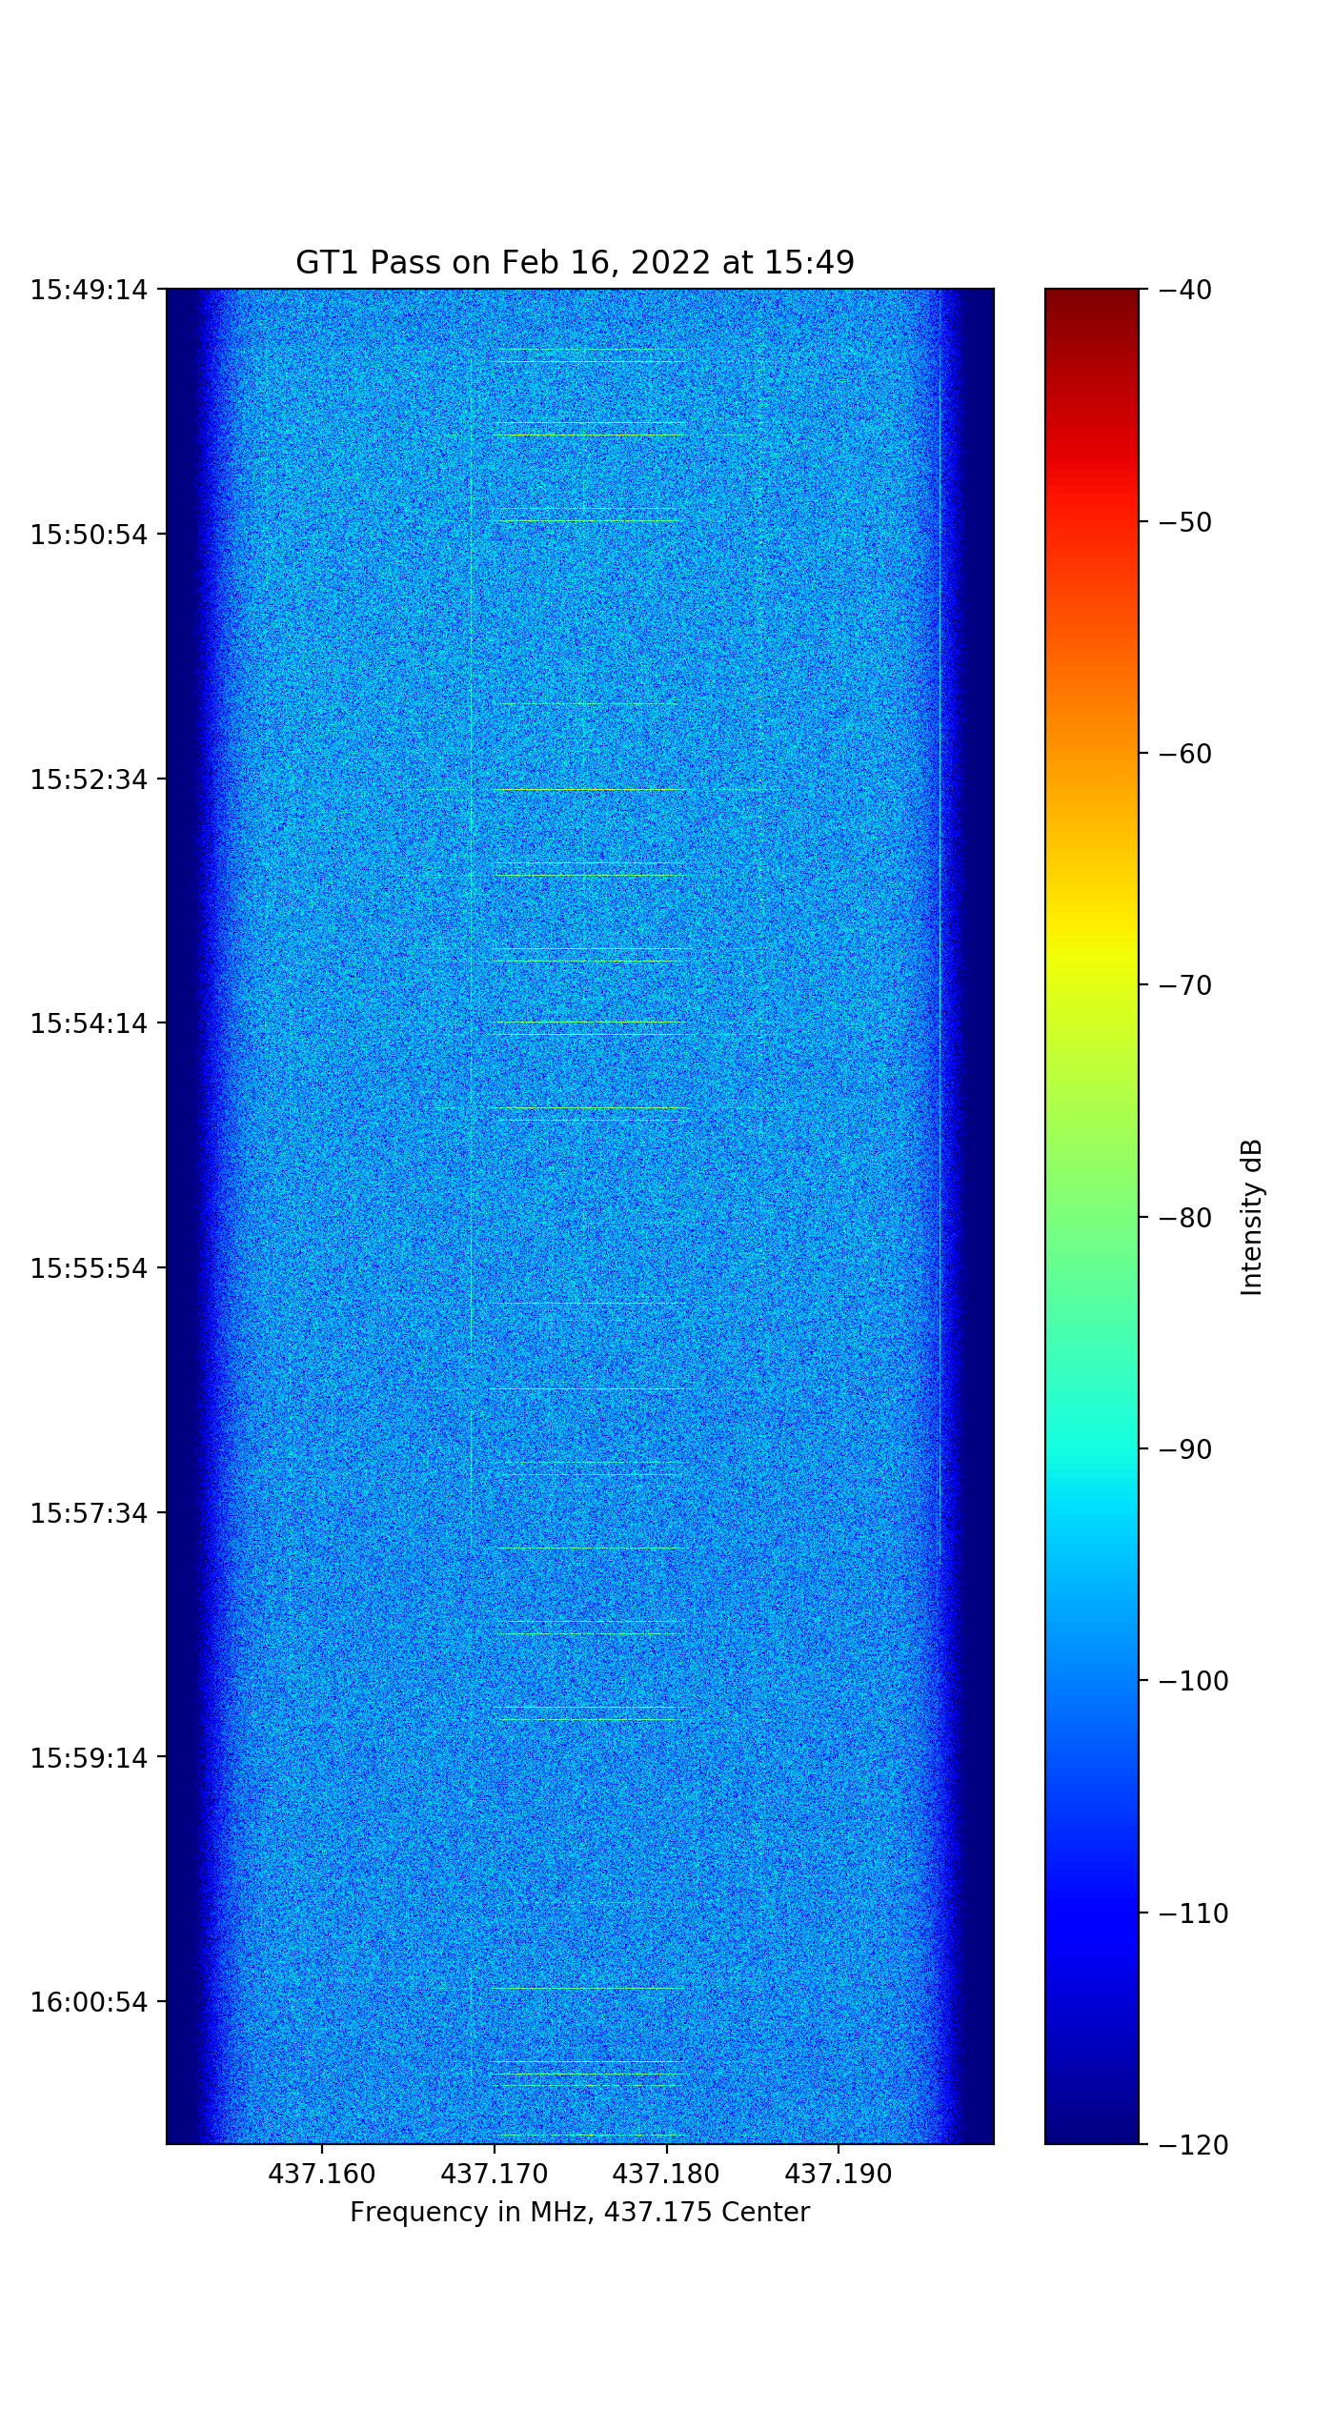
Mission Operations: Testing
GT1 In Orbit
GT1 Flatsat

Slide 14
Mission Operations: Next Steps
  All the Mission Operations Roadblocks have clear paths forward
  VL Hardware issue currently being debugged, and MK Groundstation should be operational within this semester
  Commanding issue being debugged by recording the TX of CMD’s with OpenLST
    First Approach
      Develop tool to demodulate playback into Hex Bytes so that the ‘working’ packet structure can be better understood
      Compare to what our SDR Flowgraph currently outputs and address discrepancies
    Second Approach
      Develop tool to broadcast playback recordings with our SDR, so that recorded OpenLST format can be broadcasted during a ground pass to GT-1
  ‘Groundstation Link’ tool being developed currently to enable bidirectional data flow between the MOC and both Groundstations

Slide 15
Lessons Learned
  CubeSats are hard
    Specifically, FSW and COMS development and testing take time and require a broad systems level view in order to ensure success
  ‘Fly as you Test, and Test as you Fly’
  FSW documentation is essential

Slide 16
GT-2
  Massive changes to address challenges from GT-1
    Almost entirely new avionics design
      3-4 ATmega’s + 1 Onion Omega
    Custom radio HW and SW
  Groundstation radio testing began much earlier than for GT-1, and radio design(and SDR Flowgraph) have been validated
  FSW components used for GT-1 have been transferred to GT-2 with minimal alterations

Slide 17

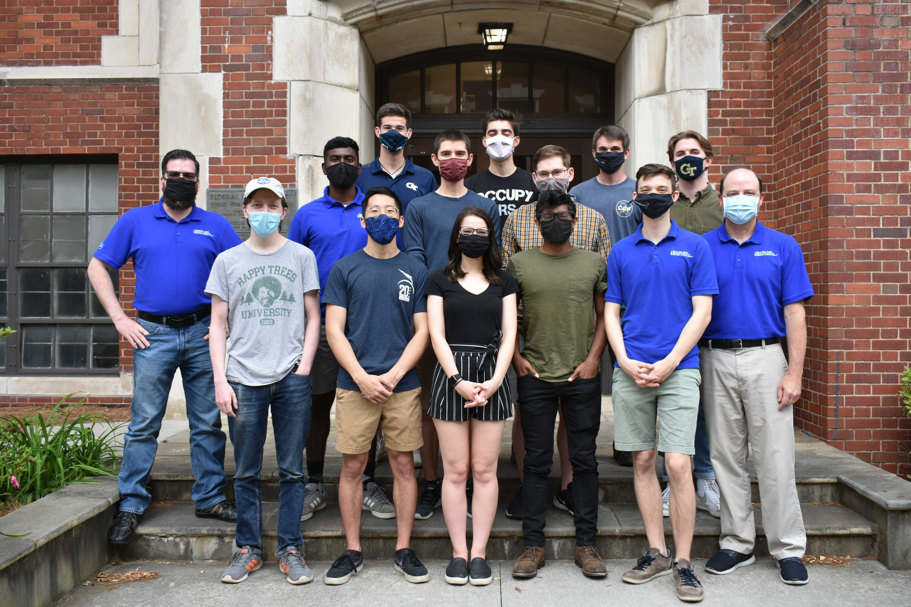
Questions?
ATMEGA DEPLOYMENT
Assert Reset
EePrmDb
GT1 CDH
Rate Group Controller
Hardware Driver Controller
Deployables
Condensed Coms
GT1 Sensors
State Machine Controller
Beacon
Shift Register
ATmega Robot

