Slide 1
Implementation of Model Predictive Control for Autonomous Rendezvous and Docking of Small Satellites
SSDL Meeting
Andrew Fear
11/2/21

Slide 2
Introduction

Slide 3
Autonomous Rendezvous and Docking
Facilitates creation of larger structures on-orbit
May be cheaper
Can replace “pieces” as needed
Autonomy helps alleviate ground resources
Robust guidance
Collision detection and avoidance
Ultimately some decision making
Challenges
Very Limited Fuel
Limited Thrust Capabilities

Slide 4
MPC Background

Slide 5
Model Predictive Control
Solves the optimal control problem by looking at “cost-to-go” from each state to next and minimizing this cost over some prediction horizon, N.
Typical formulation for predictive control is of the form
$$\min_{u}{J}=V_{N}\left(x_{N}\right)+\sum_{k=1}^{N−1}{l(x_{k},u_{k})}$$
$$s.t. x_{k+1}=f\left(x_{k},u_{k}\right) \\ g\left(x_{k},u_{k}\right)≤0 \\ x_{k}∈X \\ { u}_{k}∈U$$
Doesn’t make any assumptions about linearity, but doing so can make solving easier
Incorporates constraints directly into problem to be solved
Solve at each sample time
Computationally costly
More robust to disturbances than other guidance (LQR)

Slide 6
Model Predictive Control

Slide 7
Dynamics
Classic Clohessy-Wiltshire equations
Good for close range
Assumes circular orbits
x is radial out, y is direction of velocity, z completes right-hand system
$$\dot{\left[\begin{matrix}x \\ y \\ v_{x} \\ v_{y}\end{matrix}\right]}=\left[\begin{matrix}0 & 0 & 1 & 0 \\ 0 & 0 & 0 & 1 \\ 3ω^{2} & 0 & 0 & 2ω \\ 0 & 0 & −2ω & 0\end{matrix}\right]\left[\begin{matrix}x \\ y \\ v_{x} \\ v_{y}\end{matrix}\right]$$
In-plane CW equations

Slide 8
MPC for Autonomous Rendezvous and Docking

Slide 9
MPC for AR&D
$$\min_{u}{\sum_{k=0}^{N−1}{\left[x_{k}^{T}Qx_{k}+u_{k}^{T}Ru_{k}\right]}}+x_{N}^{T}Q_{f}x_{N}$$
$$s.t. \begin{matrix}x_{k+1}=Ax_{k}+Bu_{k} \\ {\left|u\right|}_{∞}≤u_{maximum}\end{matrix}$$
Quadratic Program
Computationally “simple”
Linear Dynamics (Discretized)

Slide 10
MPC for AR&D – Objective
$$\min_{u}{\sum_{k=0}^{N−1}{\left[x_{k}^{T}Qx_{k}+u_{k}^{T}Ru_{k}\right]}}+x_{N}^{T}Q_{f}x_{N}$$
$$s.t. \begin{matrix}x_{k+1}=Ax_{k}+Bu_{k} \\ {\left|u\right|}_{∞}≤u_{maximum}\end{matrix}$$
Quadratic Cost
Minimizes actuation effort
Weights are PSD, Q_{f} is solution to Algebraic Ricatti

Slide 11
MPC for AR&D - Dynamics
$$\min_{u}{\sum_{k=0}^{N−1}{\left[x_{k}^{T}Qx_{k}+u_{k}^{T}Ru_{k}\right]}}+x_{N}^{T}Q_{f}x_{N}$$
$$s.t. \begin{matrix}x_{k+1}=Ax_{k}+Bu_{k} \\ {\left|u\right|}_{∞}≤u_{maximum}\end{matrix}$$

Slide 12
MPC for AR&D - Dynamics
Discretized CW equations
Impulse invariant discretization
$$A=e^{A_{c}ΔT_{s}}$$
$$B=AB_{c}$$
Assuming impulsive control, instead of a discretization that uses zero-order hold control.

Slide 13
MPC for AR&D
$$\min_{u}{\sum_{k=0}^{N−1}{\left[x_{k}^{T}Qx_{k}+u_{k}^{T}Ru_{k}\right]}}+x_{N}^{T}Q_{f}x_{N}$$
$$s.t. \begin{matrix}x_{k+1}=Ax_{k}+Bu_{k} \\ {\left|u\right|}_{∞}≤u_{maximum}\end{matrix}$$
What if we wanted to ensure docking from a specific direction?
Can use LOS constraint!

Slide 14
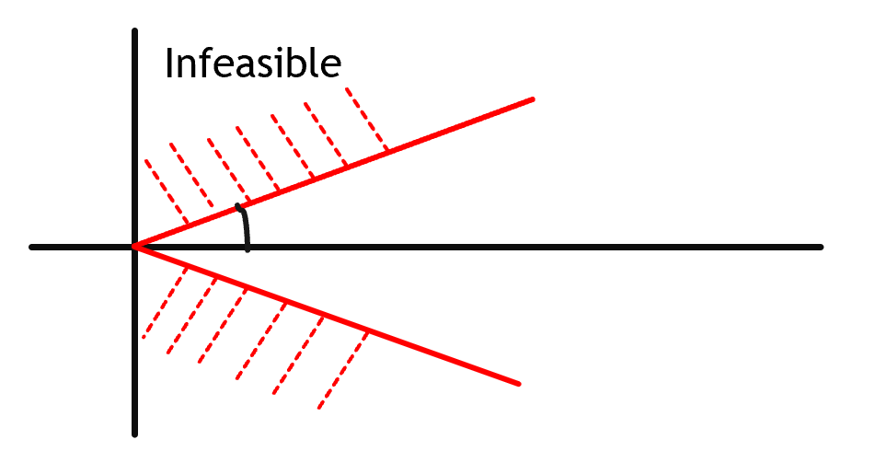
LOS Constraint
Want to stay within a designated cone
$$A_{cone}X_{k}≤b_{cone}$$
Will be added as a penalty in the objective

Slide 15
MPC for AR&D – With LOS Constraint
$$\min_{u}{\sum_{k=0}^{N−1}{\left[x_{k}^{T}Qx_{k}+u_{k}^{T}Ru_{k}\right]}}+x_{N}^{T}Q_{f}x_{N}+\sum_{k=0}^{N}{λ1^{T}\left(A_{cone}x_{k}−b\right)}$$
$$s.t. \begin{matrix}x_{k+1}=Ax_{k}+Bu_{k} \\ {\left|u\right|}_{∞}≤u_{maximum} \\ −{\hat{n}}_{cone}x_{k}≤0\end{matrix}$$

Slide 16
MPC Policy
Some papers use the same MPC formulation for the whole maneuver
Farther out, cone LOS isn’t important
As you get closer, need a shorter prediction horizon and can tighten the LOS cone
Split the whole maneuver into three phases
Far Range (> 2 km)
Mid Range (10 m – 2 km)
Close or Final approach (< 10 m)

Slide 17
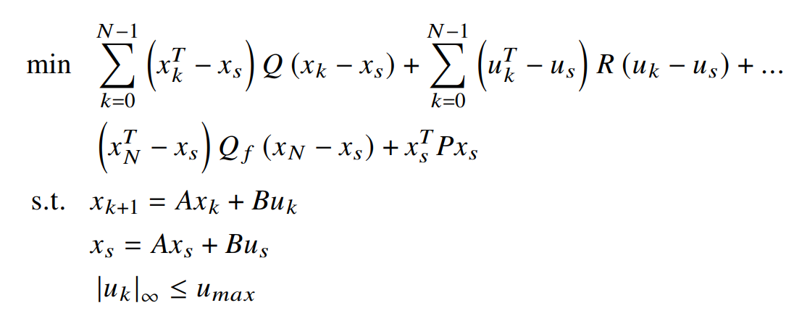
Far Range MPC Formulation

Slide 18
Mid Range MPC Formulation

Slide 19
Close Range MPC Formulation

Slide 20
Simulations

Slide 21
Simulation
Assuming 6DOF thrust for chaser for simplicity
Both MATLAB and 42
https://github.com/ericstoneking/42
42 for disturbances and propagating nonlinear EOMs and thruster modeling
Using a convex solver called CVXGEN to solve the MPC optimization at each sample time
https://cvxgen.com/docs/index.html
Fast
C++ and MATLAB
I’m pushing the limit with the number of variables

Slide 22
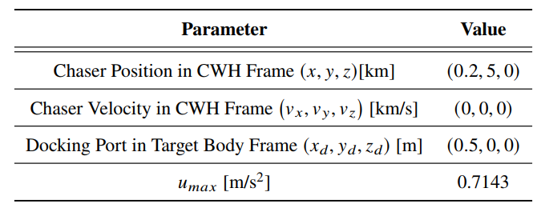
Scenario Parameters
Two CubeSats in LEO
Assumes 6DOF thruster control (Maximum thrust of 10 N)
14 kg CubeSats

Slide 23
MPC Parameters

Slide 24
Test Scenarios
Case 1: Rendezvous with a V-bar approach
LOS cone is pointed in the V-bar direction
Set overshoot constraint to $y_{k}≤0$
Case 2: Rendezvous with an R-bar approach
LOS cone is pointed in the V-bar direction
Set overshoot constraint to $x_{k}≤0$
Case 3: Rendezvous with a tumbling target
LOS cone rotates with the tumbling target
Target is tumbling about it’s Earth-pointing axis

Slide 25
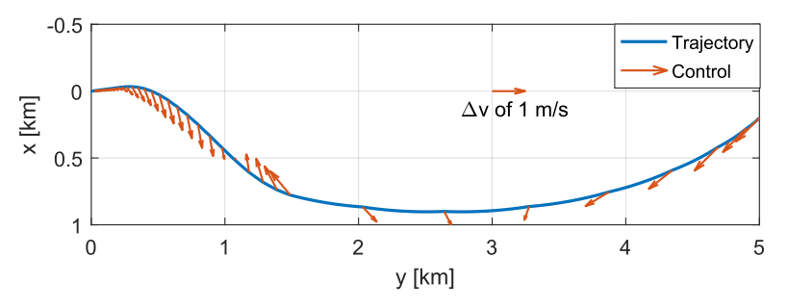
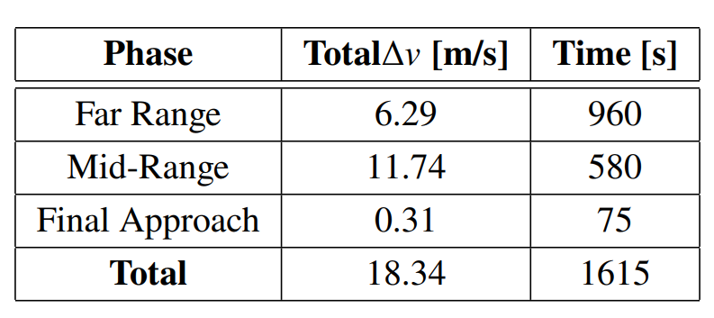
Scenario 1 – V-bar Approach
In-Plane Trajectory
Control Magnitude vs Time

Slide 26
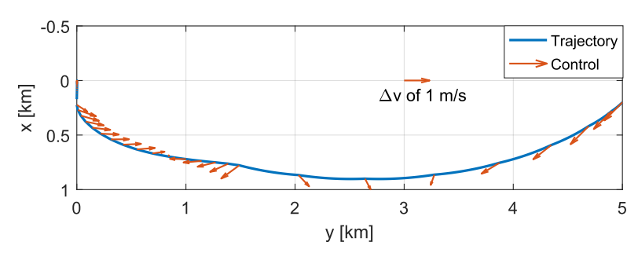
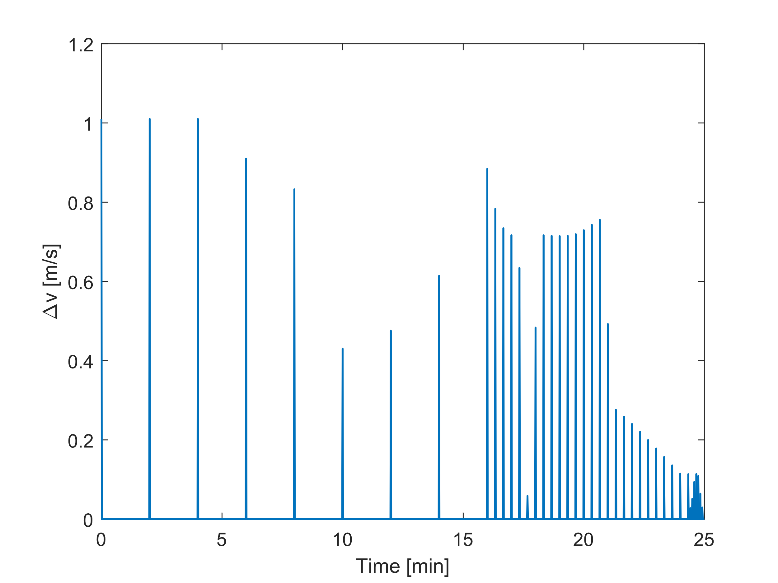
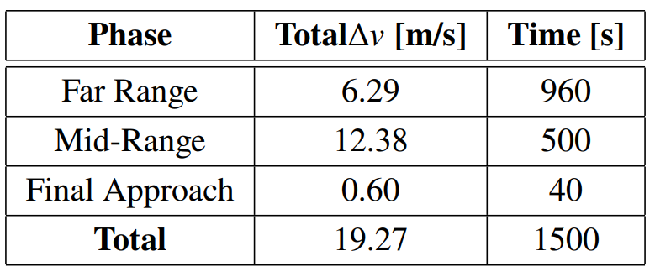
Scenario 2 – R-bar Approach
In-Plane Trajectory
Control Magnitude vs Time

Slide 27
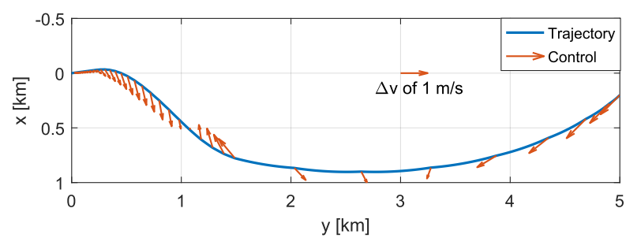
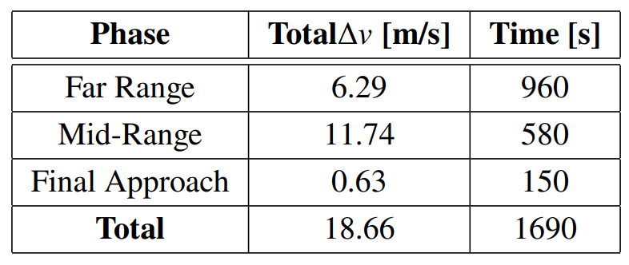
Scenario 3 – Tumbling Target
In-Plane Trajectory
Control Magnitude vs Time

Slide 28
Summary
Ran the MPC policy with changes in formulation (prediction horizon, sampling time, constraints) for 3 scenarios using simulations
Splitting into phases can cut down on fuel cost, but with longer rendezvous times
Sim used thruster models to perform the control
MPC policy is able to perform rendezvous with a tumbling target

Slide 29
Future Work
Use measurement and actuation noise to prove robustness
Run on embedded system hardware to benchmark usability

