Slide 1
OrCa2 CubeSat History Design, Fabrication, and Integration
Georgia Tech Space Systems Design Lab – Luke Lawver
Advisor - Dr. Brian Gunter
1/18/22

Slide 2
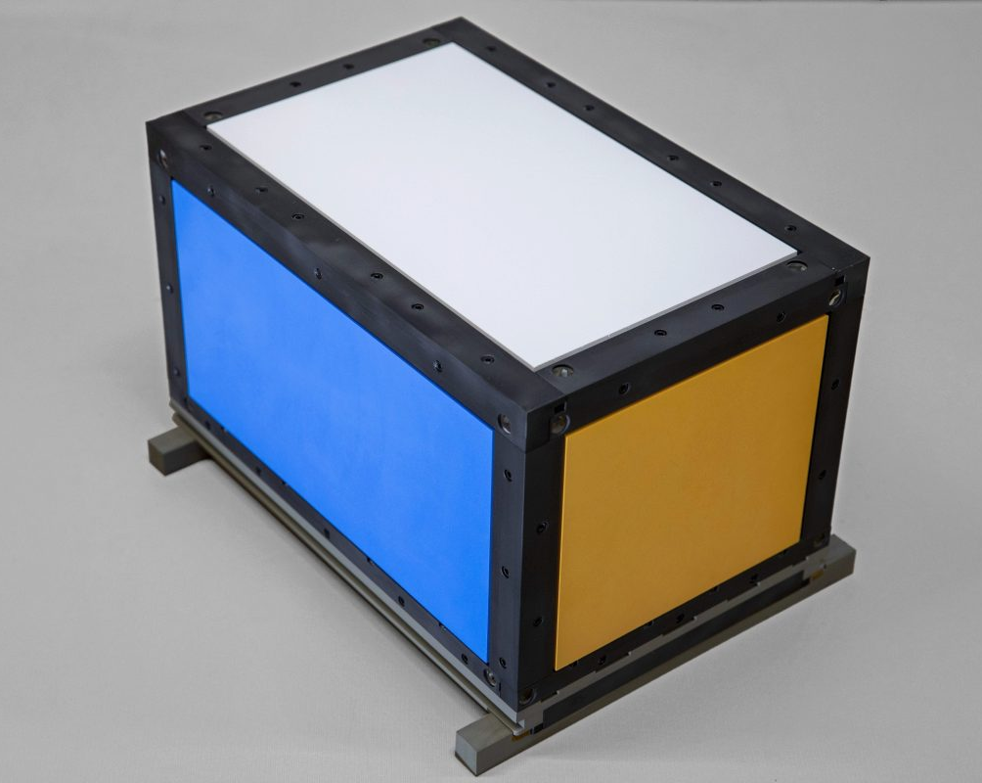
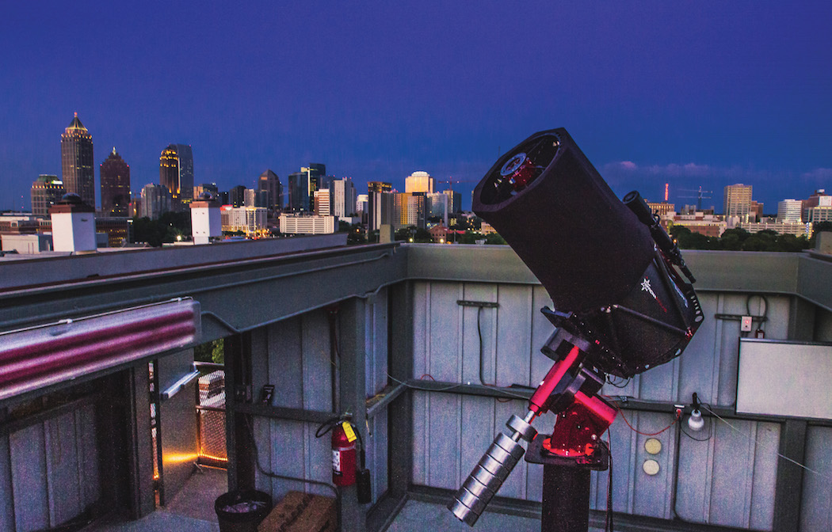
Orbital Calibration Mission History
12U CubeSat
Reflector for GT ground stations (GT SORT)
  Colored panels
  Corner cube reflectors
Corner reflectors tracked with ground-based laser-ranging
Different colored panels to be measured based on observed frequencies
Designed and built in 6 weeks
Georgia Tech Space Object Research Telescope (GT-SORT)

Slide 3
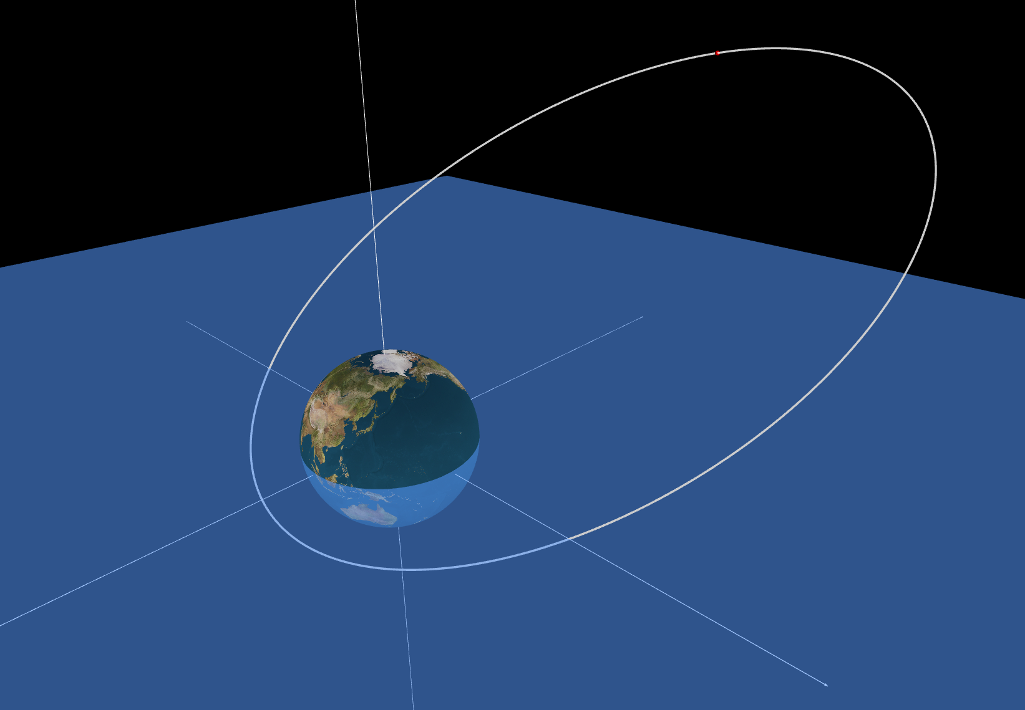
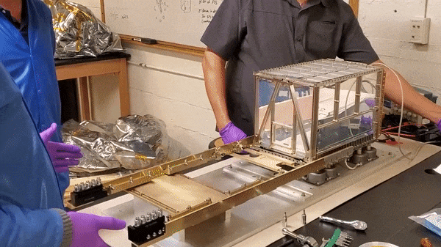
Orbital Calibration Mission History
Improve space domain awareness
Improve tracking and identification of resident space objects (RSOs)
Highly eccentric geosynchronous transfer orbit (GTO)
  Unique for a CubeSat
  Unique challenges for tracking and space environment
  Apogee past 30,000 km

Slide 4
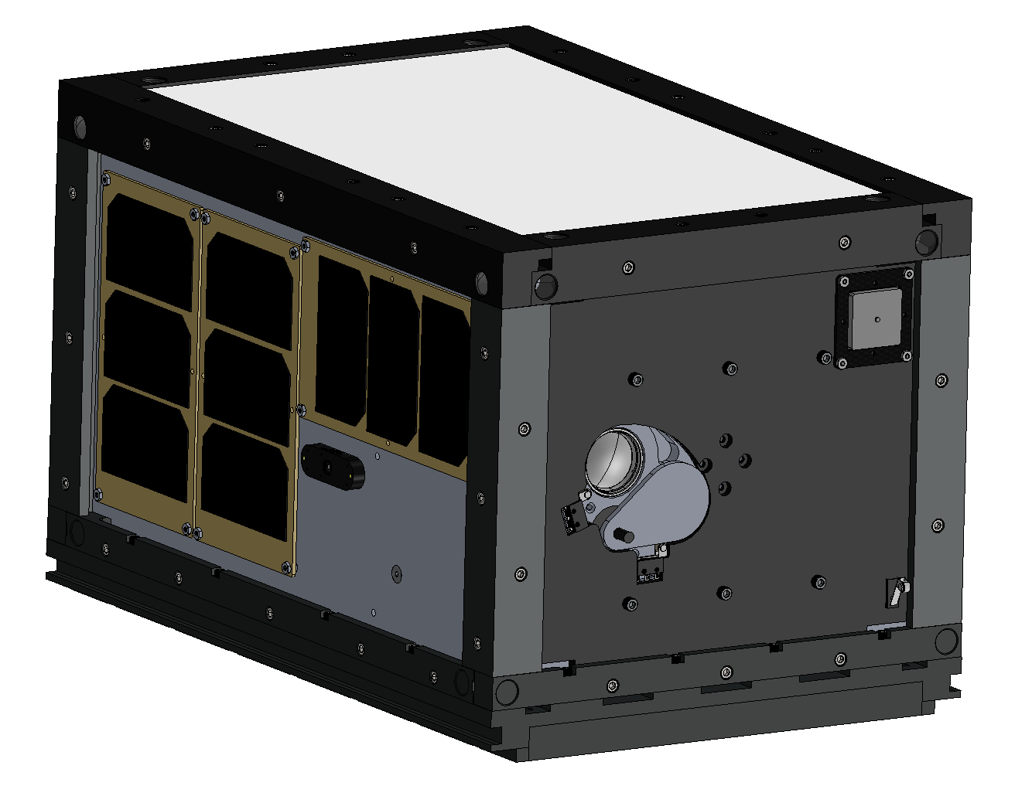
What is Orbital Calibration 2?
Following in the footsteps of OrCa
What’s new?
  Onboard imager
  Radiation experiment
  ADCS
  Prototype SSDL power board
Timeline
  Delivery May 2022
  Launch June 2022

Slide 5
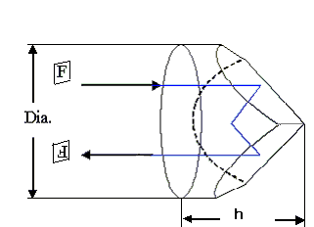
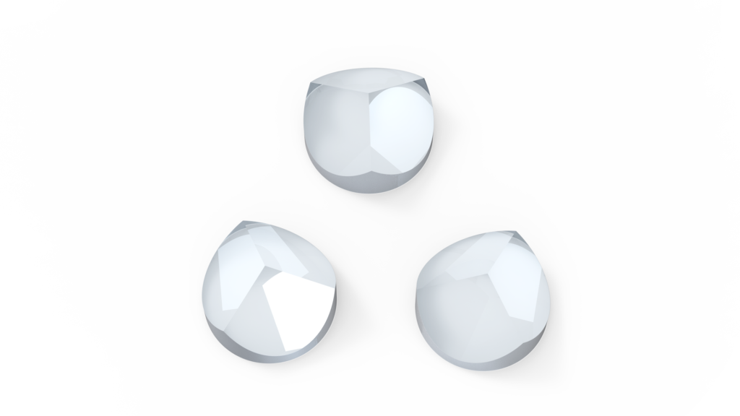
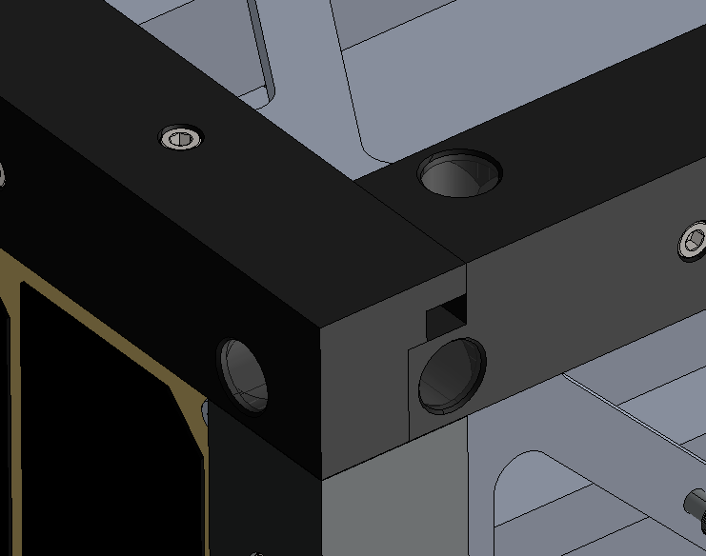
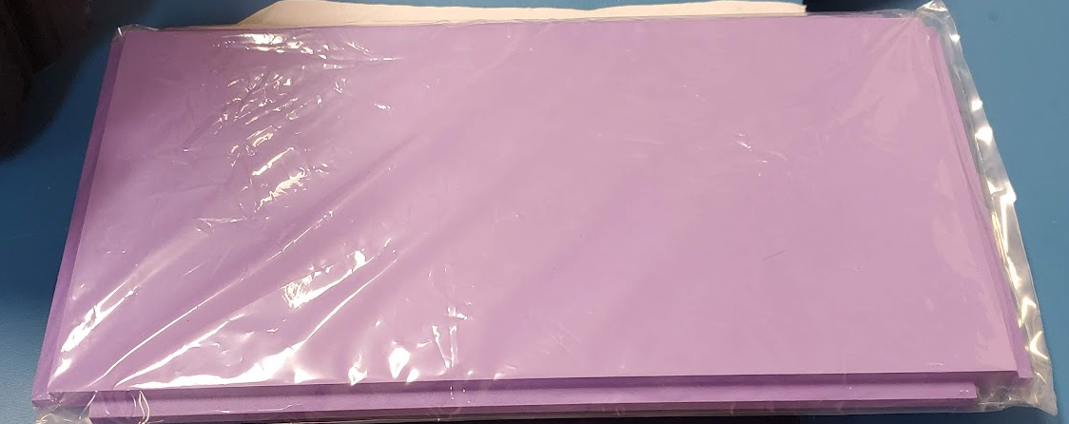
Primary Mission
Observable from Georgia Tech ground stations
Colored Panels
  Precisely colored and measured
  Reflect specific wavelengths that are used to detect satellite orientation.
Corner Cube Reflectors
  Measurable with ground-based laser methods
  Calculate distance using time of flight methods
Improve tracking and identification of resident space objects (RSOs)
Notes:
Electronics would die in days without proper shielding

Slide 6
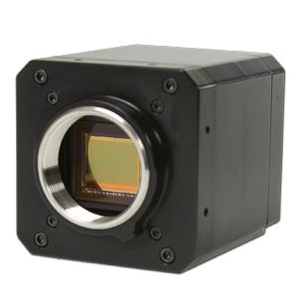
Secondary Missions
Extreme radiation environment limits operational duration of electronics
  Expecting ~1 year operational period w/ 3/8” aluminum shielding
Custom power board being developed by the OrCa2 team
  Funded by Aerospace corporation
  Hoping to create a flexible, low-cost solution for future SSDL missions
Radiation Dosimeter
Monochrome Imager

Slide 7
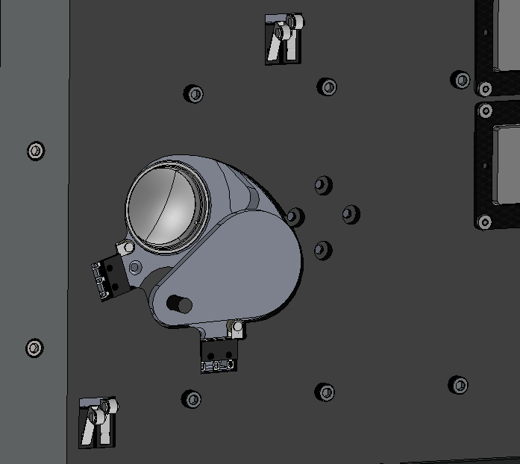
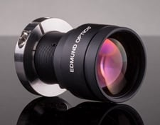
Imager
Take images of stars and use astrometric calibration to obtain satellite orientation.
Design actuated cover
  Prevent damage from direct Sun exposure
  Contain debris in the case of lens damage during launch.
  Prevent possibility of imaging during deployment

Slide 8
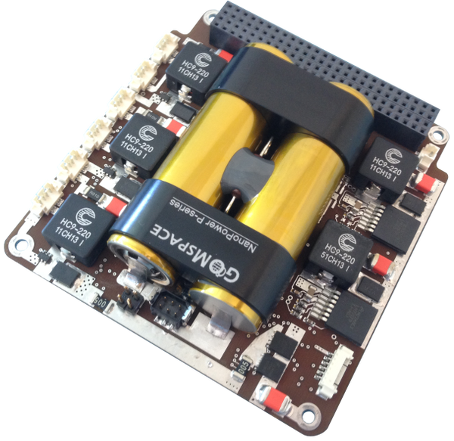
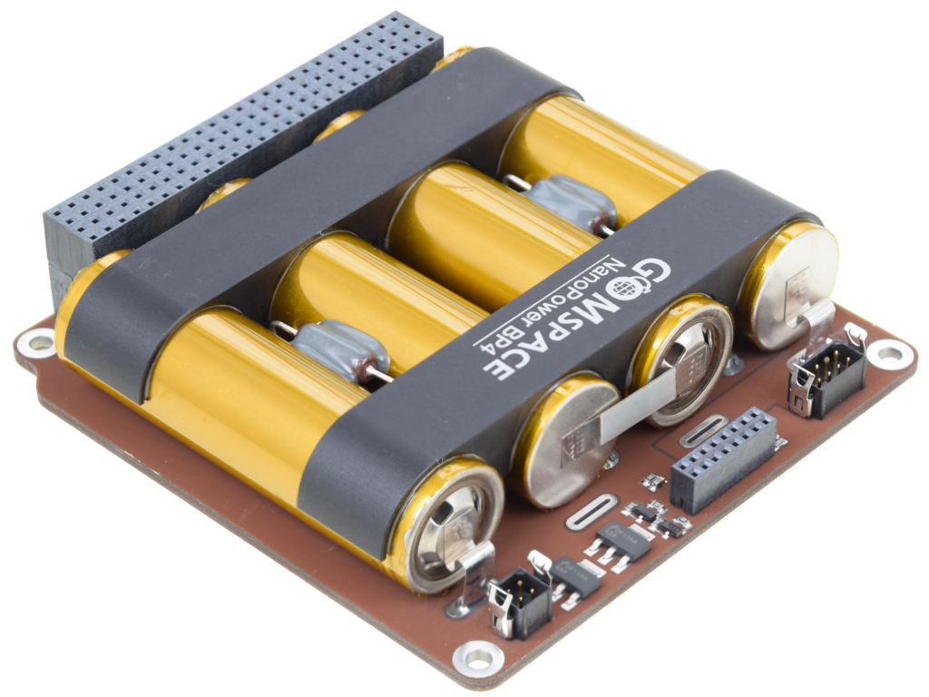
Power
GOM Space BP4 + P31 Stack
  Mission primary
  Proven, shock/vibe tested
  Long lead time
Custom power board
  Funded by Aerospace Corp.
  Build for ~$100 in raw materials
  Design custom PCB to be adapted to future SSDL missions
  Must qualify system

Slide 9
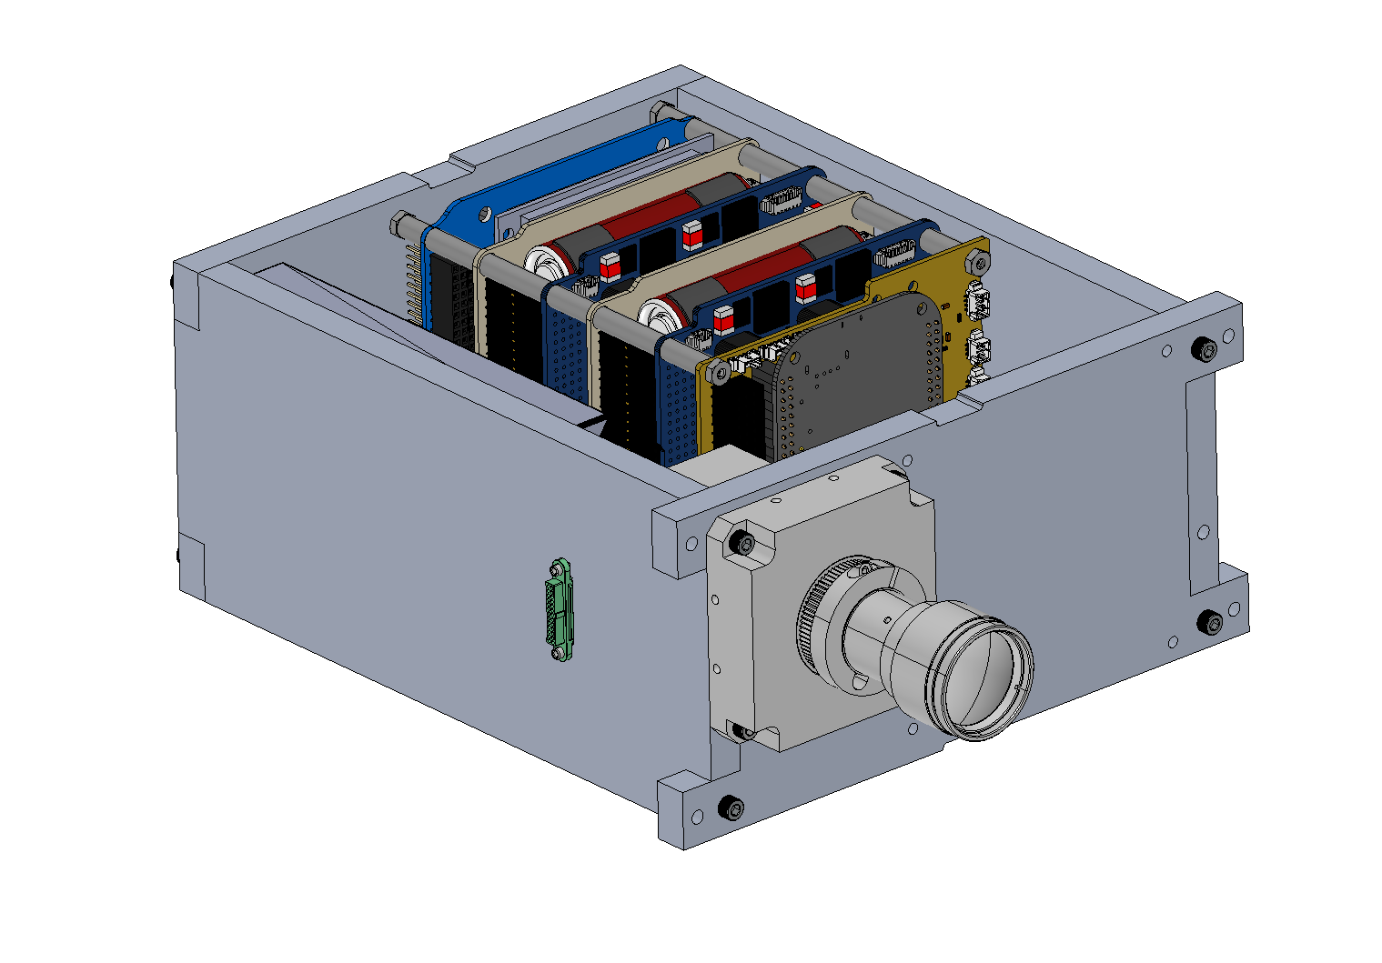
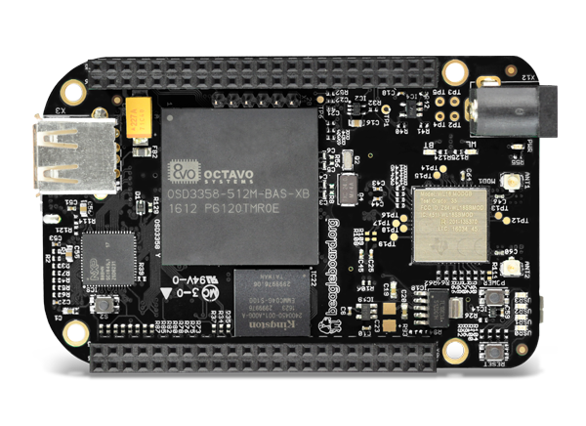
Avionics
Integrated into aluminum box with 3/8” shielding on all sides
Easily removable for accelerated integration and testing
Avionics Stack
  GOMSpace Power and Battery Stack
  SSDL Power and Battery Stack
  Beaglebone Flight computer and motherboard
  GlobalStar Simplex
  Software Defined Radio (SDR)
  Radiation Experiment(s)

Slide 10
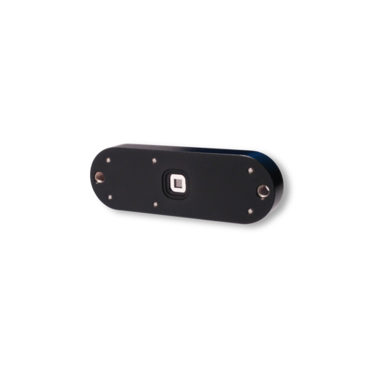
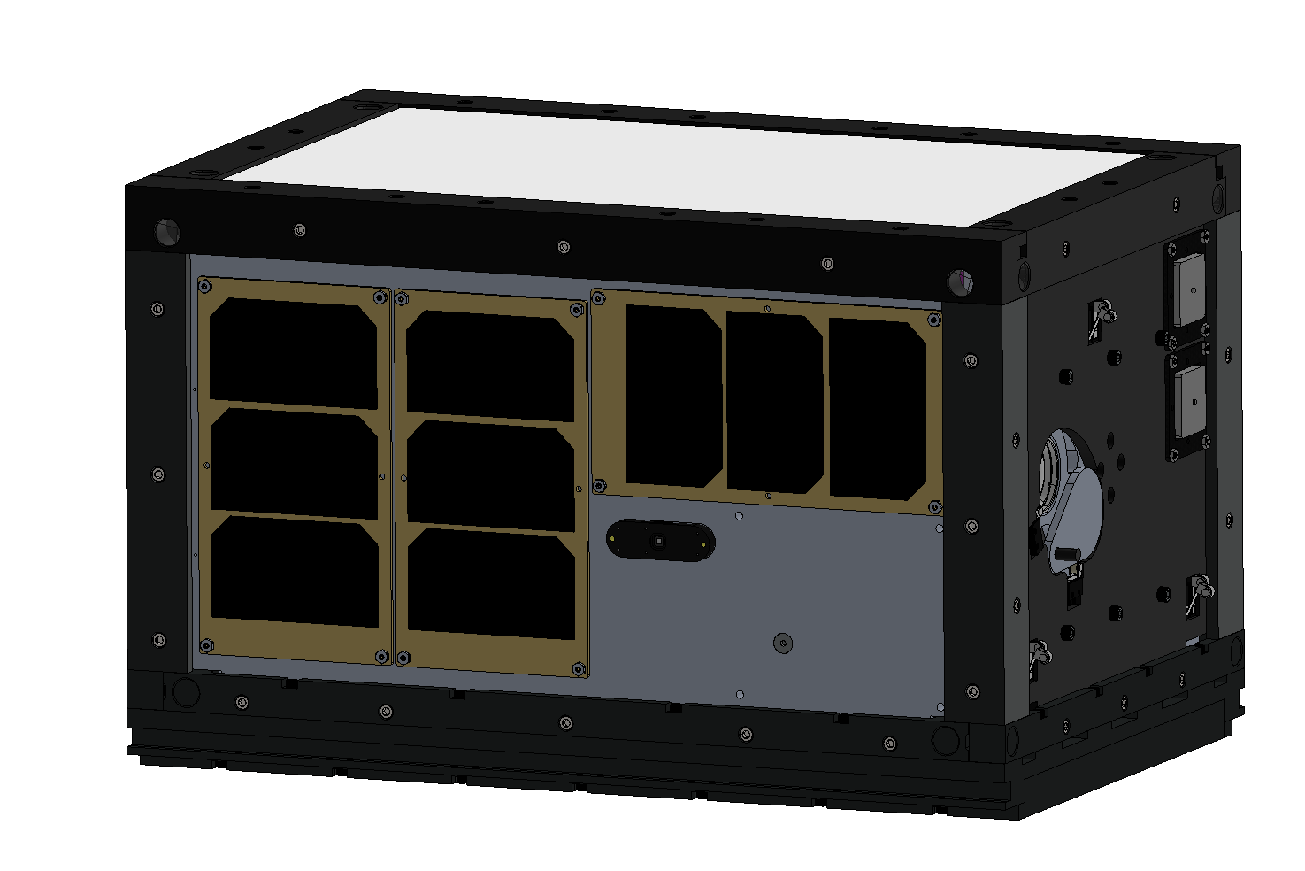
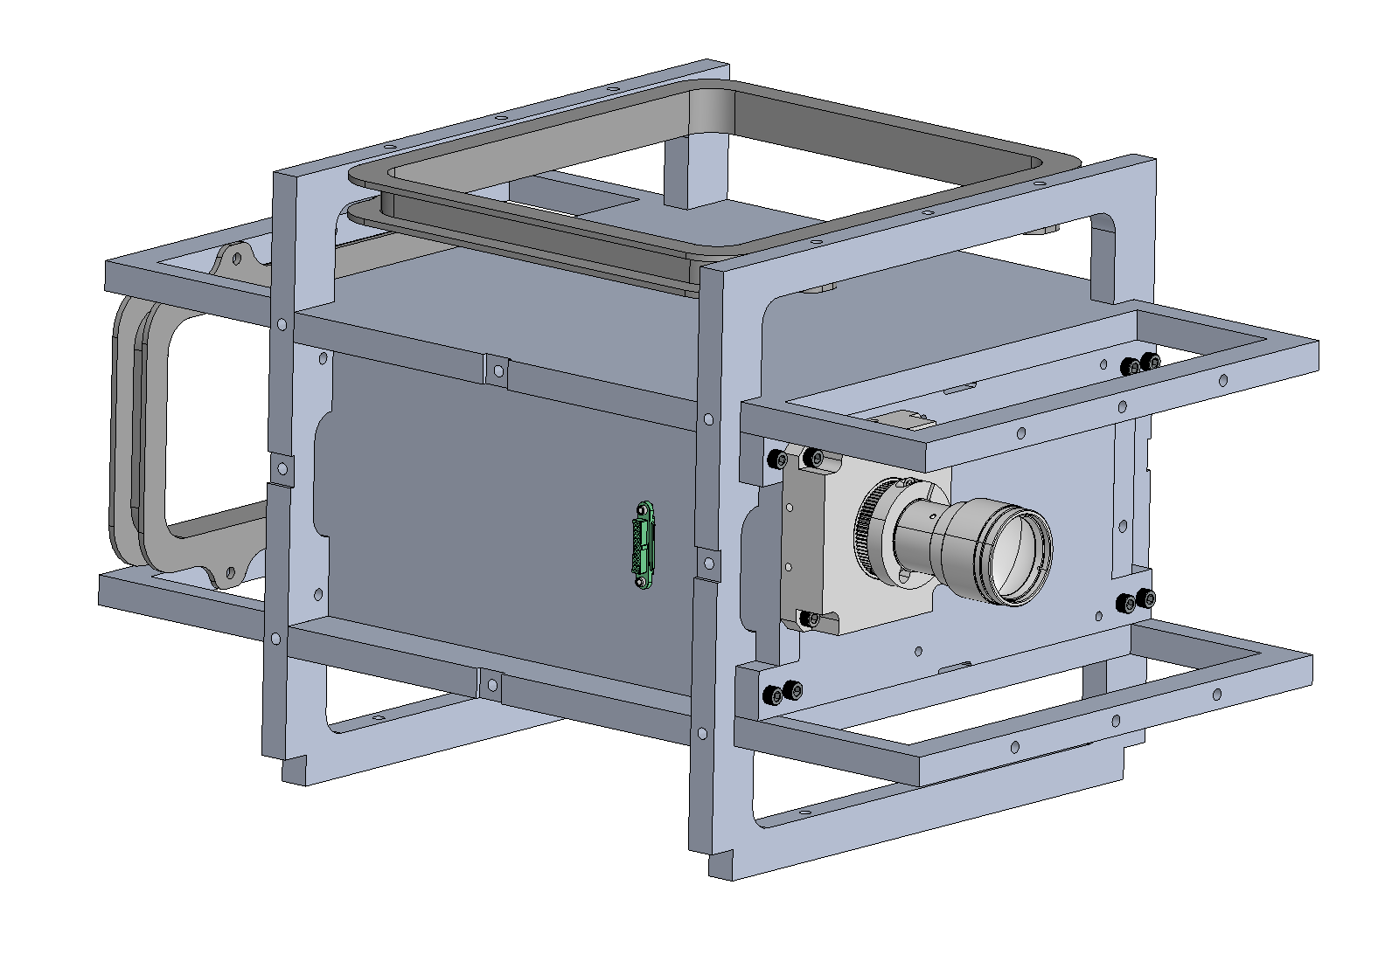
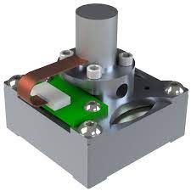
ADCS
Torque rods x3
Reaction wheel x1
Sun sensor
GPS Antennas
IMU
Magnetometer

Slide 11
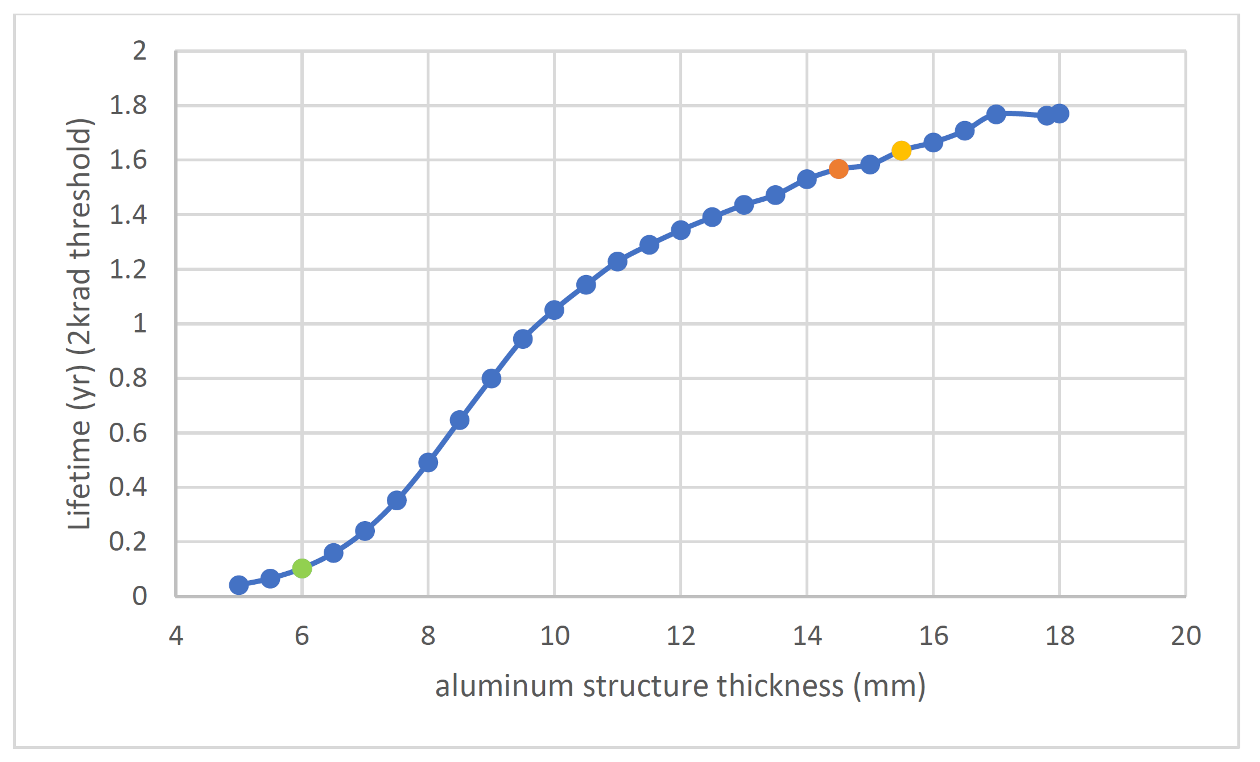
Radiation Shielding
Requires ~10 mm of aluminum shielding
  1 year survival time
  Test efficacy of shielding
  GTOSat used ~7 mm of aluminum shielding
Passing through Van Allen Belts twice per orbit
Measure radiation dosage onboard
  Simple to implement (ADC converter)
Credit: Ariel Tokarz

Slide 12
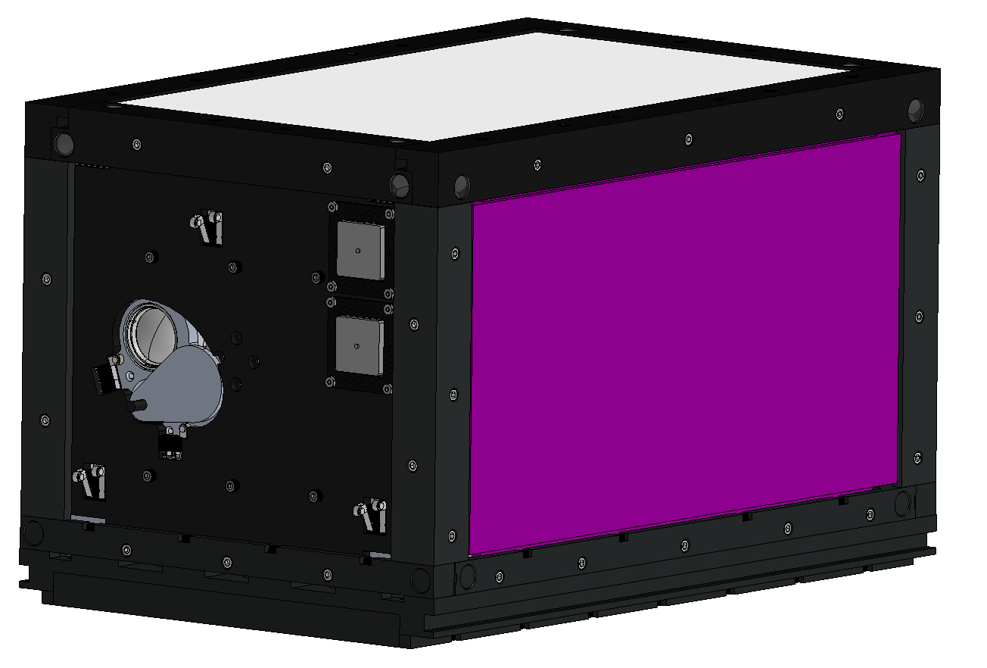
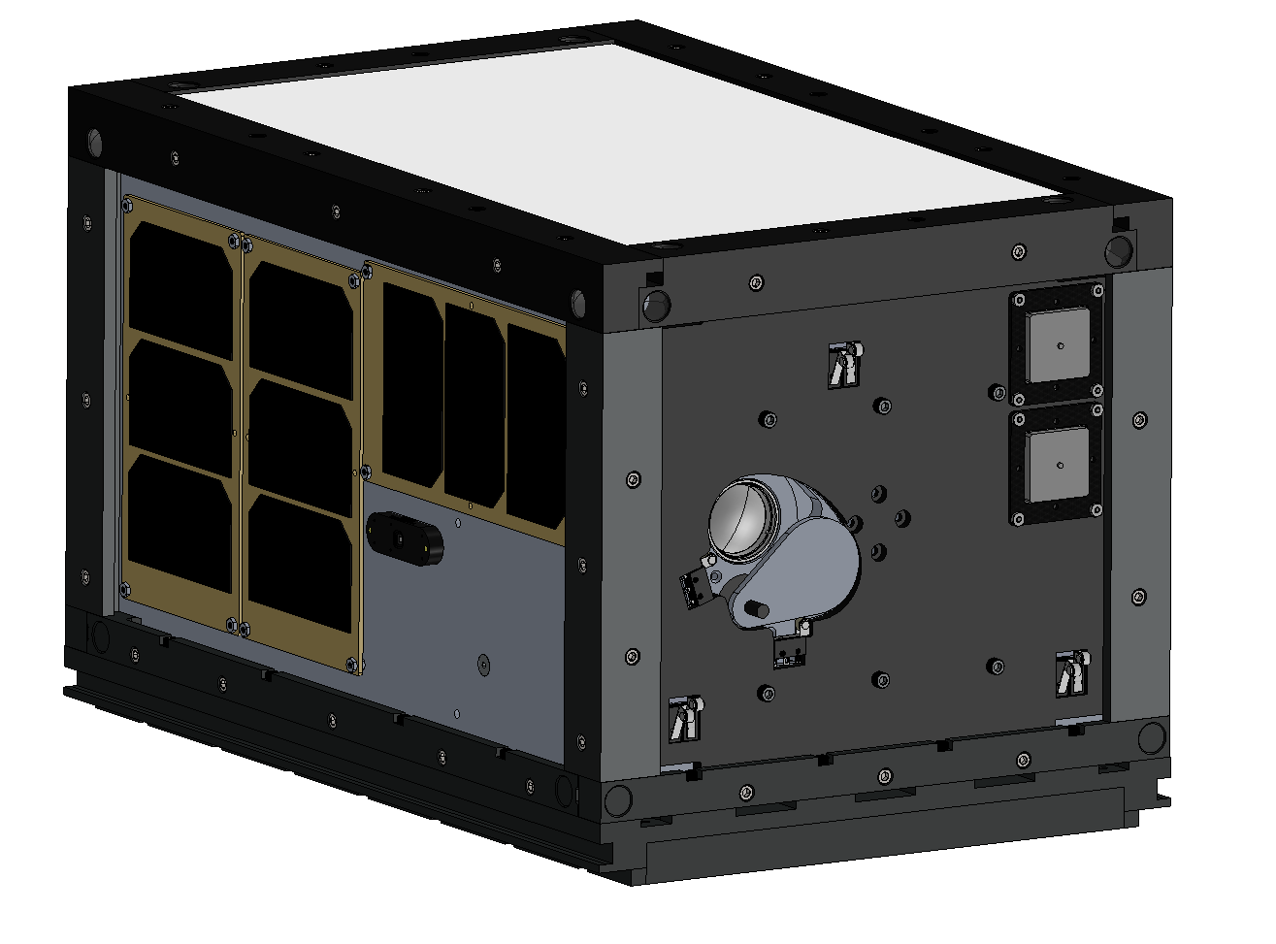
Current Design
Notes:
Adding avionics makes a satellite much more complex

Slide 13
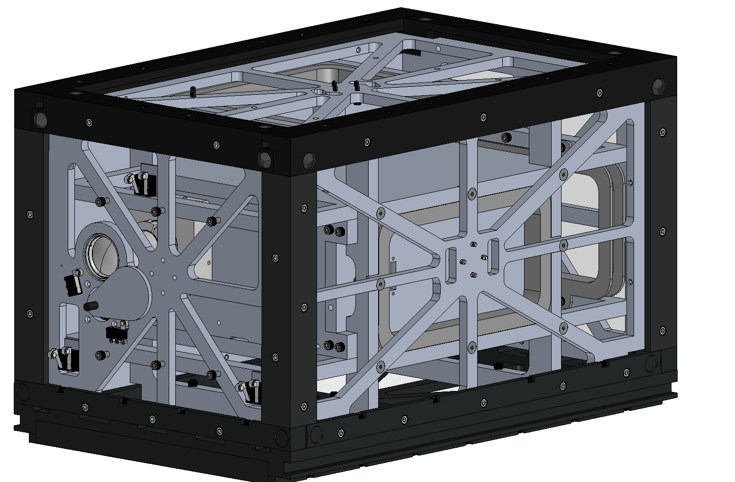
Current Design
Side panels removed
Notes:
Adding avionics makes a satellite much more complex

Slide 14
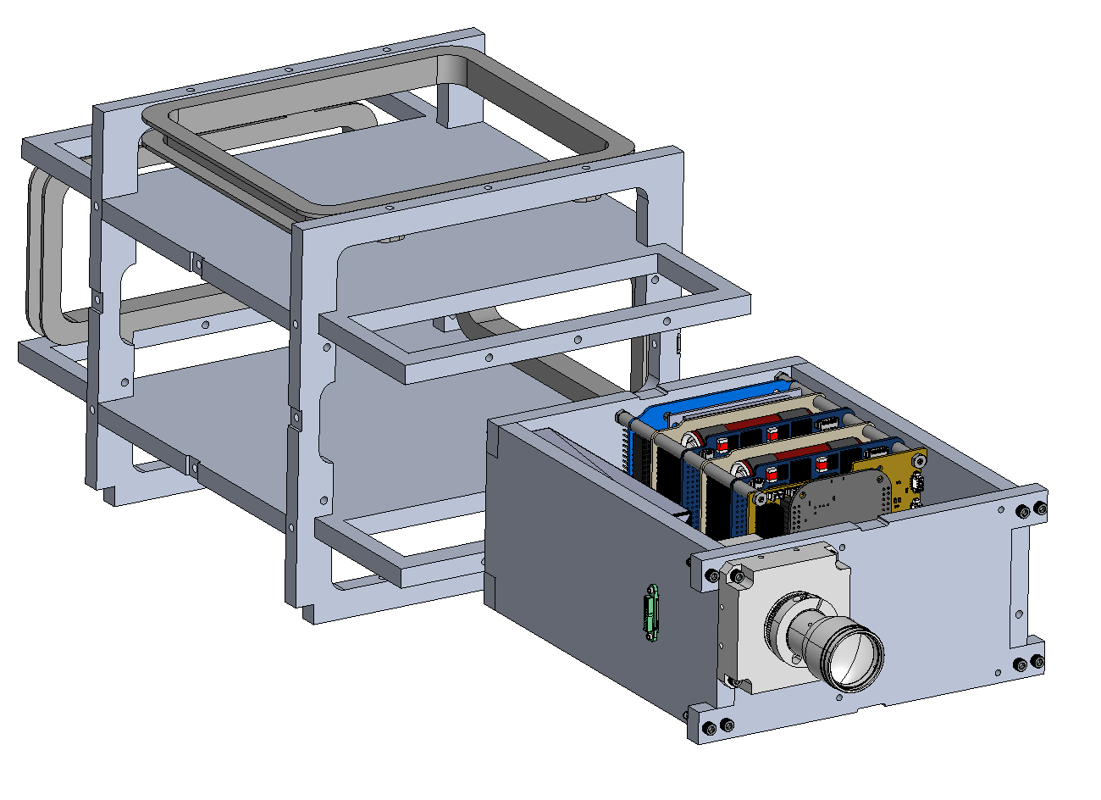
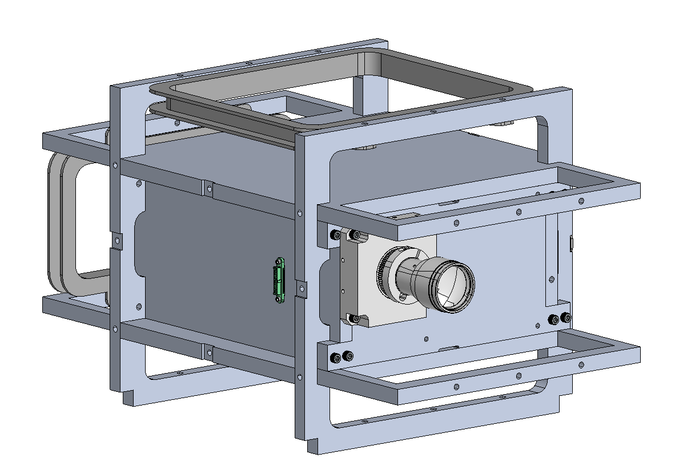
Current Design
Notes:
Adding avionics makes a satellite much more complex

Slide 15

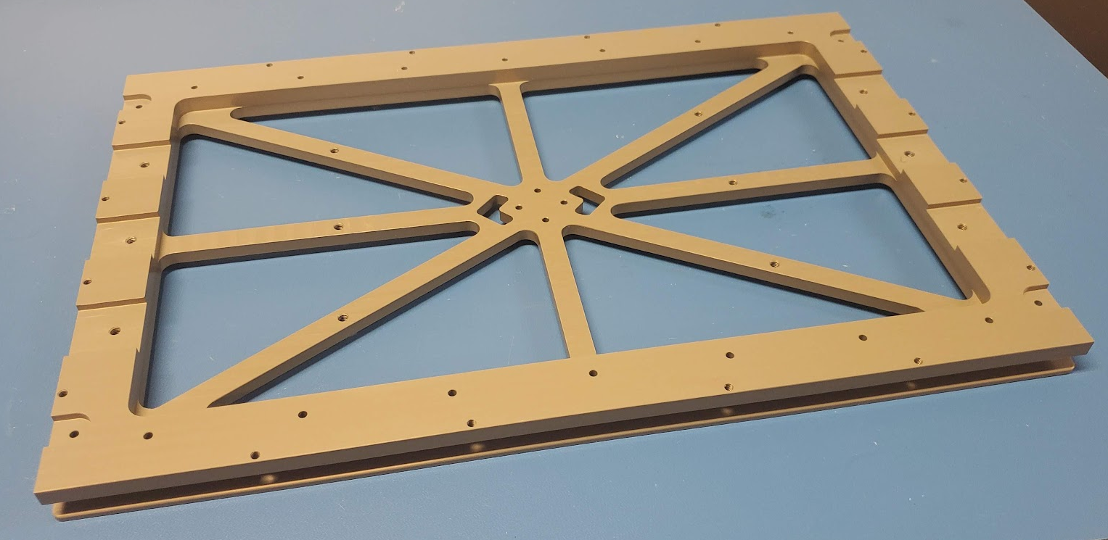
Fabrication
All parts machined in Montgomery Knight shop
Must alodine/anodize all parts to prevent outgassing
Hard anodized baseplate – Al 7075
  Tight tolerances from launch provider

Slide 16
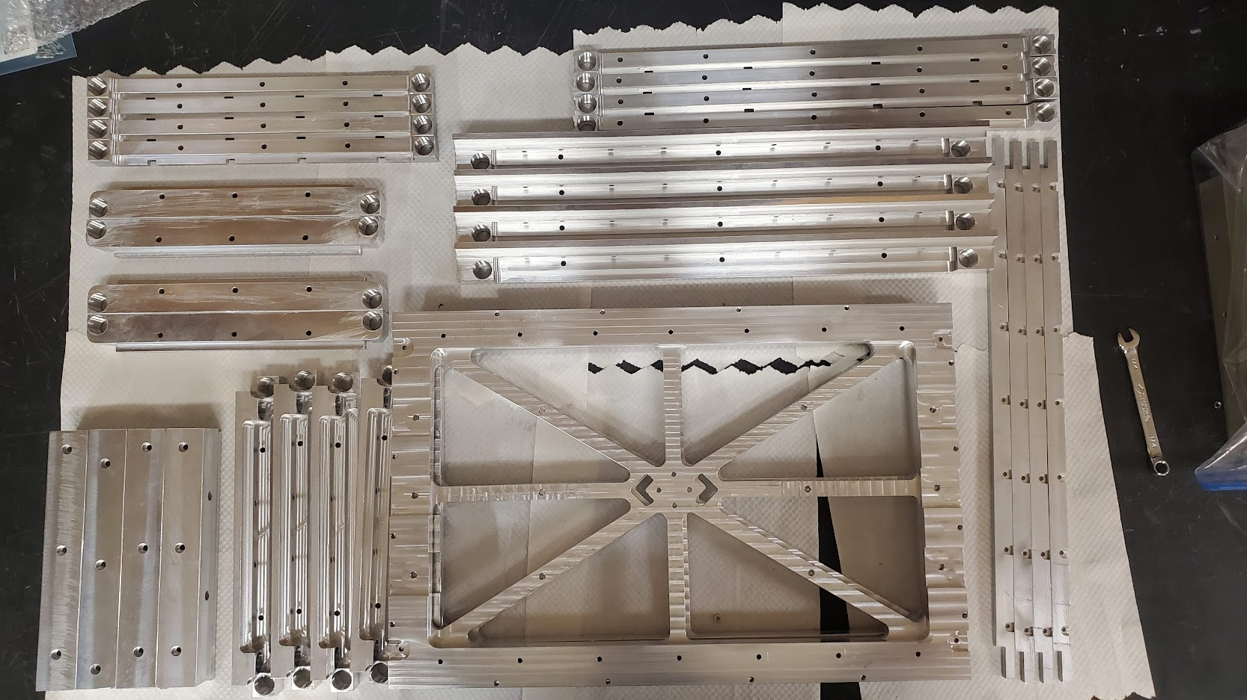
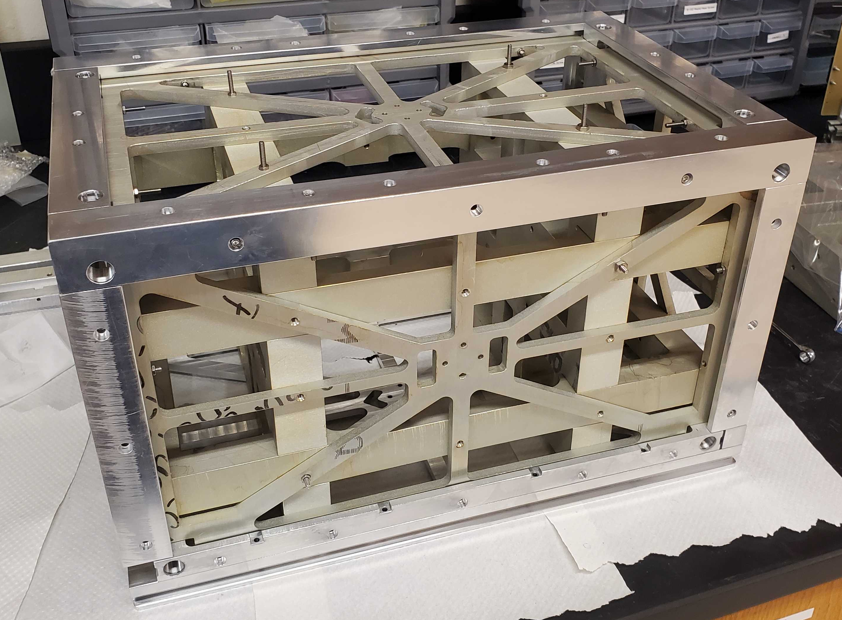
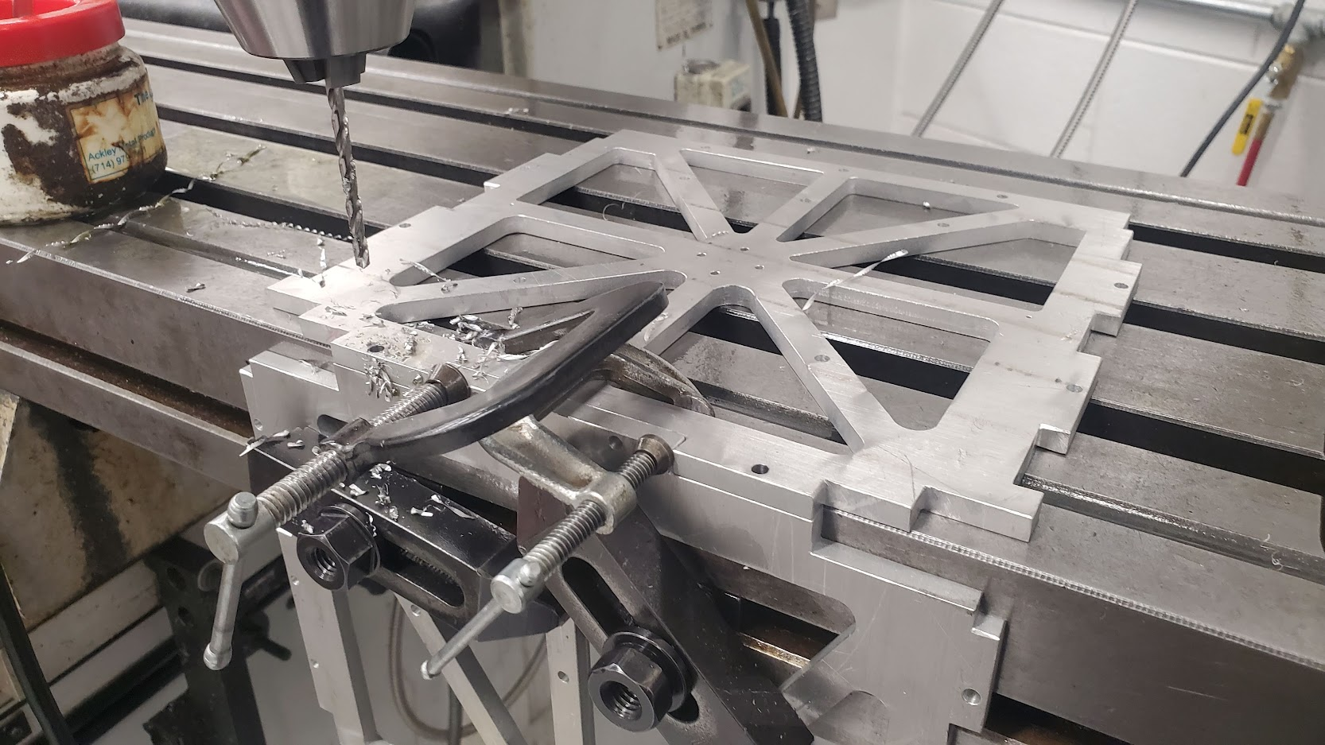
Spring 2021
Outer Structure Fabrication

Slide 17
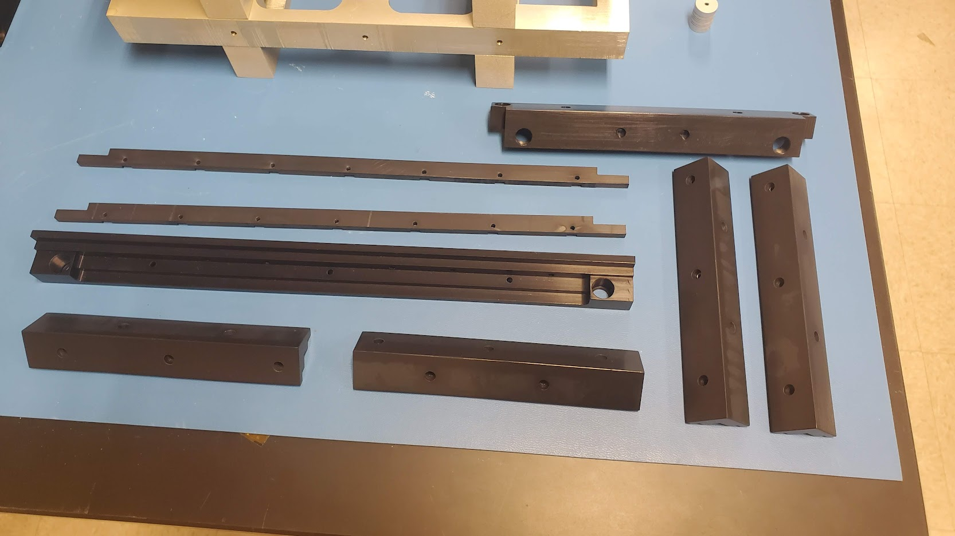
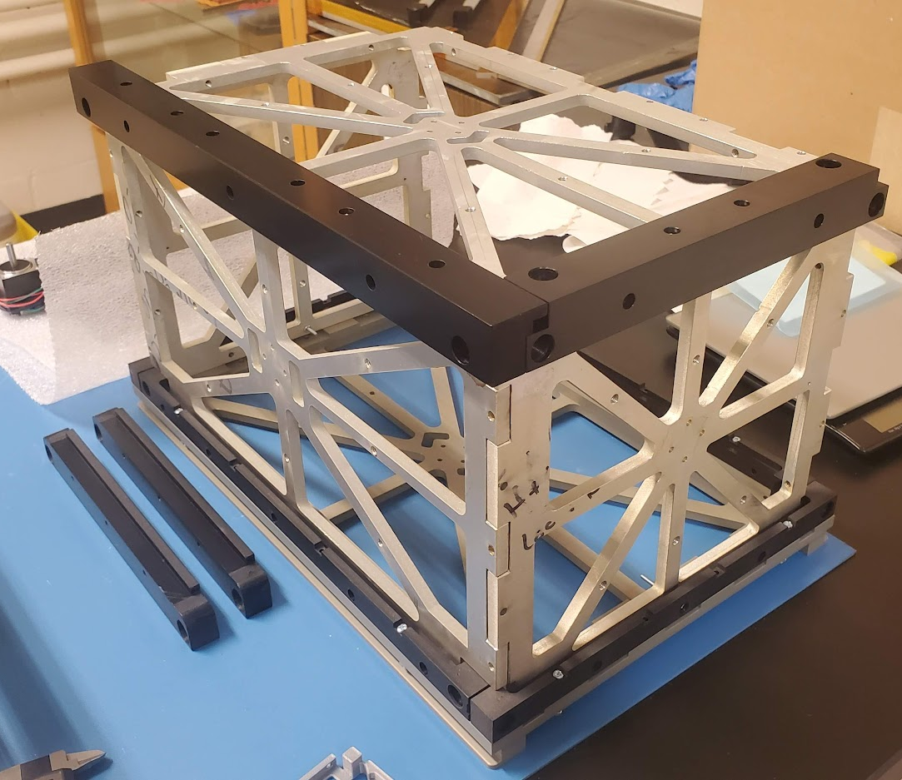
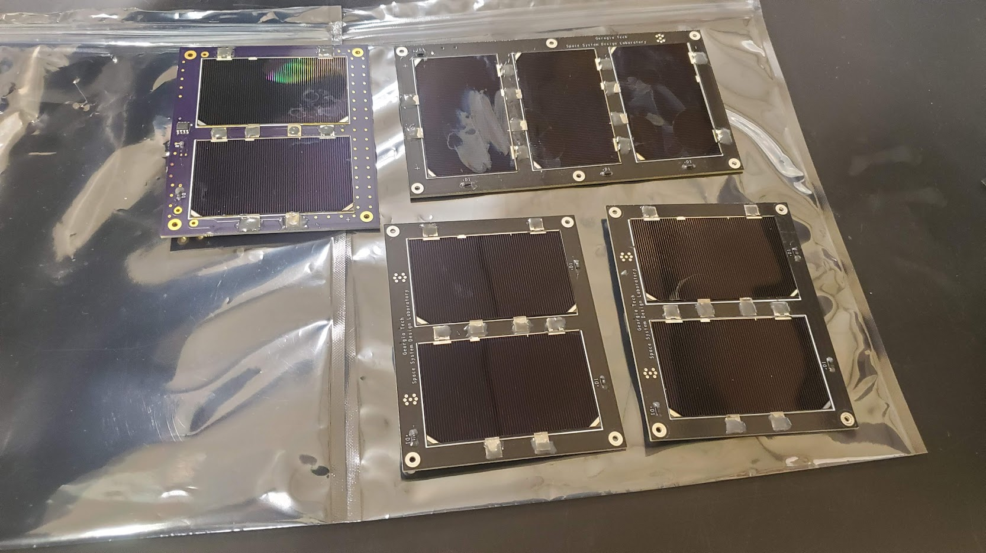
Fall 2021

Slide 18
What now?
Flight unit due in May
Building and testing engineering unit
  Shutter mechanism
  Avionics suitcase
  Deployment switches
  Mounting/testing hardware
  Vibration testing mount
  And much more…
Integration and Testing
  Vibe testing
  Refined structural and modal analysis
  Imager testing
  Shutter testing
  ADCS testing
  Solar panel testing
  etc

Slide 19
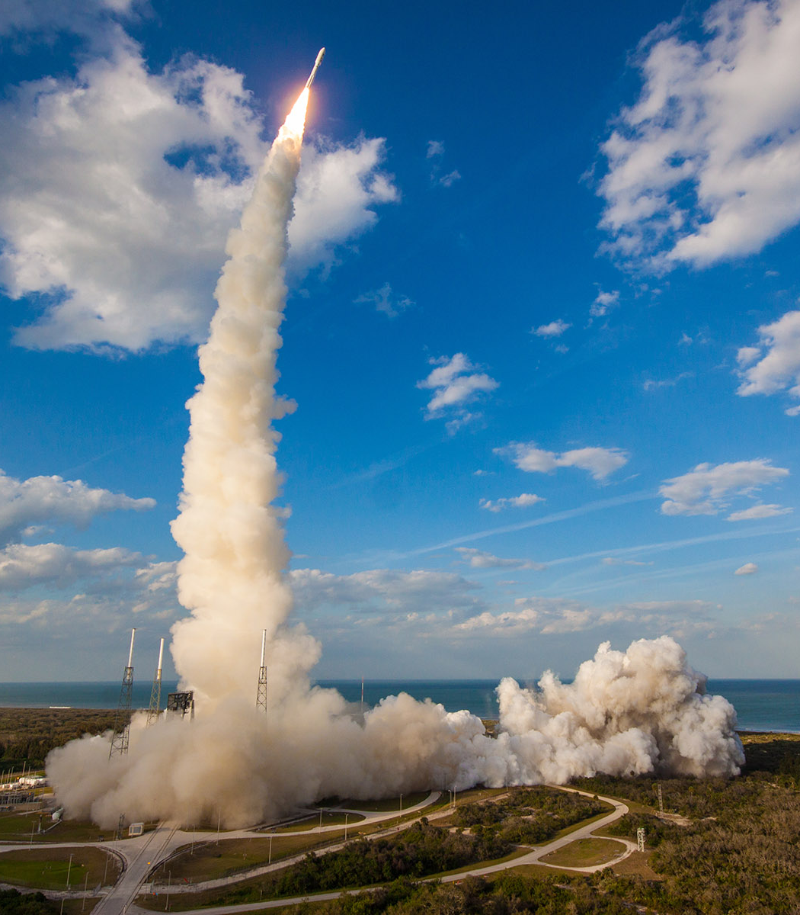
Future Plans
Flying on an Atlas V on June 22, 2022
  Vandenburg AFB
Delivery to launch provider in May 2022

Slide 20
Thank You
Thanks to Dr. Gunter and the OrCa Team!
Questions??

