Slide 1
Overview of Lunar Flashlight Operations
Jishnu Medisetti
SSDL Biweekly Meeting
1/11/2022

Slide 2
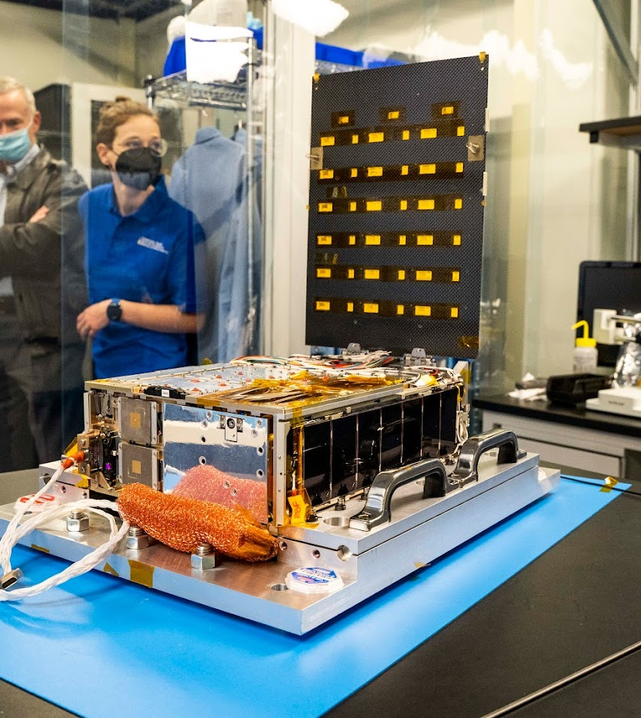
Outline
Mission Overview and CONOPS
MOS Setup
Early Operations
Spacecraft I&T Activities
Operational Readiness Tests

Slide 3


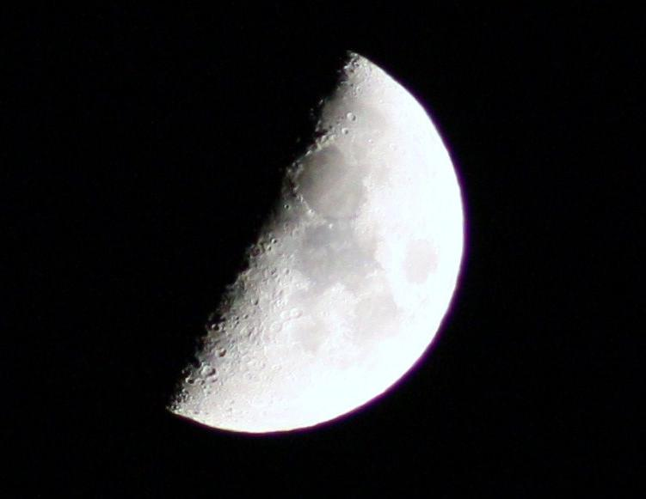
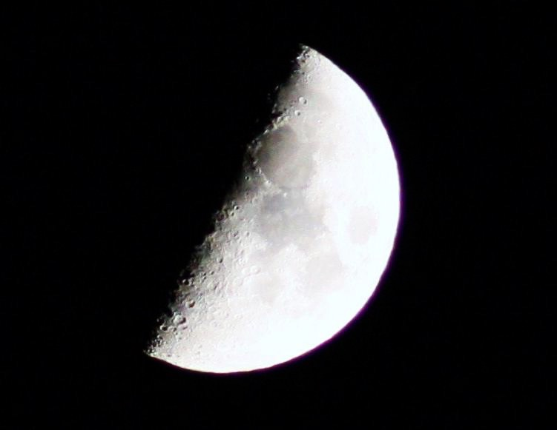

Concept of Operations (CONOPS)
Lunar Flashlight CONOPS Overview
Updated: 03-08-21
Apoapsis
OTM-B
Uplink OTM-B (1hr)
OTM-B Reconstruction (6hr)
Idle/Laser Recharge (8hr)
Deployment and Initial Bootup
Detumble, solar panel deployment
Initial contact
Desat Burns
System checkout
Thruster Calibrations
Instrument Calibrations
Instrument System Test
Monitor Health & Safety (1hr)
Preliminary
10 Science Orbits
(~60 Days)
Disposal at Lunar South Pole
Monitor Health & Safety (1hr)
OTM-A Reconstruction (6hr)
OD and Uplink OTM-C (3hr)
Additional TCMs
OTM-A
TCM4
LOI
Uplink OTM-A (1hr)
Science Pointing Update (3hr)
OTM-C
Perilune Reconstruction (5hr)
TCM 1, 2, 3
Lunar Flyby
Perilune Pass Uplink (1hr)
Perilune Pass
Eclipse
L+10 days
L+135 days
L+180 days
L+240 days
LEOP
Cruise (4 months)
Approach
Science (60 days)
Deorbit

Slide 4
Mission Phases
Mission Phase | Approx. Duration* | Begins | Ends | Events/Activities
Launch and Early Operations (LEOP) | Between 1–2 wk. | Launch | Completion of TCM4 | Launch, Deployment, Initial Bootup, System Checkout, TCM1, TCM2, TCM3, Lunar Flyby, TCM4
Cruise | 4 mo. | Completion of TCM4 | 45 days prior to LOI | Thruster Calibration, Instrument Calibration, TCMs
Approach | 1.5 mo. | 45 days prior to LOI | Completion of LOI | TCMs, Lunar Orbit Insertion (LOI)
Science Orbit | 2 mo. | Completion of LOI | End of Science Operations** | Instrument Operations, Orbit Trim Maneuvers (OTMs)
Deorbit | 1 wk. | End of Science Operations | Spacecraft Disposal | Disposal Maneuver (if required)
* The prime mission is 8 months
** The nominal Science Orbit Phase is 60 days (10 science orbits)

Slide 5
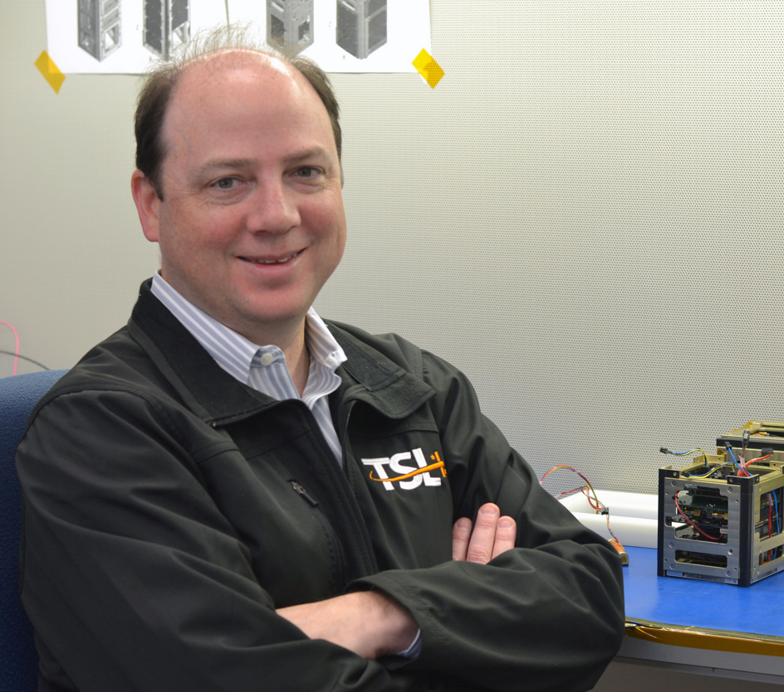


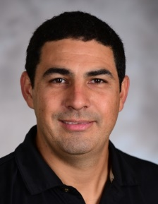
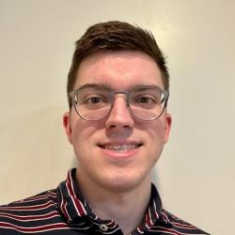

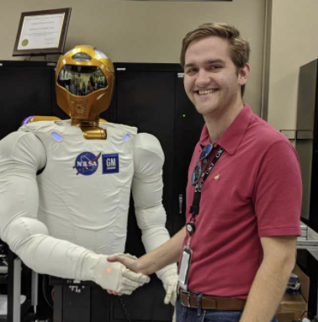


Mission Operations Team
Co-PI: Glenn Lightsey, School of Aerospace Engineering
Research Faculty:
  Conner Awald (GTRI)
  Sterling Peet
  Diego Remolina
Graduate Students:
  John Cancio
  Michael Hauge
  Dillan McDonald
  Jishnu Medisetti
  Mason Starr
Undergraduate Students:
  Alec Albrecht
  Graham Jordan
  Grace Krahn
  Sam Roquitte
  Catherine Schlabach
And lots of help from GTRI and JPL colleagues!

Slide 6
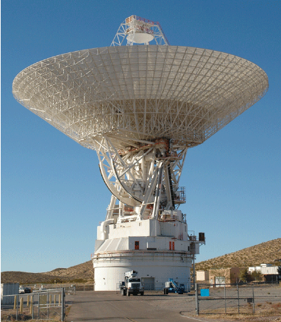
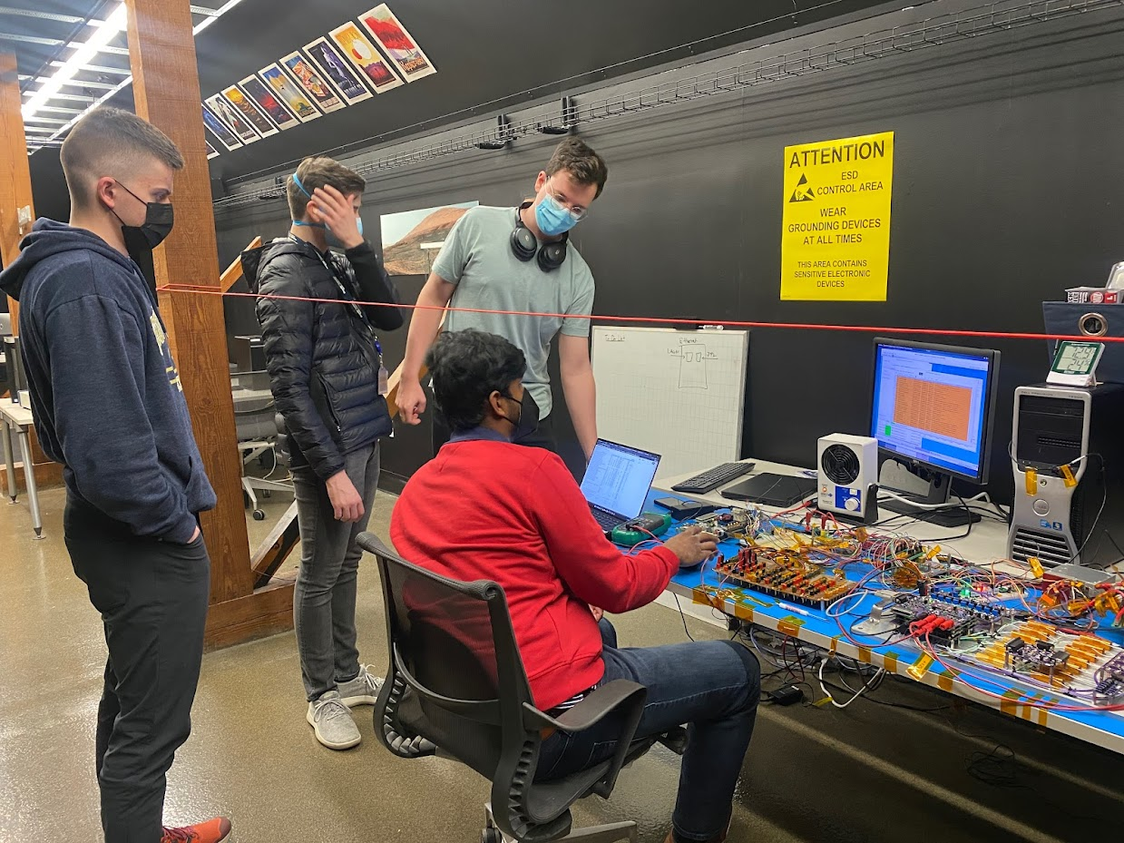
Mission Operations Center Facilities
4 Host computers with multiple operations VM’s
AMPCS Operations software
Communications pipeline to the DSN
LF Testbed workstation with similar subsystems

Slide 7
Operational Roles
Mission Planner
  Plans, organizes, and prepares for upcoming operations, Serves as the director of operations during a DSN pass.
  Serves as a liaison between the Operations Team and the other project stakeholders, including the SOC, MD/NAV, Engineering, and Propulsion.
Spacecraft Link Engineer
  Uplinks commands and directly interacts with the spacecraft during DSN ground passes.
  Monitors the signal link between the MOC and the spacecraft.
Testbed Engineer
  Verifies and validates command sequences and scripts on the testbed before they are sent to the spacecraft.
Telemetry Engineer
  Processes telemetry, creates data products, and uploads telemetry and data products to appropriate databases and repositories.
Mission Analyst
  Interprets telemetry; performs limit checks and trend analysis
  Monitors Spacecraft health, and runs visualizations of telemetry
  ADCS engineer

Slide 8
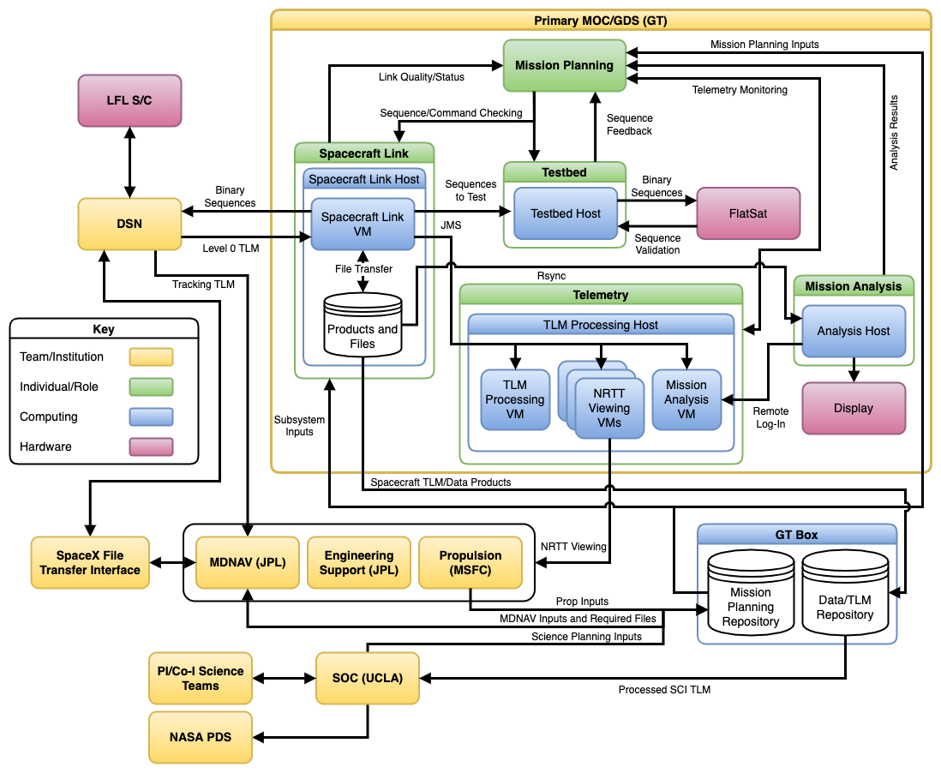
Operational Data Flow

Slide 9
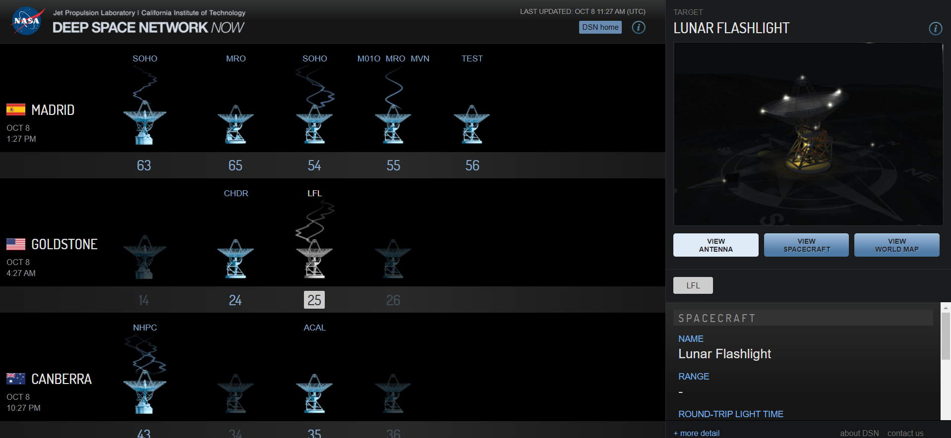
Early Operations
Generating Documentation (Mission Operations Plan, Training Plan, V&V plan, etc)
Training (spacecraft subsystems, AMPCS, DSN)
DSN Connection tests

Slide 10
Spacecraft I&T Testing
Thermal Vacuum testing (TVAC)
  I&T team is currently performing TVAC testing on the spacecraft
  Simulating the environment of space to test its response
  Will run full systems tests on the spacecraft
Fault Protection Testing
  Testing the flight software fault detection and responses on the spacecraft
  Some of these will be tested during TVAC
Day In The Life Testing (DITL)
  Simulates major mission phases on the spacecraft to put it through a normal “day in the life” situation.
  4 phases will be tested: Deployment through first contact, Initial prop activity and Desat 1, Prop maneuver sequence to TCM1, and Science Perilune pass

Slide 11
Operational Readiness Tests (ORT’s)
Operational simulation of major mission events
Operations teams to implement/test procedures, tools, and software (think Dress Rehearsal)
Includes external parties (MDNAV, SOC, DSN, JPL Engineering)
Used LF Testbed as the simulated “Spacecraft”
Planned ORT’s:
  ORT-1 – LEOP to TCM-1 → completed 3/17/2022 ​
  ORT-2 – TCM-2 → Planned 4/2022​
  ORT-3 – Off Nominal LEOP to TCM-2 → Planned 5/2022​
  ORT-4 – Thruster Calibration → Planned 6/2022​
  ORT-5 – Final TCM to LOI → Planned 7/2022​
  ORT-6 – Instrument Operations and Perilune Pass → Planned 8/2022

Slide 12
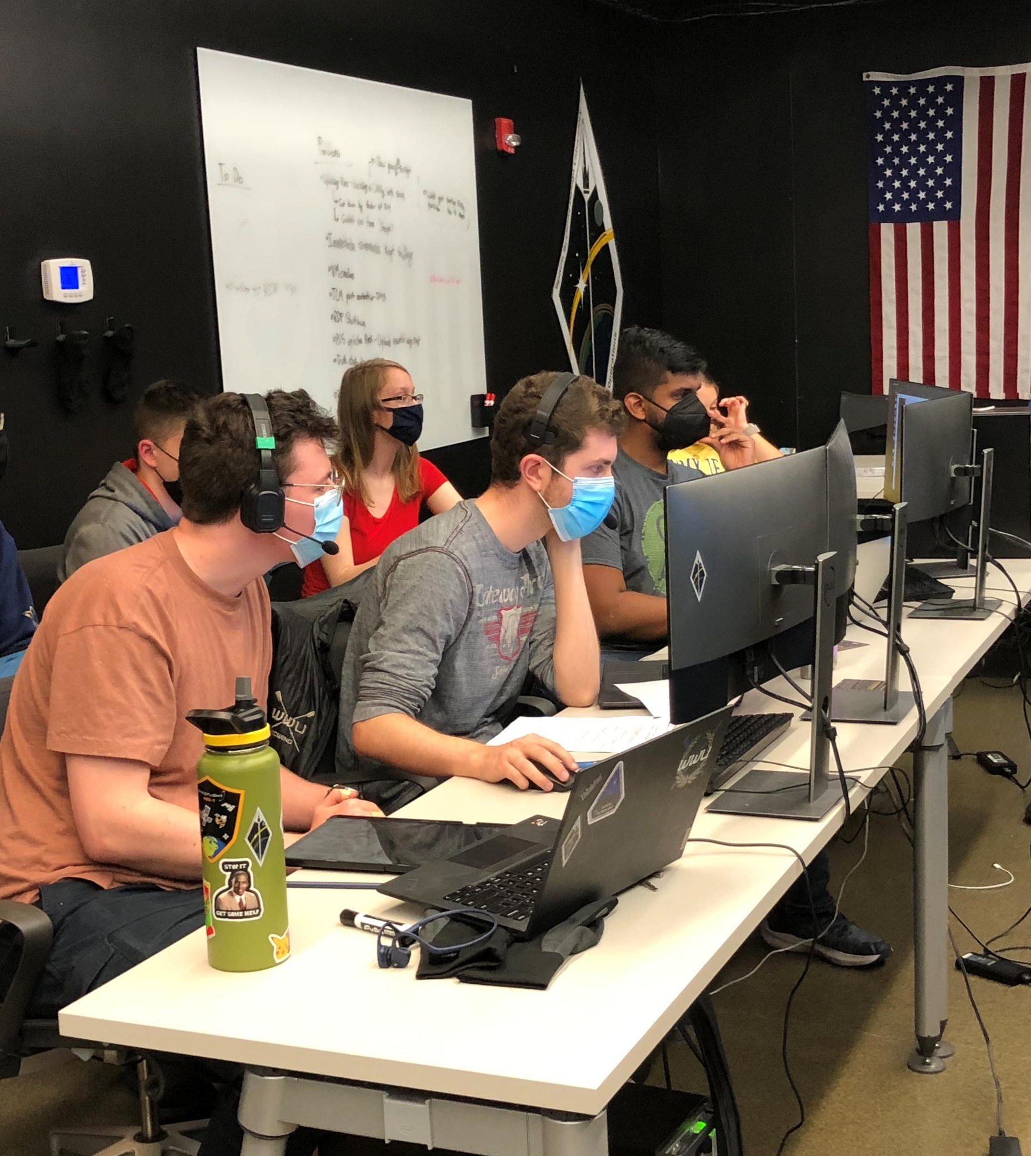
ORT-1
ORT-1 simulates initial Deployment up to TCM-1
33 hours of operations divided into 5 contacts
  Contact 1 – Deployment and subsystem checkout (1hrs)
  Contact 2 – Initial prop activities (fuel priming and commissioning, 2hrs)
  Contact 3 – Desaturation burn 1 (2hrs)
  Contact 4 – TCM 1 (1hrs)
  Contact 5 – TCM 1 Data Downlink (2hrs)
Performed 2 versions of the ORT, Deconstructed and Real Time
Deconstructed ORT simulated one contact each day
  Practice run for the ops team
  Used lessons learned
Real Time ORT simulated continuous 33 hours

Slide 13
Differences Between Deconstructed and Realtime ORT
Deconstructed ORT
Power off testbed between contacts
Frequent SCLK updates
Frequent updates to RDP setup scripts
Time between contacts significantly extended
TCM review meeting not held
JPL monitoring was not required, did not confirm with them for prop go/no go events
Realtime ORT
Testbed will be running continuously for whole duration
Requires only initial SCLK update
Only one RDP setup script required
Flight-like time between contacts
Will hold TCM review meetings
Will require JPL monitoring for prop activities and prop go/no go

Slide 14
How did it go?
Deconstructed ORT
Real Time ORT
Contacts 2-5 were completed within the contact window
Had issues with VM’s crash
Procedural errors meant incorrect sequences were uploaded
Spacecraft entered Safe mode
Downlinking sequences is a slow process
We did not finish all activities within contacts 1 and 2
Sequences were not formatted correctly
Mission Planners reacted correctly and saved the spacecraft
Able to adjust mission plan and use contact 3 to catch up
Successfully executed all prop activities and TCM-1
Overall Mission success

Slide 15
Lessons Learned
File uplink is a slow and unrealistic process
  Files need to be chunked and concatenated which is a long process
  Time simulation of uplinking files is much longer than in operations
  Possible solution might be pre uploading all sequences and just simulating time passing during the ORT
We will not be able to downlink all the files we want during the initial contacts, and we can prioritize ranging instead
  Need to create a downlink schedule
Internal review up to 1 week prior to ORT to review procedures and sequences (changed from 2 days)
Ground response steps need to be laid out for when VM’s crash
  Need to create contingency plans and test them out
Version controlled sequence database is needed
Some contacts will be finished early and have space for more activities

Slide 16
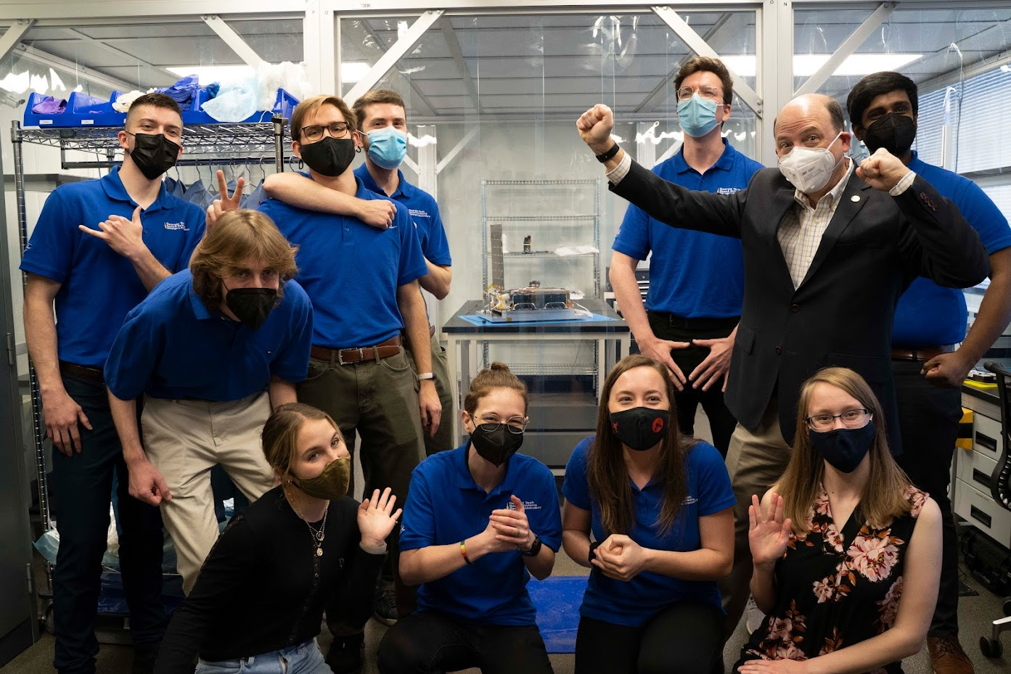
Next Steps
Further updates to procedures and tools
Preparation and execution of ORT’s 2-6+
Operational Readiness Review
Training, testing, practice

Slide 17
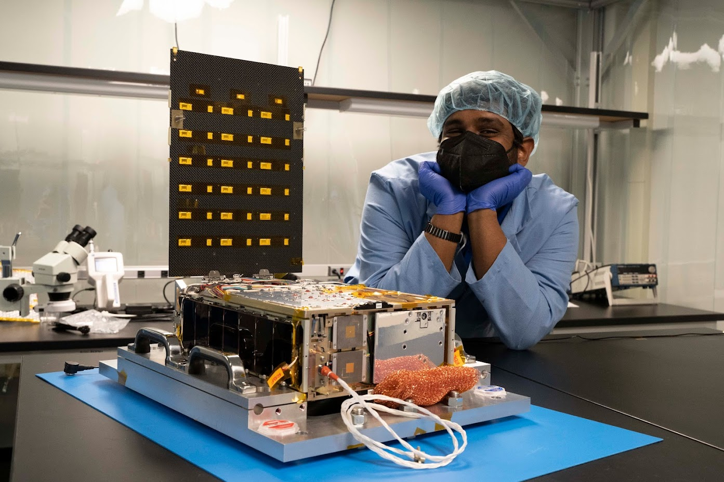
Questions?

