Slide 1
Real-Time Terrain Mapping and Processing for Autonomous Safe Landing via Supervised Learning
Kento Tomita
Ph.D. Student, Space Systems Optimization Group
Daniel Guggenheim School of Aerospace Engineering
2021/11/30
SSDL Group Meeting

Slide 2
Background
2021/11/30
SSDL Group Meeting

Slide 3
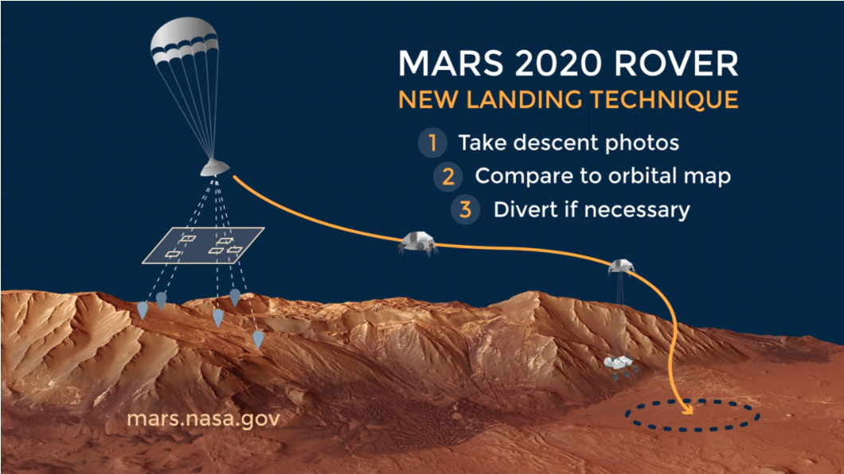
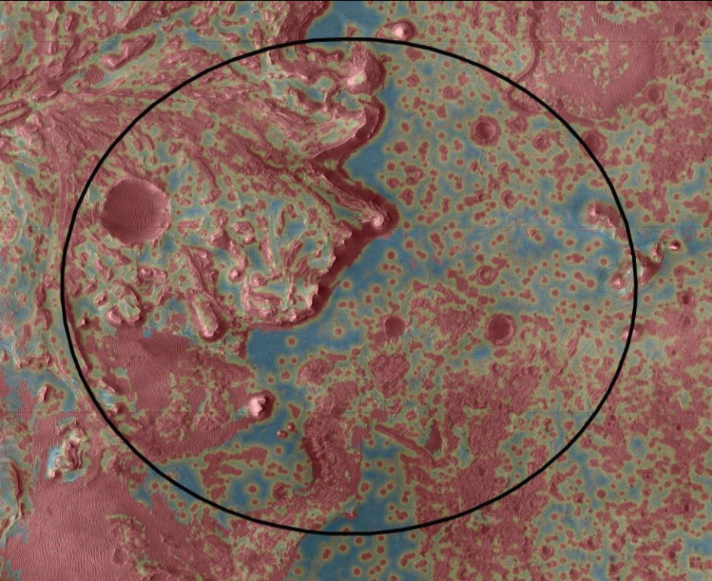
Hazard Detection and Avoidance
for Planetary Landing
Mars 2020
  Generate hazard map (1~m/pix) from
  orbiter’s observations
  +
  precise navigation (Terrain Relative
  Navigation)
https://mars.nasa.gov/mars2020/mission/technology/#Range-Trigger
Avoiding Hazards During Landing:
By taking images of the surface during its descent, the rover can quickly determine whether its headed toward an area of its landing zone that the mission team has determined is hazardous. If necessary, a divert maneuver can send it toward safer terrain.
Jezero crater’s hazard map created by carefully processing images form MRO; you can detect hazards of 1m~
https://www.jpl.nasa.gov/images/jezeros-hazard-map
2021/11/30
SSDL Group Meeting

Slide 4
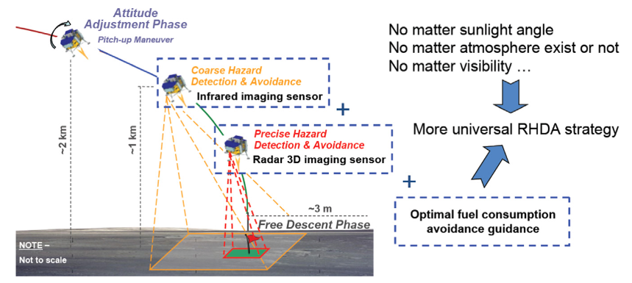
Hazard Detection and Avoidance
for Planetary Landing
Chang’e-3 Lunar Lander (2013)
  First mission with successful Autonomous HDA
  Two-stage hazard detection
  Coarse safety map from passive sensor (camera) & Fine safety map from active sensor (LiDAR)
  Based on plane fitting algorithm
2021/11/30
SSDL Group Meeting

Slide 5
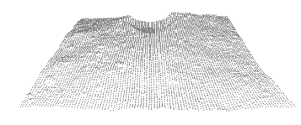
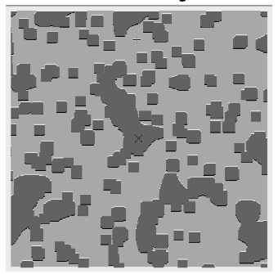
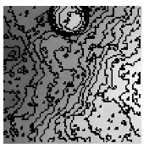
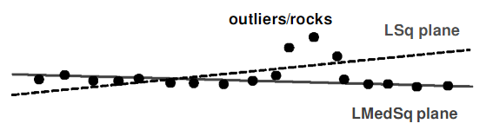
Hazard Detection Algorithms(1)
Robust plane fitting (Johnson 2002)
  Landing hazards = slope & roughness
  Step 1: plane fitting (=slope evaluation)
  Step 2: roughness evaluation
  *plane-fitting potentially smooths out roughness
  features and underestimates the slope of the lander
roughness
slope
Point cloud from LiDAR
Digital Elevation Map (DEM)
Safety map
2021/11/30
SSDL Group Meeting

Slide 6
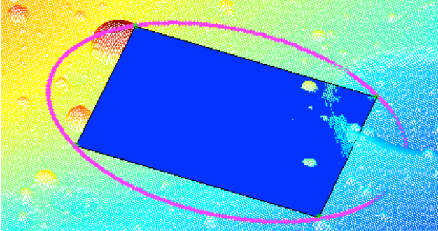
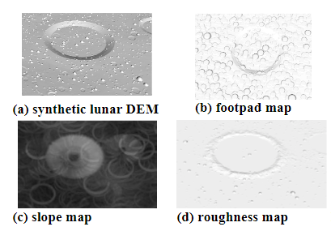
Hazard Detection Algorithms(2)
ALHAT (Ivanov 2013)
  Landing hazards = slope & roughness
  Step 1: try one orientation
  Step 2: evaluate lander’s footpad positions
  Step 3: evaluate slope and roughness
  Try all orientations and record worst case
  *slow (to make it real-time, search window takes wide strides, resulting coarse safety map)
Digital Elevation Map (DEM)
Safety map
2021/11/30
SSDL Group Meeting

Slide 7
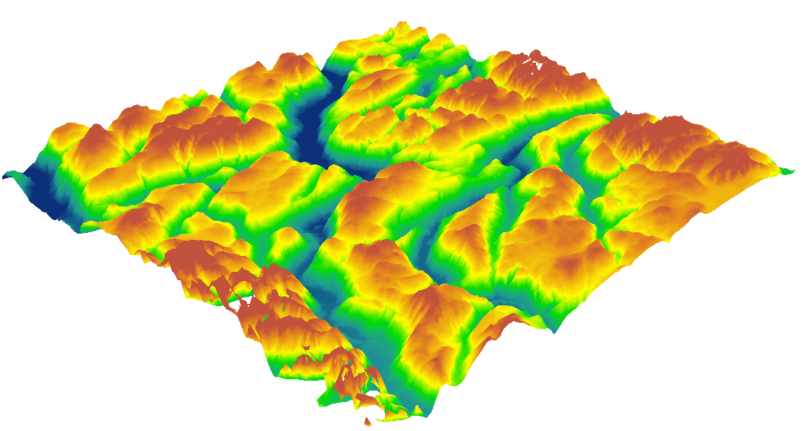
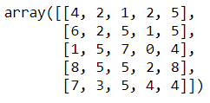
Digital Elevation Map
Basically 2D array data
Each element stores height of the point

Slide 8
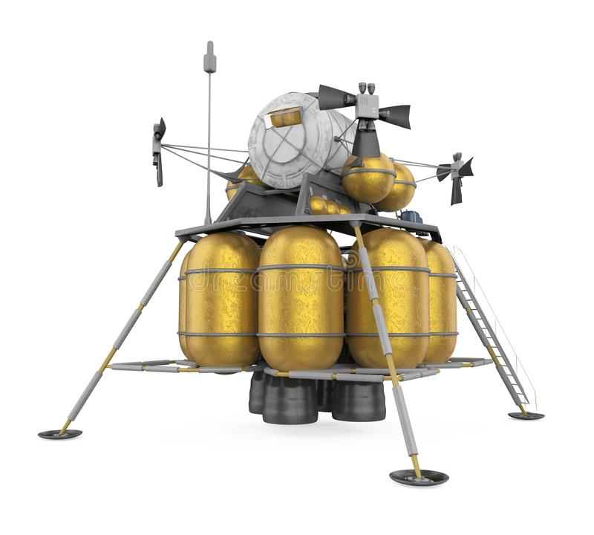
ALHAT Computation Scalability
Aiming points to evaluate: X₁₁, …, X_{nm}
  Ex)
  suppose originally this number is 4x4=16
  if resolution doubles it increases to 8x8=64
Lander projection points: A₁₁, …, A_{kl}
  Ex)
  suppose originally this number is 3x3=9
  if resolution doubles it increases to 6x6=36
Total number of evaluation: (nm) x (kl)
  Proportional to (resolution)⁴
  Ex)
  original resolution: 16x9=144
  doubled resolution:64x36=2304
  ➔ increase rate: 2304/144 = 16 = 2⁴
X₁₁
A₁₁
…
…
…
X_{n1}
…
…
A_{k1}
A_{kl}
X_{nm}

Slide 9
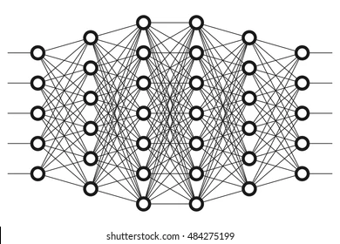
Hazard Detection Algorithms(3)
Convolutional Neural Network (this study)
Use of Convolutional Neural Network (CNN) for extracting features from a DEM and generating a safety map.
  Basic idea behind CNN: Reduce the input DEMs into a form that is easier to process, while keeping the critical features.
    Conventionally, done by handcrafted filters for image processing
    Brute force approach is often not feasible for online processing without approximation
Why CNN?
  Does not depend on manual feature engineering once trained.
  Accurate estimation of the safety of each landing zone leveraging the information of the surrounding regions.
  Well-used for image processing and pattern recognition.
Digital Elevation Map (DEM)
Deep Neural Networks
Safety map
2021/11/30
SSDL Group Meeting

Slide 10
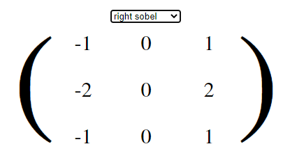
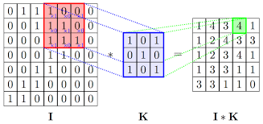
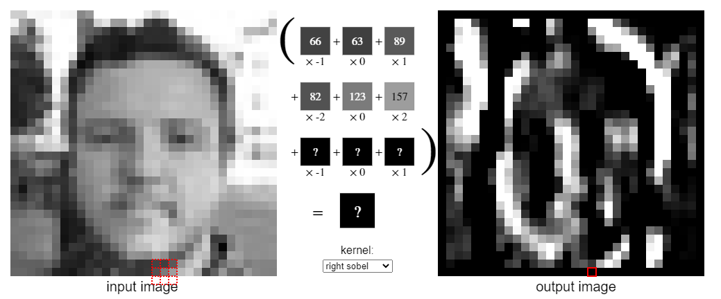
Convolutional Neural Network (CNN)
Convolution of Kernels
Can extract local features
Ex) vertical/horizontal lines
Ex) Extraction of local slope (high right and low left)
Input image
kernel
output

Slide 11
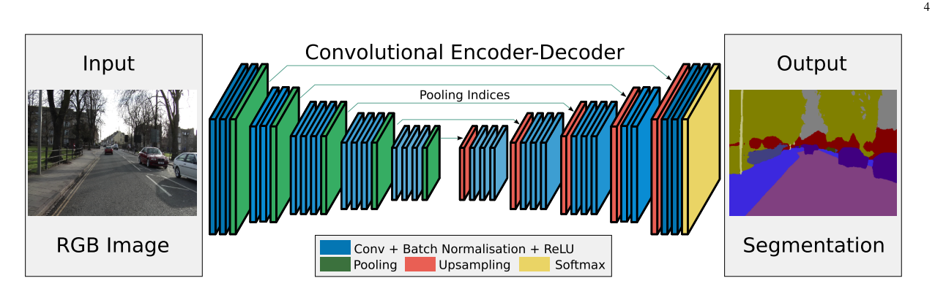
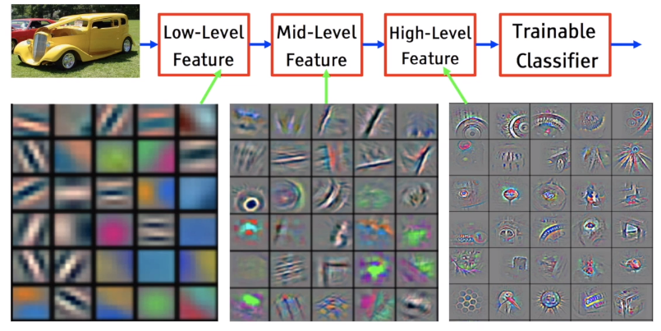
Convolutional Neural Network (CNN)
Convolutional Neural Network
Repeat convolution with many kernels in layered structure
Any shape/curves can be explained with combinations of simple lines
  → can extract arbitral shape/curves with the right kernels
How to choose the right kernels?
  → learn by minimizing the loss function (=discrepancy between prediction and ground truth)
  → need training dataset: combination of input and output

Slide 12
Technical Approach
2021/11/30
SSDL Group Meeting

Slide 13
Overview of Technical Approach
Supervised learning for landing zone evaluation.
  Effective for general missions with a given DEM.
  Enabling rapid terrain processing/mapping under general uncertainties with little simplifying assumptions
Target
ML Model:
Designed by humans
Model parameters:
Learned form data
Error
Input:
(S/C states)
Noisy DEM
Output:
Safety Map
Model
2021/11/30
SSDL Group Meeting

Slide 14
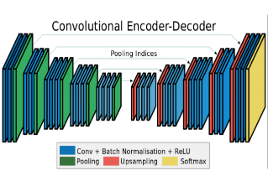


Supervised Learning Model Overview
TRAINING
These models are not available in real time but are available for training.
This training phase enables the machine learning model to achieve hazard detection considering more system-level parameters/ noises than SOA.
The quality and quantity of the training dataset determines the model’s performance.
Noised DEMs
S/C States
Safety Maps
HD Machine
Realistic Sensor/
Environment Model
Ground Truth:
Touchdown simulation
Terrains
ONBOARD MACHINE LEARNING MODEL
Noised DEMs
S/C States
Safety Maps
HD Machine
2021/11/30
SSDL Group Meeting
Notes:
Classification or regression

Slide 15
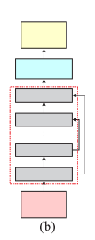
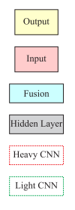
Supervised Learning Model
1. SegNet
Encoder decoder model designed to be efficient in terms of memory and computational time during inference.
Passes pooling indices computed in the max-pooling step to the up-sampling step to transfer low-level information across the network.
Number of trainable parameters is small.
* Badrinarayanan, V., et al. (2017), SegNet: A Deep Convolutional Encoder-Decoder Architecture for Image Segmentation. PAMI 2017.
2021/11/30
SSDL Group Meeting

Slide 16
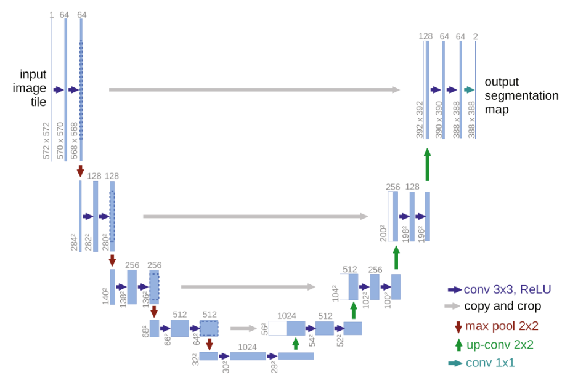
Supervised Learning Model
2. U-Net
Encoder decoder model designed to learn from small size of original training data.
Learns to up-sample by deconvolution.
Feature maps from the down-sampling part are copied to the up-sampling part to avoid losing pattern information.
Expected to be computationally costly but accurate.
* O. Ronneberger, et al. (2015). U-Net: Convolutional Networks for Biomedical Image Segmentation. MICCAI 2015.
2021/11/30
SSDL Group Meeting

Slide 17
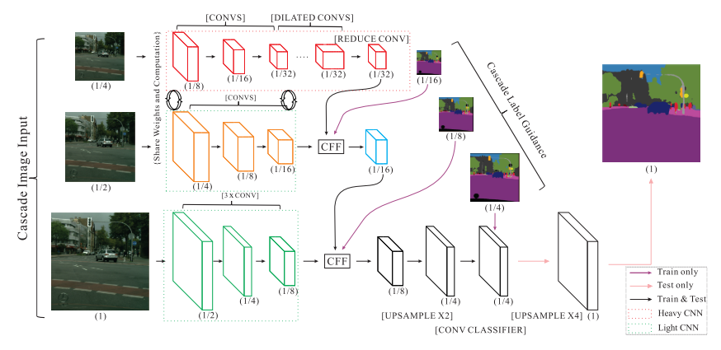
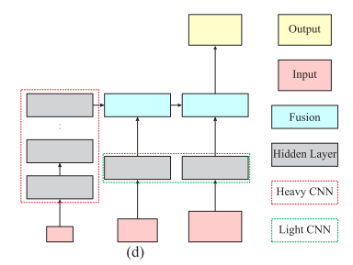
Supervised Learning Model
3. ICNet
Multi-scale prediction ensemble designed for real-time processing on high-resolution images
Image cascade network (ICNet) that incorporates multi-resolution branches under proper label guidance.
Balancing accurate but slow high-resolution processing and coarse but fast low-resolution processing
Fast processing of high-resolution DEMs, trading off with the accuracy.
* Zhao, H., et al. (2018), ICNet for Real-Time Semantic Segmentation on High-Resolution Images. ECCV 2018.
2021/11/30
SSDL Group Meeting

Slide 18
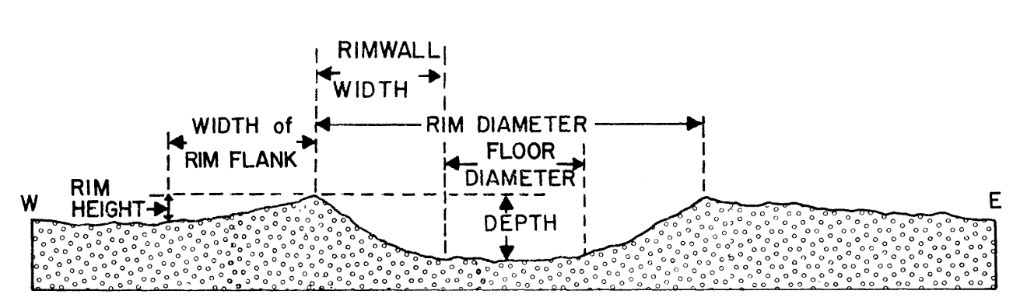
Dataset: Realistic Terrain Generator
Model-based approach
  Use size-number distribution for rocks and craters from literatures
  Use shape functions for craters from literature
    Place rocks and craters at random.
    Fractals are applied using Perlin noise for realistic terrain/rock/crater shapes
    Near craters, the size-number distribution of ejecta varies with the distance from the center of the crater.
Generation of Background Terrain with Rocks
Size-frequency distribution: Rock
Fractal terrain generation
Fractal rock Generation
Crater Generation
Size-frequency distribution: Crater
Fractal crater generation
Add ejecta
* Pike, R. J. (1977). Size-dependence in the shape of fresh impact craters on the moon. In Impact and explosion cratering: Planetary and terrestrial implications; Proceedings of the Symposium on Planetary Cratering Mechanics, September 13-17, 1976 (pp. 489–509).
2021/11/30
SSDL Group Meeting

Slide 19
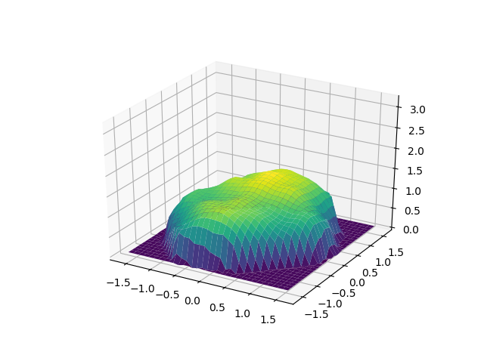
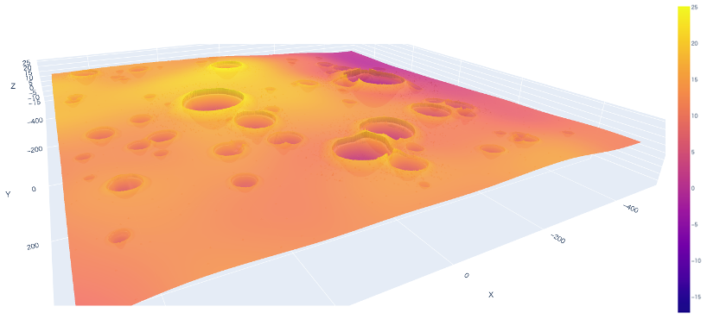
Dataset: Terrain Samples
Example of the generated terrain
Example of the generated rock
2021/11/30
SSDL Group Meeting

Slide 20
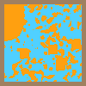
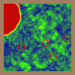
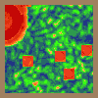
Dataset: Label Samples
  Binary Safety Map
    Each pixel has a label of either safe or unsafe
  Multi-level Slope/Roughness Maps
    Discretized slope maps and roughness maps
    Discretization is conducted in a way such that the class distribution gets balanced
Safe
Unsafe
Undefined
Binary safety map
Undefined
Undefined
Slope map
Roughness map
2021/11/30
SSDL Group Meeting

Slide 21
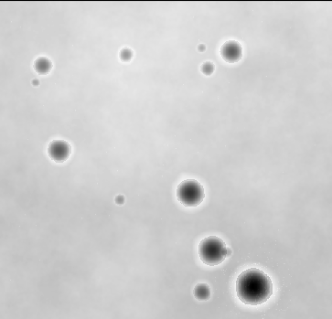
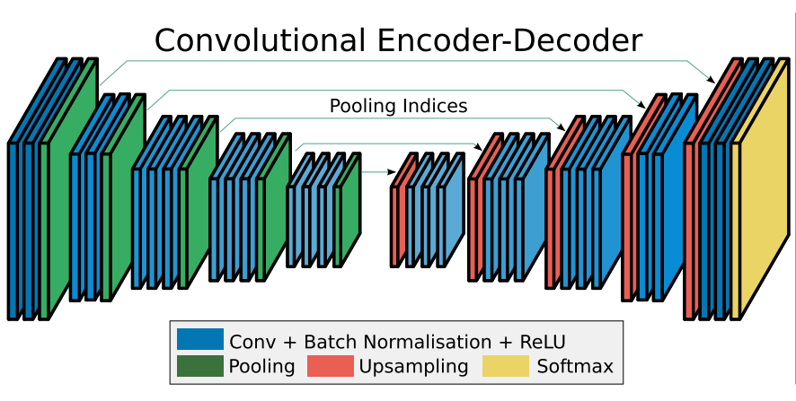
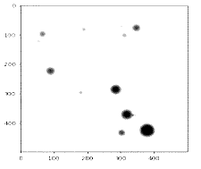
Case Study Overview
  Three models for HD machine
    SegNet, U-Net, ICNet
  Three types of labels
    Binary safety map, Discretized slope map, Discretized roughness map
  Resulting 9 different trained networks
  Networks trained with discretized slope maps and roughness maps are combined together to output safety maps based on the predicted slope and roughness
  We obtain two types of HD algorithms that
    directly predict safety map from DEM
    Predict slope and roughness and then generate safety map based on them
Labels
Safety Maps
Slope Maps
Roughness Maps
HD Network
SegNet
U-Net
ICNet
Noised DEMs
2021/11/30
SSDL Group Meeting

Slide 22
Case Study Configuration
  Generated annotated DEMs of 100×100 at resolution of 1 m/pixel for training.
  Noised DEM is normalized using the maximum and minimum altitudes of all DEMs in the dataset such that each pixel has the value in [0,1]
  Image size is increased to (reduced from) 512×512 before (after) processed by machine to enhance learning performance via bilinear interpolation
  Training on GPU with 990 DEMs
  Testing on CPU with 100 DEMs
Hazard configuration
Radius of lander: 5 [m]
Radius of landing pad: 0.5 [m]
Critical roughness: 20 [cm]
Critical slope: 5 [deg]
2021/11/30
SSDL Group Meeting
Notes:
Computational cost for label generation

Slide 23
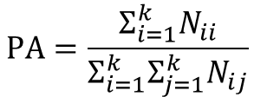
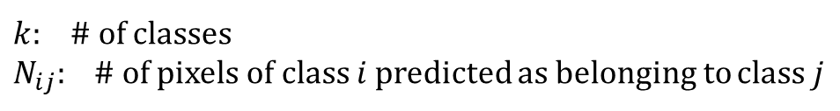

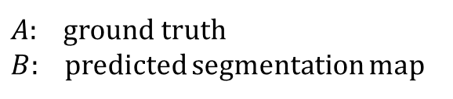
Metrics
  Pixel Accuracy
    The ratio of pixels properly classified, divided by the total number of pixels
  Mean Intersection over Union (mIoU)
    The area of intersection between the predicted segmentation map and the ground truth, divided by the area of union between the predicted segmentation map and the ground truth
    One of the most commonly used metrics in semantic segmentation
2021/11/30
SSDL Group Meeting

Slide 24
Results
  All machine learning based HD algorithm outperforms ALHAT in speed and accuracy for noised input
  Tradeoff between speed and accuracy
    ICNet is faster but less accurate
    SegNet and U-Net is more accurate but slower
    U-Net is better in regression and SegNet is better in binary classification
  Regression based prediction improves mIoU in all three networks
Model* | Binary Safety Map Network |  |  | Slope + Roughness Network
 | Pixel Accuracy [%] | mIoU [%] | Computational Time [s] | Pixel Accuracy [%] | mIoU [%] | Computational Time [s]
SegNet | 90.4 | 82.2 | 0.66 | 88.6 | 82.6 | 1.39
U-Net | 89.6 | 80.8 | 0.88 | 89.4 | 84.3 | 1.71
ICNet | 85.5 | 74.0 | 0.33 | 85.1 | 78.0 | 0.66
Baseline (Replicated ALHAT*) | - | - | - | 80.5 | 66.5 | 13.4
* Low ALHAT performance is partly due to the low resolution (1m/pixel); better results can potentially be obtained at higher resolution (10cm/pixel)
2021/11/30
SSDL Group Meeting

Slide 25
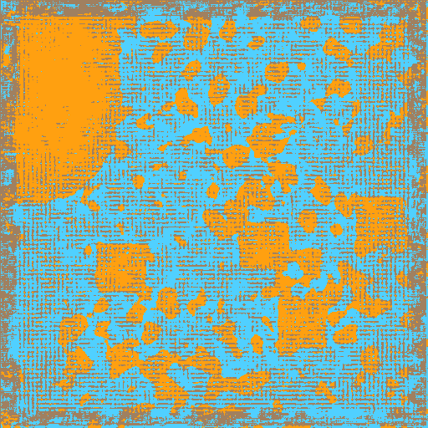

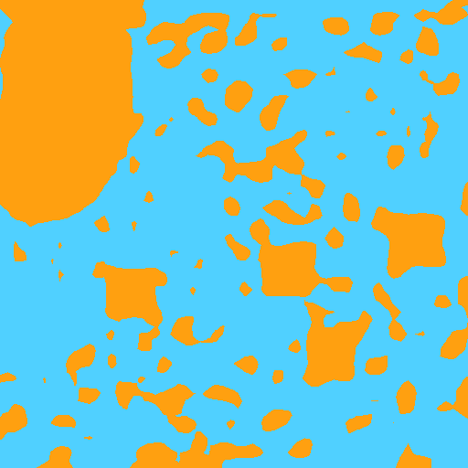
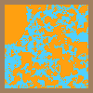
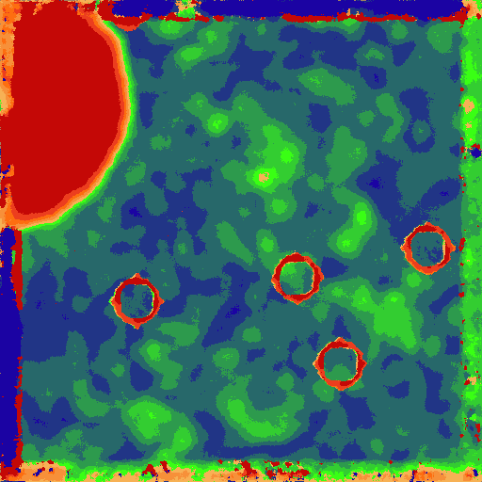
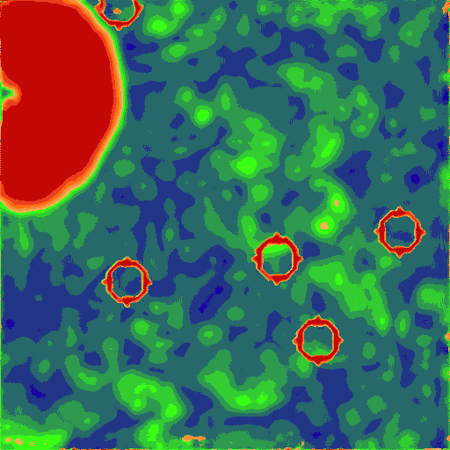
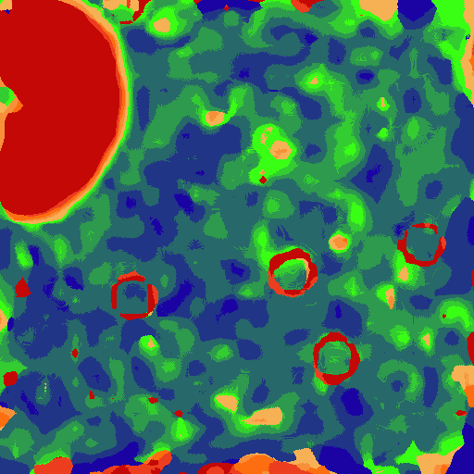
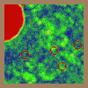
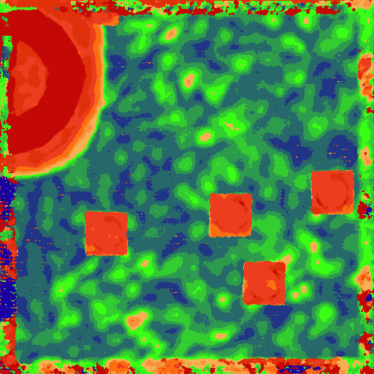
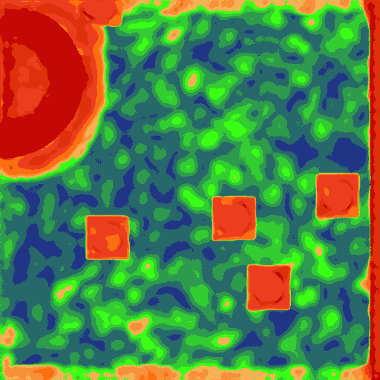
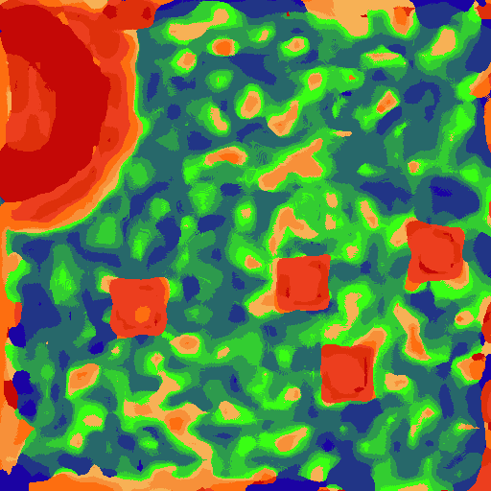
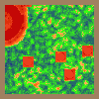
Demonstration
  Brown frame is the area where safety cannot be evaluated, which is ignored in loss and accuracy calculation
  SegNet reproduces details but also noised by wrong labels
  U-Net reproduces details to the extent that predicted labels does not get too scattered and maintain some connectivity with neighborhood pixels
  ICNet’s output is low resolution
Safe
Replicated
ALHAT
Unsafe
Truth*
SegNet
U-Net
ICNet
Undefined
Binary
(Safety Map)
Slope
Roughness
2021/11/30
SSDL Group Meeting

Slide 26
Uncertainty-Aware Deep Learning
Overview
Motivation: the ML outputs is not always reliable. Can we filter out some pixels that the ML methods are not uncertain about and only use the “certain” ones?
Perform semantic segmentation (i.e., output prediction) + prediction uncertainty estimation for input DEMs
Develop an algorithm that takes in the output predictions and uncertainty maps to produce an uncertainty-aware safety map
2021/11/30
SSDL Group Meeting

Slide 27
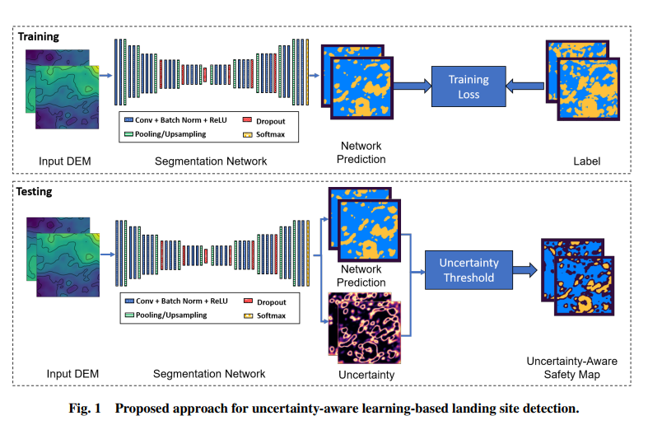
Uncertainty-Aware Deep Learning
Overview
2021/11/30
SSDL Group Meeting

Slide 28
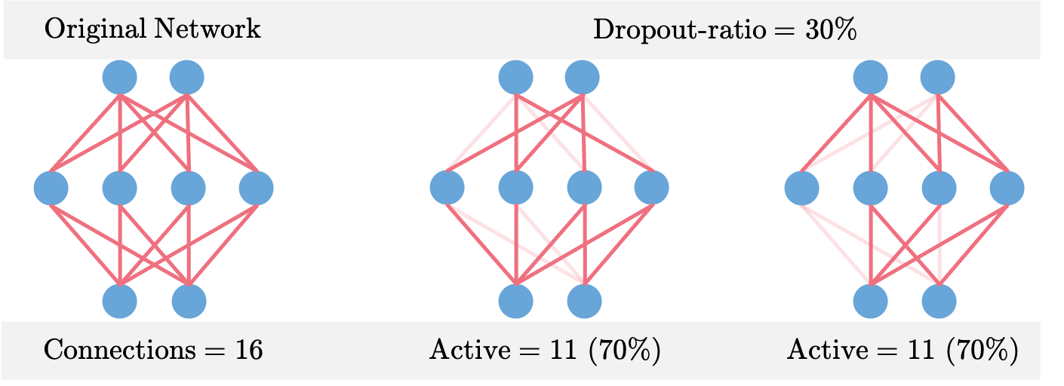
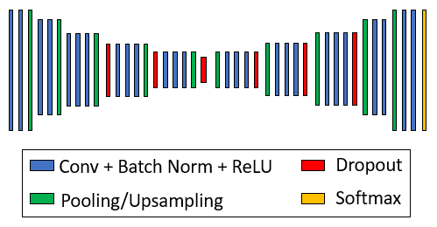

Uncertainty-Aware Learning Model
Bayesian SegNet
Bayesian SegNet [1]
Dropout layers
  Randomly drop out nodes during training with probability p
Monte Carlo (MC) dropout
  Use dropout layers at test time
  The upper bound of # of realized network: $2^{n}$
  Perform M stochastic forward passes with the same input at test time
Bayesian SegNet network architecture [1]
* A. Kendall, et al., “Bayesian segnet: Model uncertainty in deep convolutional encoder-decoder architectures for scene understanding,”arXiv preprint arXiv:1511.02680, 2015.
2021/11/30
SSDL Group Meeting

Slide 29




Prediction Uncertainty
Predictive distribution
Predicted class
Uncertainty – Entropy of the predictive distribution
* J. Mukhoti and Y. Gal. "Evaluating Bayesian Deep Learning Methods for Semantic Segmentation." ArXiv 2019.
2021/11/30
SSDL Group Meeting

Slide 30

Uncertainty Threshold
Uncertainty threshold is selected based on a static from training set
2021/11/30
SSDL Group Meeting

Slide 31

Qualitative Results
2021/11/30
SSDL Group Meeting

Slide 32



Quantitative Results
Reliability of predicted safe sites
The rate of safe sites the algorithm detects
2021/11/30
SSDL Group Meeting

Slide 33
Conclusions
Supervised deep learning model is used to create a safety map from DEMs.
Incorporating network uncertainty into the final safety map improve the performance of the algorithm.
Choosing an appropriate uncertainty threshold allows us to find as many safe sites as possible while maintaining the reliability of the prediction
2021/11/30
SSDL Group Meeting

Slide 34
Can we do better?
More efficient training for higher resolution DEMs and safety maps
  only pixel area of lander footprint defines the safety of the area
  segmenting inputs and labels increase the variance of the training input per mini-batch
  *normalization has to be modified to be consistent for different input window size
  *receptive field size of the network has to be taken into account
  →preliminary results show improved performance/efficiency
Loss function devised with hazard size (slope/roughness value)
  Expect increased prediction performance for very hazardous/safe sites
Autonomous adjustment of uncertainty threshold via reinforcement learning
  Correlated with target site selection strategy
(very) safe
2021/11/30
SSDL Group Meeting

Slide 35
References
Latest Paper
K. Tomita, K. Skinner and K. Ho, “Uncertainty-Aware Deep Learning for Autonomous Safe Landing Site Selection,” https://arxiv.org/abs/2102.10545
Previous Publications
K. Skinner, K. Tomita, and K. Ho, “Uncertainty-Aware Deep Learning for Safe Landing Site Selection,” AAS/AIAA Space Flight Mechanics Meeting, Online, Feb. 2021.
K. Tomita, K. Skinner, K. Iiyama, B. Jagatia, T. Nakagawa, and K. Ho, “Hazard Detection Algorithm for Planetary Landing Using Semantic Segmentation,” AIAA ASCEND Conference, Online, Nov. 2020.
K. Iiyama, K. Tomita, B. Jagatia, T. Nakagawa, and K. Ho, “Deep Reinforcement Learning for Safe Landing Site Selection with Concurrent Consideration of Divert Maneuvers,” AAS/AIAA Astrodynamics Specialist Conference, Online, Aug. 2020.
2021/11/30
SSDL Group Meeting

