Slide 1
SPECTRE: Design of a Dual-Mode Green Monopropellant Propulsion System
AAS Guidance, Navigation and Control Conference February 4, 2022
Brandon J. Colón
Dr. Glenn Lightsey

Slide 2
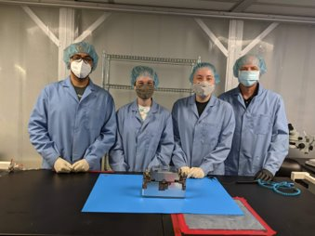
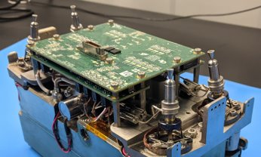
Background
SSDL has experience building cold gas and monopropellant propulsion systems
Additive Manufacturing (AM) has enabled the design of volumetrically efficient propulsion systems
Mission | Dry Mass | Total Impulse | Propellant Type
PROX-1 | 6.000 kg | 999 N-s | Cold Gas
BioSentinel | 1.265 kg | 36 N-s | Cold Gas
ASCENT | 3.660 kg | 549 N-s | Cold Gas
LFPS | 5.550 kg | 1800 N-s | Monopropellant
SunRISE | 1.27 kg | 135 N-s | Cold Gas
SWARM-EX | 0.475 kg | 82 N-s | Cold Gas
VISORS | 1.031 – 1.117kg | 117 – 197 N-s | Cold Gas

Slide 3
What is Dual – Mode?
A Dual – Mode system allows for propulsion technologies to complement each other’s deficiencies
Spectre makes use of both chemical and electrospray propulsion technologies
Partnership between:
Georgia Tech – SSDL
System design and integration
Controller design
Plasma Processes Inc (PPI)
Chemical thruster
MIT – SPL
Electrospray thrusters
ESPACE
Electrospray controller
NASA – MSFC
Project Management

Slide 4
System Specifications
​12U CubeSat
Structure is completely additively manufactured
Both systems are fed from same tank for volume efficiency
Make use of AF-M315E green monopropellant
 | Chemical | Electrical | Total
ISP (s) | 250 | 1500 | ---
Allocated Propellant (kg) | 4.464 | 0.496 | ---
Delta V (m/s) | 619 | 477 | 1097
Thruster Class (N) | 1 | 2.00E-05 | ---
Prop Flow Rate (g/s) | 0.55 | 5.00E-07 | ---
Number of Thrusters | 1 | 16 | ---
Performance characteristics courtesy of Daniel Cavender

Slide 5
Proposed ConOps
Main goal is to demonstrate compatibility and reusability of both systems
Fill electrospray tanks
Fire electrospray thrusters
Fire chemical thruster
Refill and fire electrospray thrusters
# | Operation/Sequence | Mission Time
0 | Launch & Deployment | Day 0
1 | Spacecraft Commissioning | Day 0
2 | Prop System Commissioning | Day 1
3 | Chemical Thruster Checkout | Day 1
4 | Electrospray Fill Operation | Day 1
5 | Electrospray Thruster Checkout | Day 1
6 | Chemical Thruster Endurance Burn #1 | Day 2 -3
7 | Electrospray Thruster Endurance Test #1 | Day 4 – 29
8 | Chemical Thruster Endurance Burn #2 | Day 30 -31
9 | Electrospray Thruster Endurance Test #2 | Day 32 – 59
10 | Chemical Thruster Endurance Burn #3 | Day 60 -61
11 | Electrospray Thruster Endurance Burn #3 | Day 62-89
12 | Disposal Burn (Chemical & Electrospray Thrusters) | Day 90
13 | End of Mission | Day 90

Slide 6
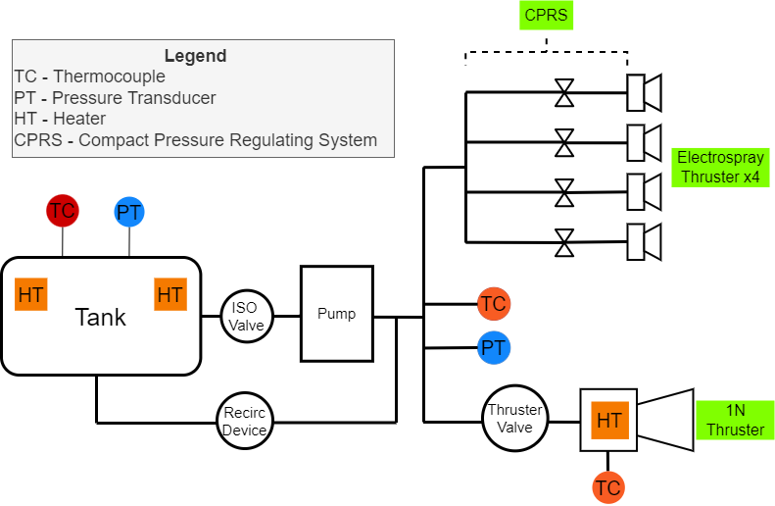
System Schematic

Slide 7
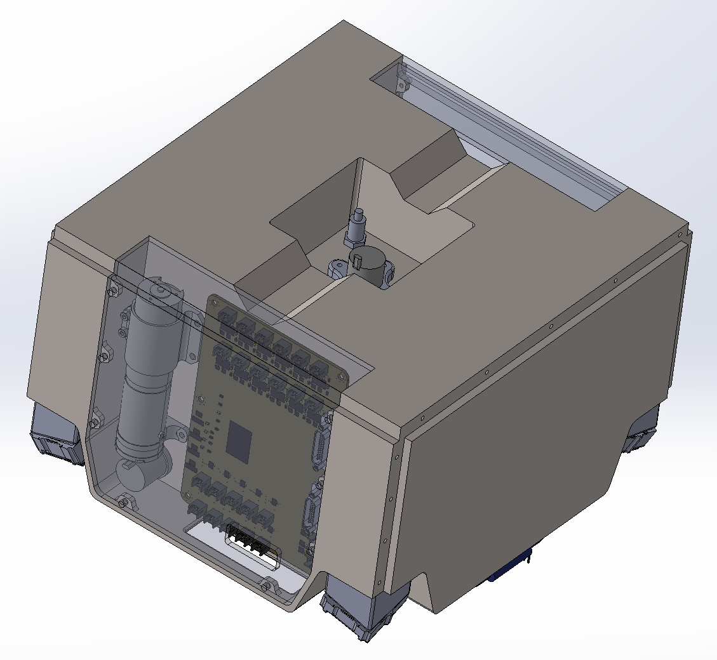
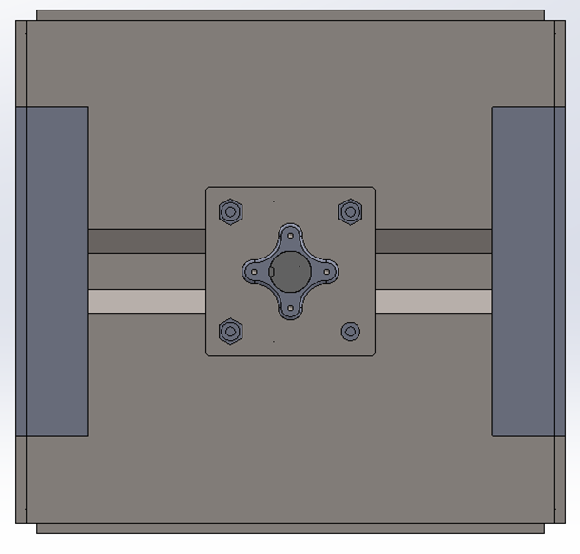
System Design – Approach
Cable Management Bridge
Mechanical Design
Additively Manufactured Structure – Ti-6Al-4V
226.5mm x 216.5mm x146 mm
Internal Volume: 4.78 L
Dry Mass Estimate: 5.2 kg
Pump
PT/TC Sensors
Isolation Valve
Controller
Electrospray Stands x4
Electrospray Thrusters
x4
Thruster Valve

Slide 8
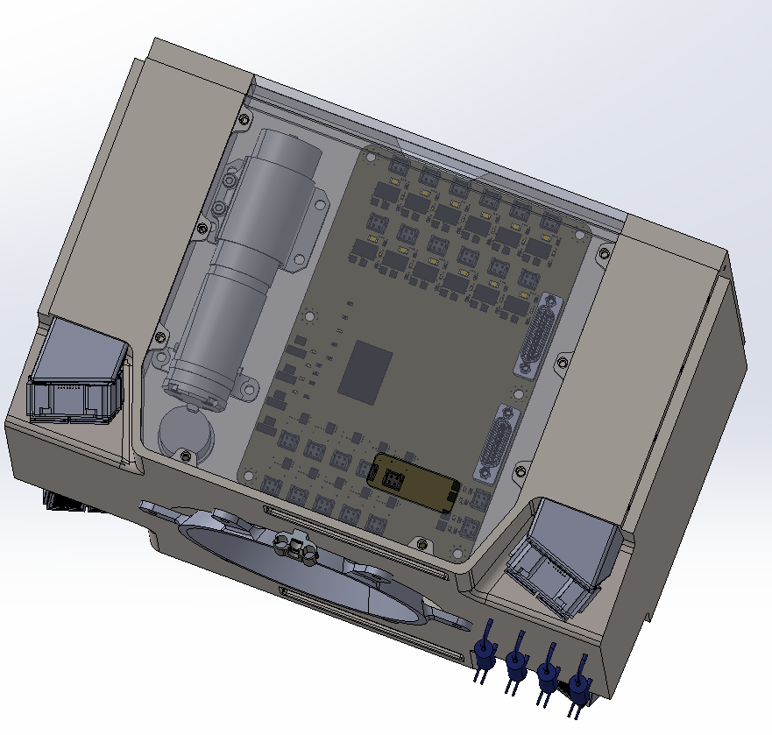
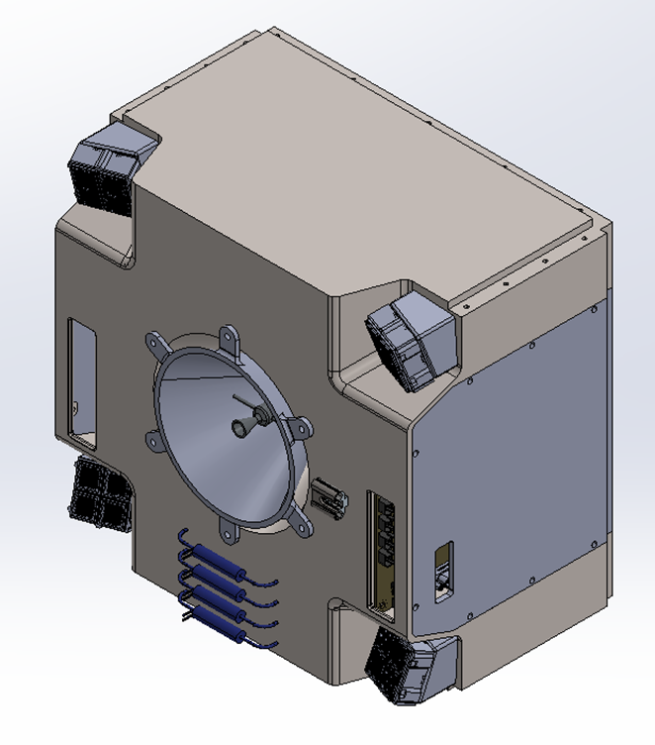
System Design – Integration
Micro Pump
Controller
Thermal Protection Cone
Electrospray Thruster Group x4
Chemical Thruster
Isolation Valve
CPRS Valve x4

Slide 9
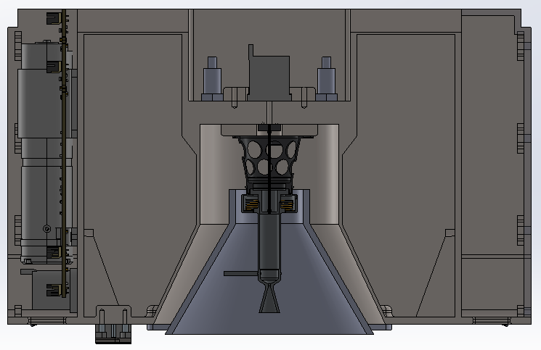
System Design – Tank
Design for Additive Manufacturing
Print along the Z direction
Use necessary internal features as support structures
Route propellant passage lines along the structural features that already need to be printed
Top face open to allow for post machining processes
PMD
PMD
Z
X

Slide 10
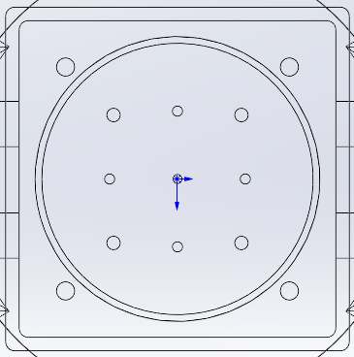
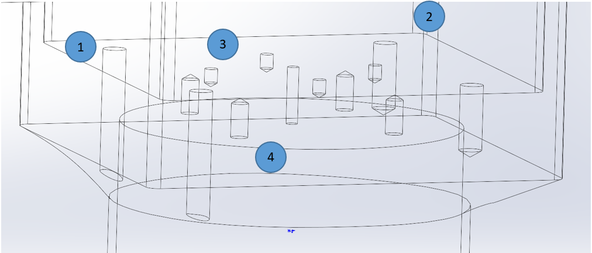
System Design – Tank
Design for Additive Manufacturing
PT/TC interface to read tank properties
PT/TC interface to read passage properties (high pressure)
Thruster valve interface
Thruster interface
1
2
4
3
1

Slide 11
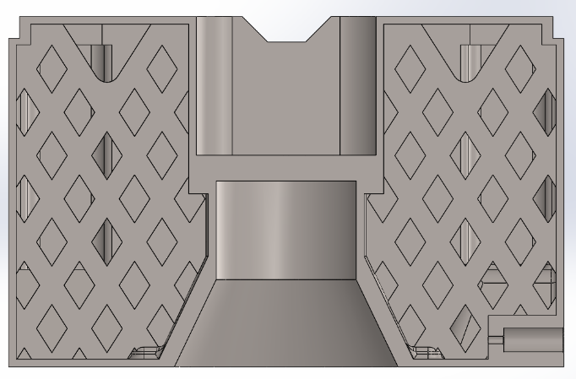
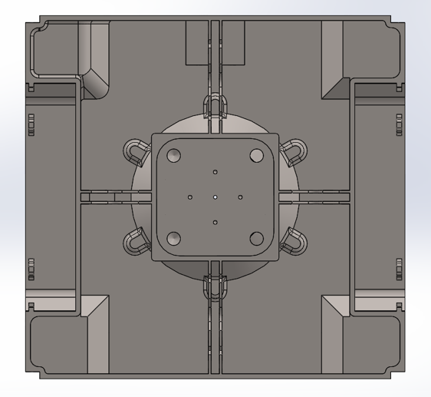
System Design – Tank
Propellant Management Device (PMD)
Used to help propellant reach exit port
Make use of Additive Manufacturing
Printed directly into the main structure
Cross Section
Z
Y
Top View

Slide 12
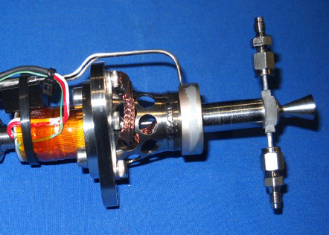
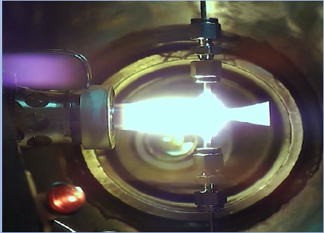
System Design – Chemical Thrusters
1N Thruster provided by partners at Plasma Processes Inc (PPI)
Isp:
250 s – steady state
Estimated Mass: 140 ~ 150 g
Thruster images courtesy of Tomas Hasanof.

Slide 13
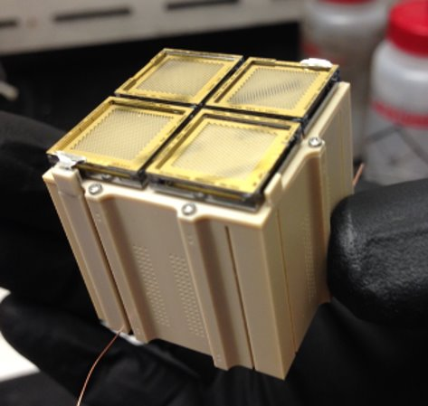
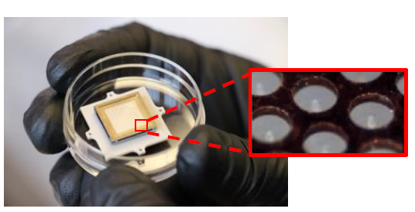
System Design – Electrospray Thrusters
Electrospray thrusters provided by MIT’s Space Propulsion Lab (SPL)
Micromachined emitter tips
Each module consists of 4 thruster heads
 | Per Individual. Thruster Head | Per 4-Thruster Tank/Unit​
Thrust​ | 20 μN​ | 80 μN​
Flow Rate​ | 0.5 μg/s​ | 2 μg/s​
Specific Impulse​ | 1800 s​ | 1800 s​
Dry Mass ​ | -​ | 15 g​
Propellant Volume​ | -​ | 5 mL​
Images and electrospray performance characteristics courtesy of Amelia Bruno

Slide 14
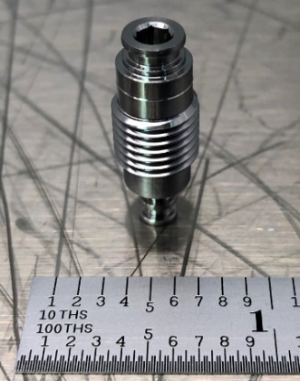
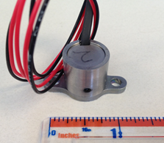
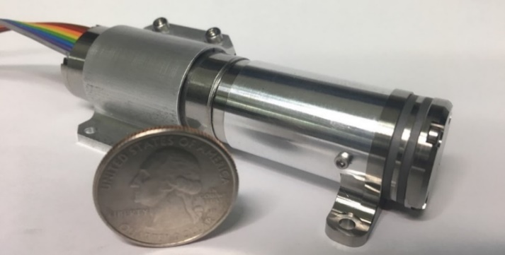
System Design – Heritage Components
Heritage Components
Micro-Pump TRL 8
Micro-Solenoid Valve TRL 8
Fill/Drain Valve TRL 6
COTS Components
Solenoid Valves
Pressure Transducers
Thermocouples
Patch Heaters
Fill/drain valve
Micro-solenoid valve
Micropump developed for LFPS

Slide 15
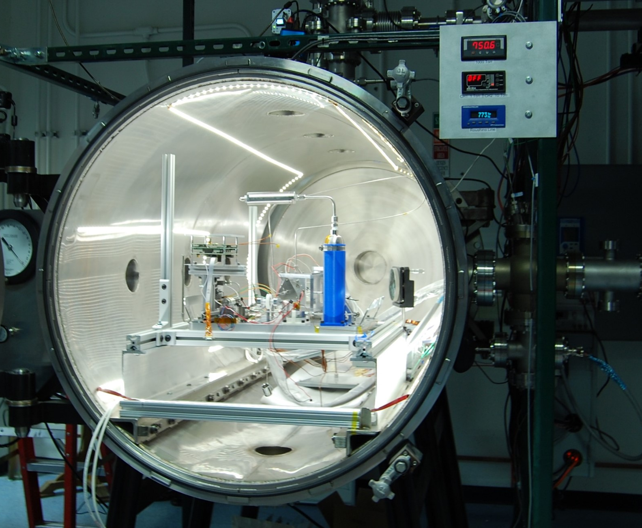
Future Work
Continue Detailed Design
Propellant Passage Design
Weld Plate
Printability Assessment
FlatSat Testing Campaign Demonstrated
Electrospray remote filling
Electrospray firing
Chemical thruster firing
Final electrospray refill and fire

Slide 16
Questions?
AAS Guidance, Navigation and Control Conference February 4, 2022
Brandon J. Colón
Dr. Glenn Lightsey

