Slide 1
Multidisciplinary Design Optimization Approach to Integrated Space Mission Planning and Spacecraft Design
www.ascend.events
Masafumi Isaji, Yuji Takubo, and Koki Ho
Georgia Institute of Technology
Copyright © 2021 by Masafumi Isaji, Yuji Takubo, Koki Ho/Georgia Institute of Technology. Published by the American Institute of Aeronautics and Astronautics, Inc., with permission.

Slide 2
Presentation Outline
Introduction
Problem Definition
Proposed Approach
Case Study: Human Lunar Exploration Campaign
Conclusion

Slide 3
Introduction: Integrated Space Mission Planning and Spacecraft Design
Space Mission Planning and Spacecraft Design should be concurrently optimized
Space mission planning = Mixed-Integer Quadratic Programming (MIQP) problem
Spacecraft design = Nonlinear Programming (NLP) problem, no integer variables
Integrated problem is a Mixed-Integer Nonlinear Programming (MINLP) problem → computationally prohibitive
Approaches so far:
Sequential optimization
i.e., optimize the mission first, then spacecraft
Piecewise linear approximation of nonlinear portion
Nonlinearity is not strictly enforced
Our Approach: Decomposition-Based Optimization

Slide 4
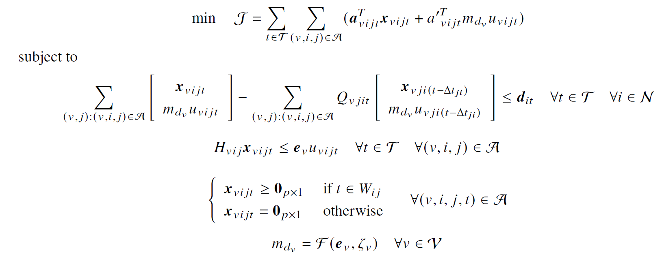
Integrated MINLP Problem Definition
→ Objective to minimize
IMLEO in this case
→ Mass Balance Constraint
→ Concurrently Constraint
→ Time Window Constraint
→ SC Design Constraint Only Nonlinear part

Slide 5
Proposed Approach: Augmented Lagrangian Coordination (ALC)
ALC is decomposition-based, bi-level formulation with penalty method for MDO [1]:
Master Problem
Updates shared variables y/minimizes the sum of penalty functions ϕ_{k}
$$\min_{y} \sum_{k=0}^{M−1}{ }φ_{k}\left(c_{k}\left(y,y_{k}\right)\right)$$
Subproblem(s)
Minimizes the local objective f_{k} and local penalty function ϕ_{k}
consistency constraint c_{k} is relaxed and not strictly enforced
$$\begin{aligned}\min_{y_{k},z_{k}} &f_{k}\left(y_{k},z_{k}\right)+φ_{k}\left(c_{k}\left(y,y_{k}\right)\right) \\ \text{subject} \text{to} &g_{k}\left(y_{k},z_{k}\right)≤0 \\ &h_{k}\left(y_{k},z_{k}\right)=0\end{aligned}$$
ϕ_{k} : penalty function
c_{k}: local consistency constraint
y: shared variable
y_{k}: local shared variable
y_{k}: local shared variable
z_{k}: local variable
g_{k}: local inequality constraint
h_{k}: local equality constraint

Slide 6
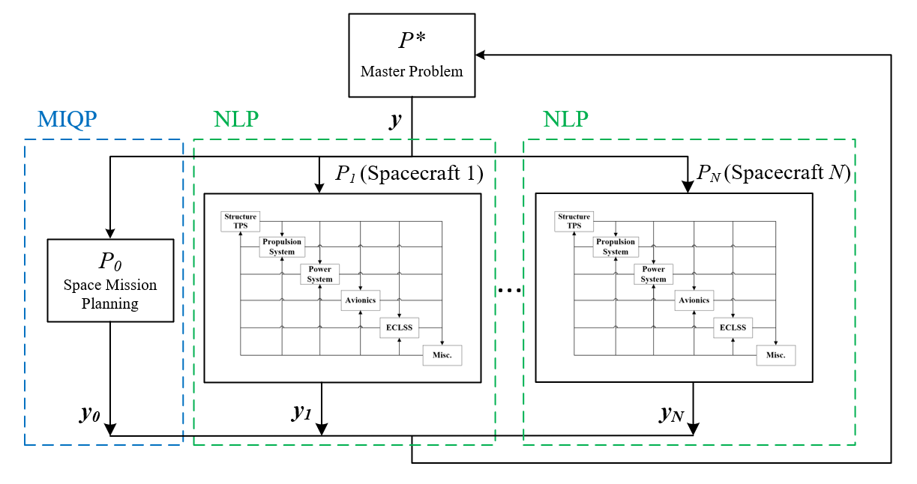
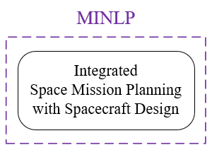
Applying ALC to Our Problem
y includes spacecraft payload capacity, propellant capacity, dry mass (m_{pv}, m_{fv}, m_{dv})
Decomposes MINLP into MIQP and NLP subproblems
Penalty becomes stricter at every outer loop iteration

Slide 7
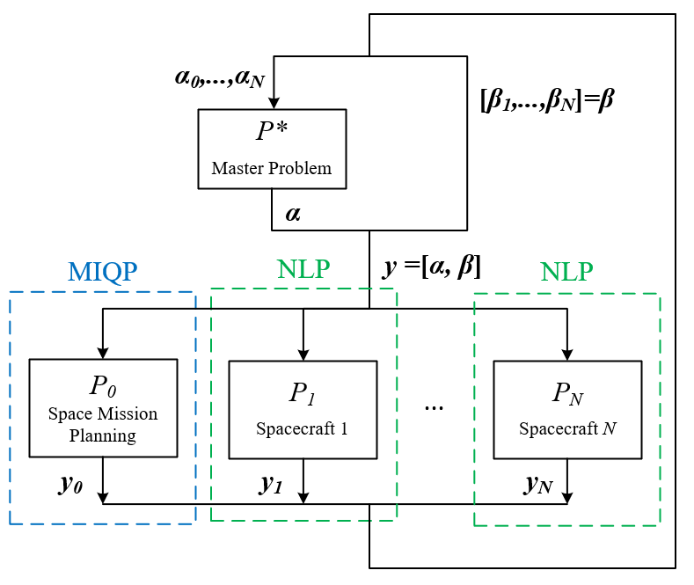
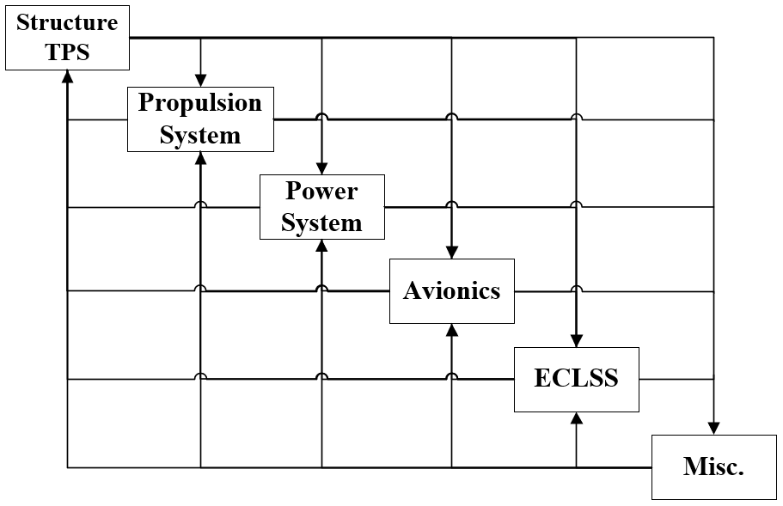
Prioritized Shared Variables and New Spacecraft Design Model
Prioritized Shared Variables
some subproblems knows better about some shared variables
Parametric Spacecraft Sizing
Subsystem interactions through dry mass
Dry mass is summation of subsystem mass
Subsystem mass are function of dry mass

Slide 8
Case Study: Human Lunar Exploration Two-Mission Sequence (Campaign)
Automatic Initial Guess generation by Mixed-Integer Linear Programming (MILP)
Piecewise linear (PWL) approximation for nonlinear spacecraft model
Global optimum with the approx. model
MILP problems do not need initial guess
Solutions and comp. time depend on PWL breakpoint increment/number of mesh points
Results:

Slide 9
Benchmarking with State-of-the-Art Method
The embedded optimization method [2]
A metaheuristics algorithm determines spacecraft parameters
Send them to space mission planning problem (solved by MILP)
Three different metaheuristics algorithms are applied:
Ant Colony Optimization (ACO) [3], Genetic Algorithm (GA) [4], and Particle Swarm Optimization (PSO) [5]

Slide 10
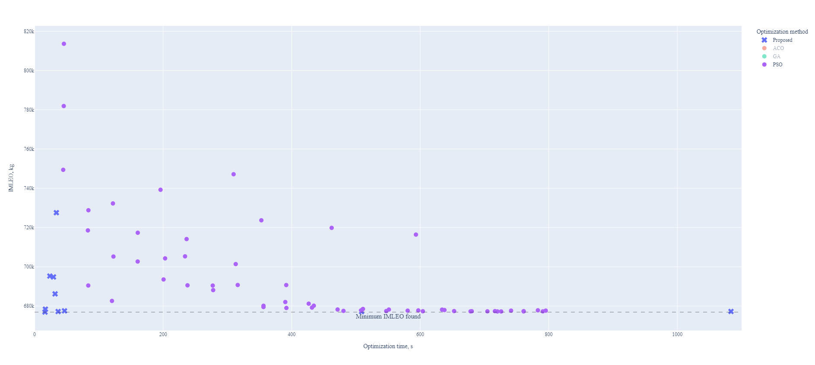
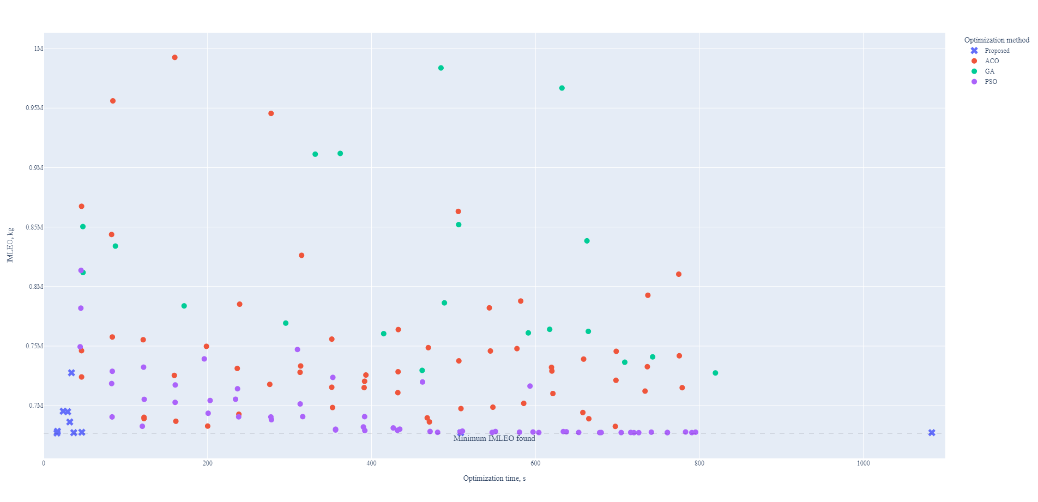
Visual Comparison of the Two Methods
→ increasing number of generation/mesh points

Slide 11
Performance Comparison and Conclusion
Case study (IMLEO minimization problem) best performance comparison
Proposed method: 676,930kg IMLEO in 16.27s
Embedded opt. method: 677,221kg IMLEO in 793.9s
Conclusion
Proposed method achieves better and consistent solutions in less time due to:
1. unique problem structure 2. efficient initial guess generation 3. prioritized shared variables 4. specialized solvers for subproblems
Further room for improvement
Parallelization of subproblems, MDO problems integration

Slide 12
References
[1] Tosserams, S., Etman, L., and Rooda, J., “An augmented Lagrangian decomposition method for quasi-separable problems in MDO,” Structural and Multidisciplinary Optimization, Vol. 34, No. 3, 2007, pp. 211–217. https://doi.org/10.1007/s00158-006-0077-z.
[2] Taylor, C., “Integrated Transportation System Design Optimization,” Ph.D. thesis, Dept. of Aeronautics and Astronautics, MIT, Cambridge, MA, 2007.
[3] Schlüter, M., Egea, J. A., and Banga, J. R., “Extended ant colony optimization for non-convex mixed integer nonlinear programming,” Computers & Operations Research, Vol. 36, No. 7, 2009, pp. 2217–2229. https://doi.org/https://doi.org/10.1016/j.cor.2008.08.015.
[4] Holland, J. H., “Genetic Algorithms,” Scientific American, Vol. 267, No. 1, 1992, pp. 66–73. URL http://www.jstor.org/stable/24939139.
[5] Kennedy, J., and Eberhart, R., “Particle swarm optimization,” Proceedings of ICNN’95 - International Conference on Neural Networks, Vol. 4, 1995, pp. 1942–1948 vol.4. https://doi.org/10.1109/ICNN.1995.488968.16

Slide 13
Thank You
Any Questions?
Preprint available on arXiv and ResearchGate

Slide 14
www.ascend.events
Powered by

