Slide 1
A Heuristic Method for Determining Payload-to-Vehicle Assignment & Launch Order for Multi-Vehicle Exploration Campaigns
Nick Gollins, Masafumi Isaji, Yuri Shimane, and Koki Ho

Slide 2

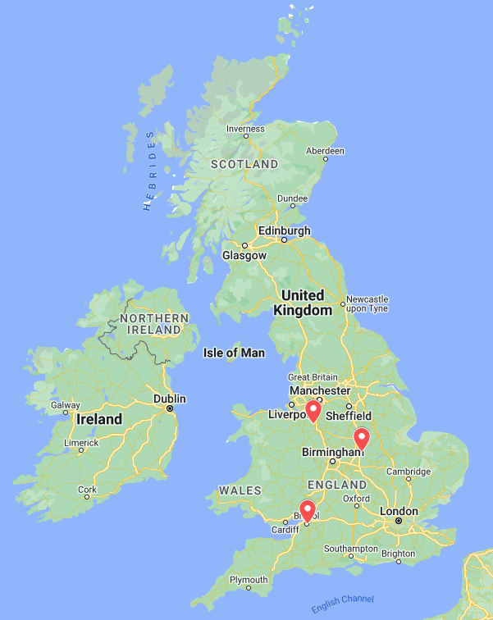
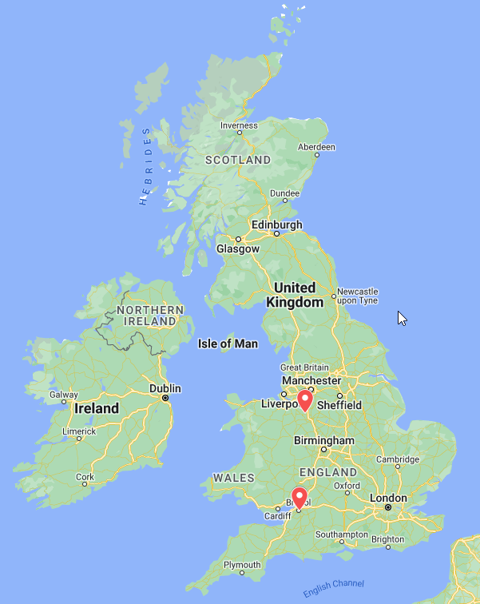









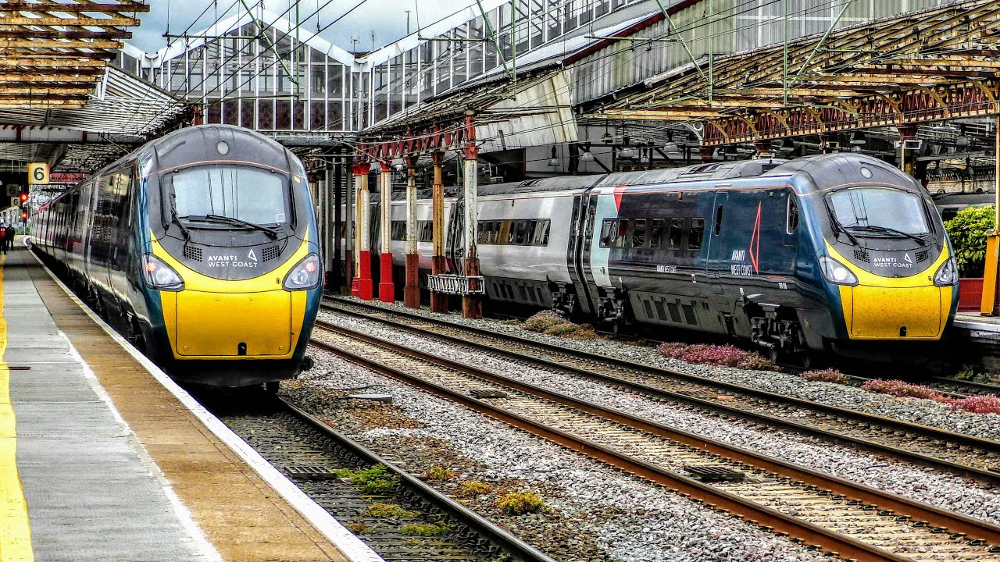


Slide 3
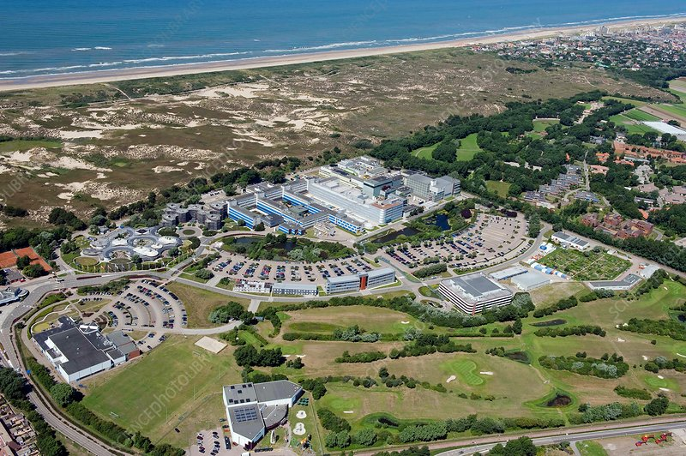
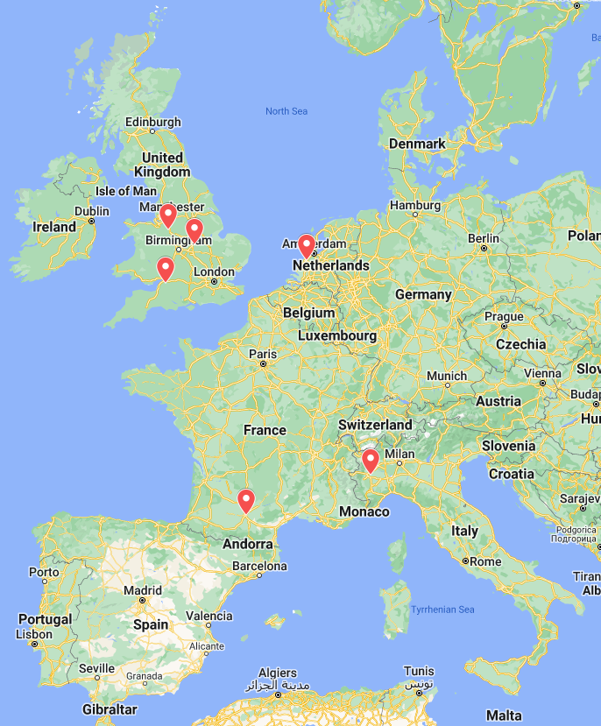




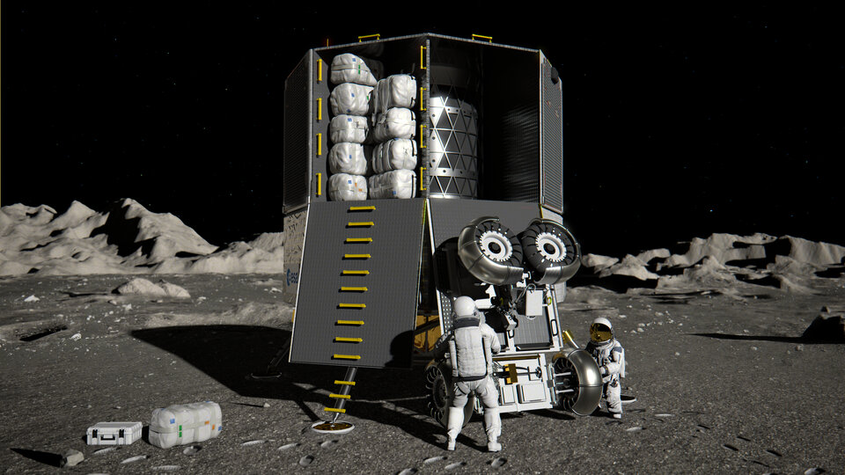

Slide 4
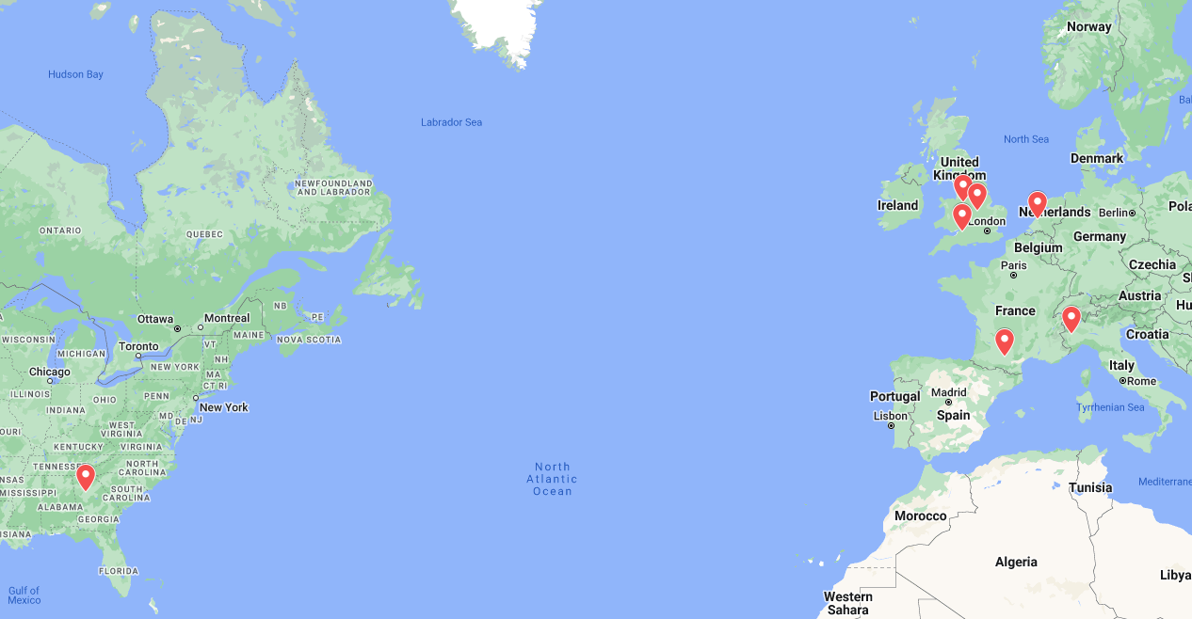

Slide 5
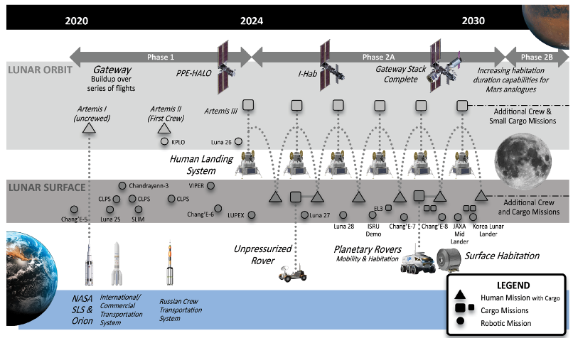
Introduction
Lunar exploration plans over the coming decade include a wide variety of logistics vehicles, each with their own scheduling constraints.
The method presented attempts to navigate those scheduling constraints, in addition to programmatic requirements, to produce an optimal campaign schedule.
Credit: Global Exploration Roadmap (GER) Supplement August 2020: Lunar Surface Exploration Scenario Update
Notes:
First I’ll briefly explain why exploration mission campaign scheduling and vehicle assignment is a problem that needs addressing. Over the coming decade, the Global Exploration Roadmap sees the frequency of missions to cis-lunar space increasing greatly. In addition, the logistics vehicles that contribute to the campaign are from a wide variety of sources, introducing a great deal of programmatic variables and uncertainty.

Slide 6
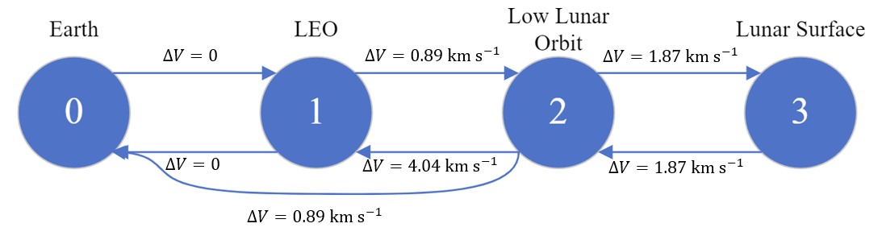
Background: Lunar Exploration Logistics Modelling
The commodity flow throughout an exploration campaign can be modelled as a mixed-integer linear programming problem.
By defining the Earth, LEO, lunar orbit, and the lunar surface as a network of “nodes” connected by “arcs”, we can calculate the optimal flow of commodities through the network.
Notes:
In past work, space logistics has been modelled using sets of “nodes” connected by “arcs”. There is a cost associated to transporting commodites along these arcs, determined by the delta V of transferring between those locations.

Slide 7

Demand and Supply
The flow of commodities is driven by user-defined “demand” and supply. The solver must find the flow that satisfies demands, given supplies, at specified nodes.
In this model, the demand and supplies are defined in a “demand matrix”, which quantifies the demand or supply of:
  a specific payload,
  to be carried by a specific vehicle,
  to be satisfied at a certain time,
  at a specific node.
Notes:
The commodity flow must satisfy programmatic requirements enforced using “demand matrices”. These express the amount and type of payload to be delivered to a specific node at a certain time.

Slide 8
Programmatic Requirements
In the real world, “demand” and “supply” times are rarely definite.
Scheduling requirements (demand times) are often expressed in the form “…no later than..”, and lower bounds on supply times are determined by vehicle or payload development time.
It is more realistic to work within constrained scheduling windows.
Therefore, this method aims to generate demand matrices that satisfy programmatic requirements, scheduling constraints, and minimize the launch mass of an exploration campaign.
Notes:
However, in the real world, scheduling requirements are rarely so exact. Instead, they are expressed as “no later than” requirements, and lower bounds on the delivery time are determined by the development time of the payload or vehicle. So, this method aims to generate demand matrices that satisfy programmatic requirements, whilst minimising the overall mass delivered to Low Earth orbit across a campaign.

Slide 9
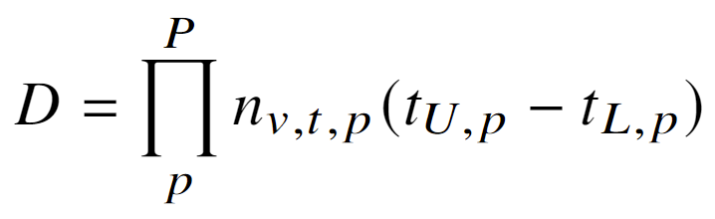
Scheduling Decisions
Considering the relaxation of supply/demand times and also the problem of vehicle choice, the decision space quickly blows up:
Additionally, the feasible space is sparse: small changes to the decision variables can easily break scheduling constraints.
It is important therefore to efficiently navigate this space.
Notes:
By relaxing the delivery time requirements across a window, however, the decision space of the problem blows up very quickly, in a combinatorial manner according to the number of payloads in the campaign. Therefore, we require an efficient method for exploring the decision space. For that reason, we turn to metaheuristics.

Slide 10
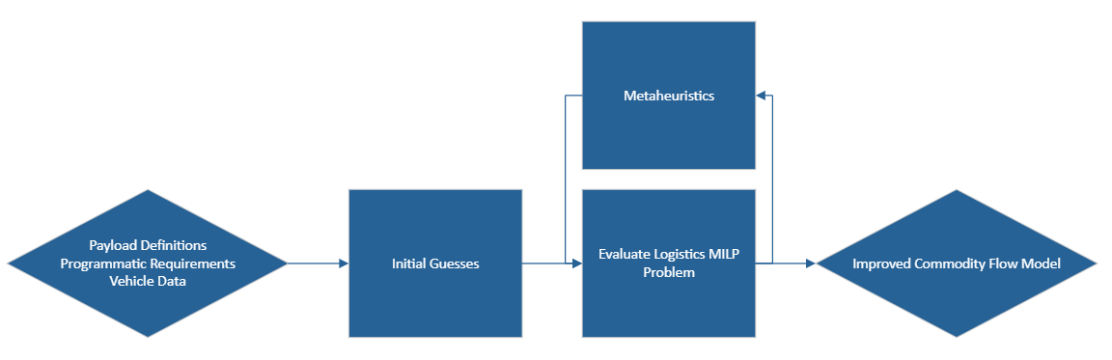
Overall Structure
Notes:
The overall structure of this method is as follows: an exploration campaign is defined using programmatic requirements and payload and vehicle definitions. Initial feasible guesses are generated according to those inputs, and evaluated using the mixed-integer linear programming logistics model. Then, those solutions are used to initialise a metaheuristics population, and evolved until a better solution is found.

Slide 11
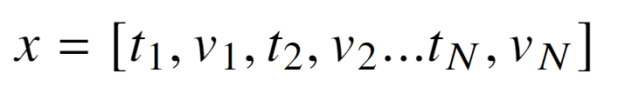
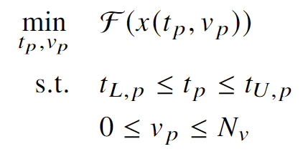
Metaheuristics
A metaheuristic algorithm can be used to efficiently explore new demand matrices.
In particular, the “pygmo” Simple Genetic Algorithm was used.
Notes:
The metaheuristics’ aim is to generate decision vectors, containing launch time and vehicles choices, that minimise the output of the MILP layer of the algorithm. The Simple Genetic Algorithm from the pygmo Python library was used.

Slide 12
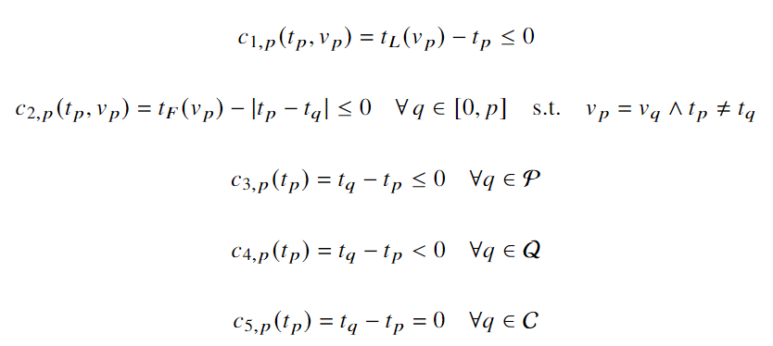
Metaheuristics: Constraints
The 𝑐₁ and 𝑐₂ constraints ensure that a payload can only launch if its assigned vehicle is available at that time index.
𝑡_{𝐿}(𝑣) is the lower bound on the time availability of vehicle 𝑣. 𝑡_{𝐹}(𝑣) is the minimum time between launches
(maximum launch frequency) of vehicle 𝑣.
Constraints 𝑐₃, 𝑐₄ and 𝑐₅ define payload sequencing constraints, corresponding to the sets of soft (P) and strict (Q) precursor payload, and strict co-payload (C) requirements.
Notes:
The metaheuristics was constrained by the programmatic requirements. C1 enforces the earliest date at which a vehicle is available; c2 enforces the frequency with which a vehicle can be used; c3 – 5 enforce precursor and co-payload scheduling.

Slide 13
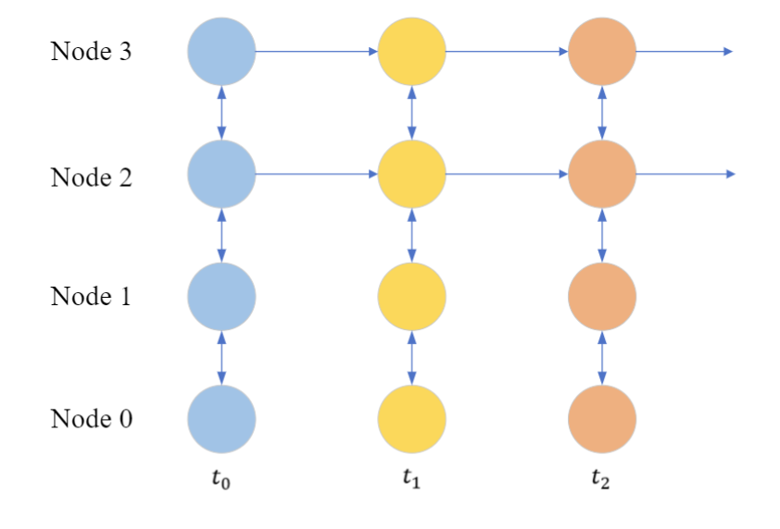
MILP Logistics Model
The logistics flow is modelled in a partially-static time expanded network.
Flows happen instantaneously within single time steps, but can be held-over to the next step.
Notes:
The logistics network was modelled as a partially-static time-expanded network. This means that a low resolution time step was used in order to model long-term campaigns, so commodity flow happens “instantly” within a time step. However, commodities can be kept on holdover arcs so that missions are not isolated from each other in the overall campaign.

Slide 14
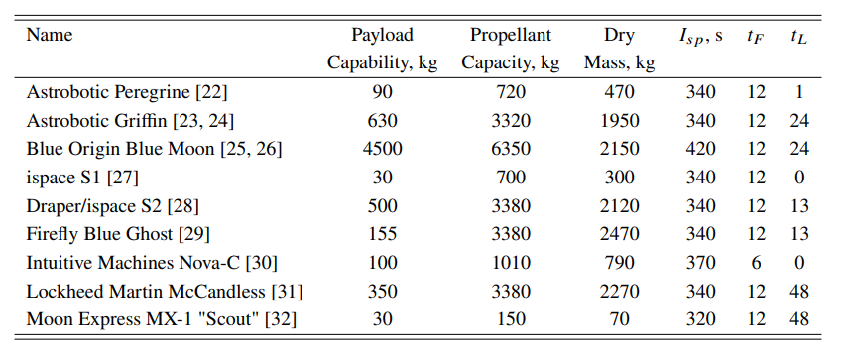
Case Study 1: CLPS Vehicles
Notes:
The method was applied to 2 case studies. First, we analysed the Commercial Lunar Payload Services program. This is a technology development program which is not optimised to reduce the overall mass to orbit, so it should be an easy to find if the algorithm is performing as expected. The vehicles used for the analysis on shown on this table, and contain the vehicles which had sufficient data publicly available to at least make informed guesses about their performance. It’s not, however, intended to be a completely accurate representation of those vehicles. tF in this table launch frequency, and tL is the earliest time at which the vehicle is available.

Slide 15
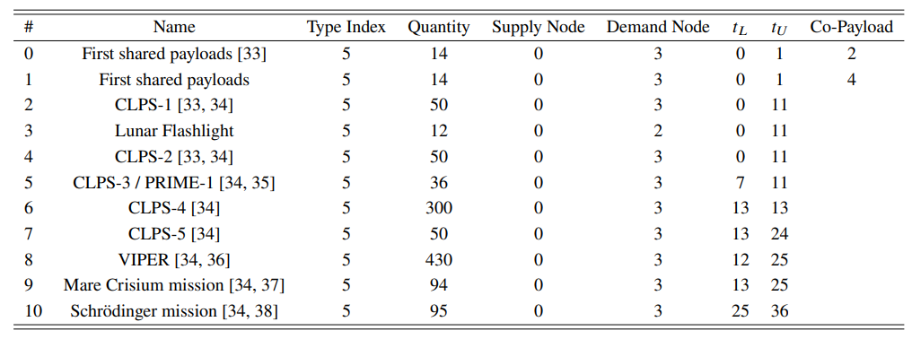
Case Study 1: CLPS Payloads
Notes:
In this table we show the list of payloads considered for the CLPS campaign, inspired by the missions already contracted out by NASA.

Slide 16
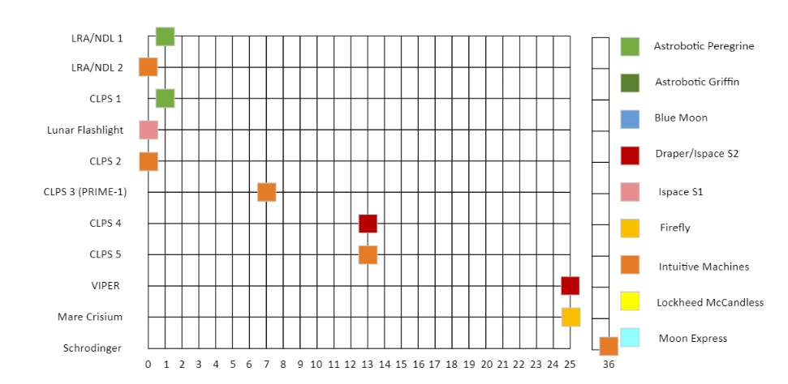
Case Study 1: CLPS Baseline Timeline
Notes:
This slides shows the assumed baseline schedule and vehicle assignments of the CLPS campaign.

Slide 17
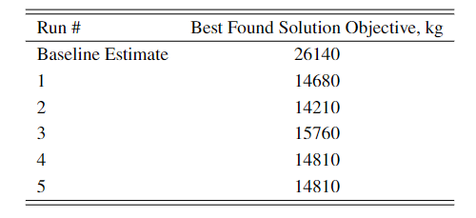
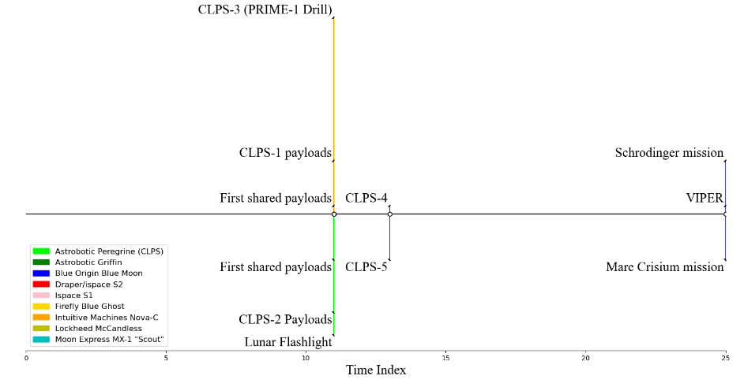
Case Study 1: CLPS Results
Notes:
And this slide shows the optimised schedule found by the algorithm. The results are very intuitive: grouping payloads together where possible will reduce the overall mass of the campaign.

Slide 18
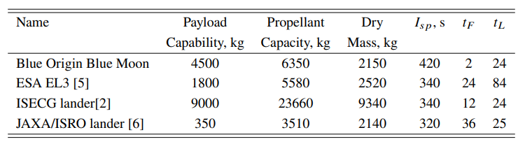
Case Study 2: Artemis Vehicles
Notes:
Next, we test how well the algorithm can handle more complex sets of constraints. To do so, we analyse the Artemis campaign through to Artemis 6, as according to the Global Exploration Roadmap. We append to the list of vehicles the following landers, including an assumed Human Landing system design. Also note that the frequency with which the BO lander can be used was increased to once every two time steps: this was necessary in order to achieve a variety of feasible solutions. This result in itself shows the importance of a lander of that capability to the flexibility of the campaign.

Slide 19
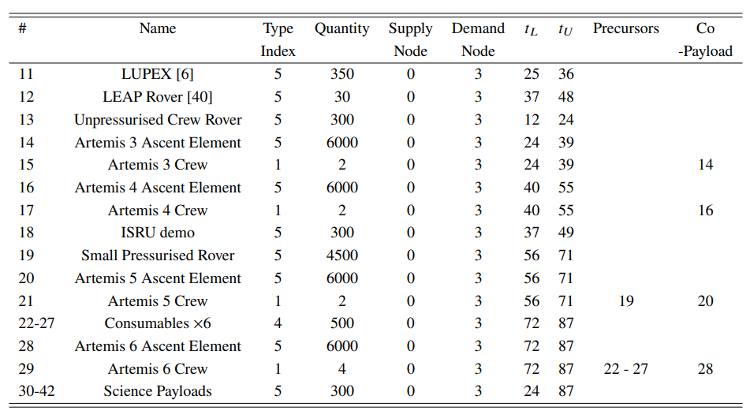
Case Study 2: Artemis Payloads
Notes:
We used this extended list of payloads for this analysis. Note that importantly, there are more scheduling constraints in this problem.

Slide 20
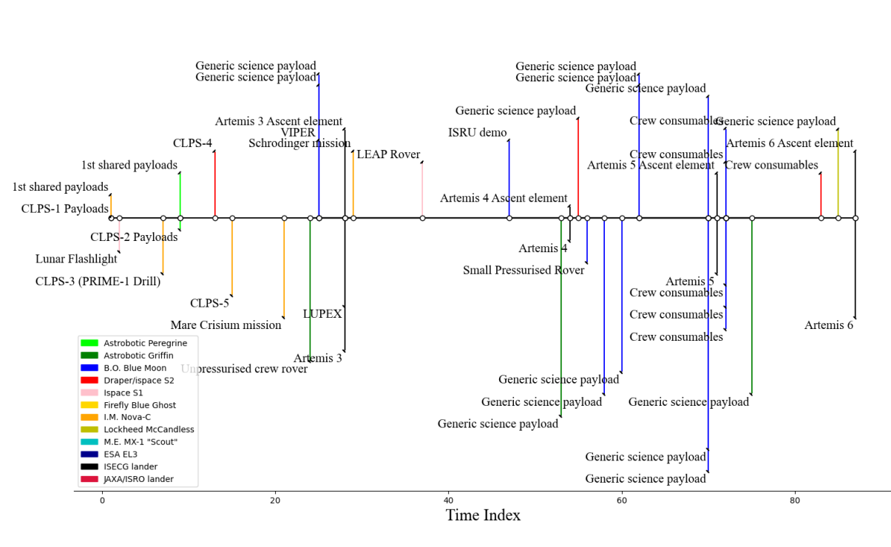
Case Study 2: Artemis Schedule Results
Notes:
The algorithm successfully navigated those constraints and produced this campaign timeline.

Slide 21
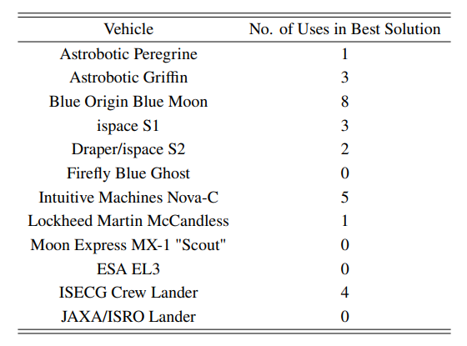
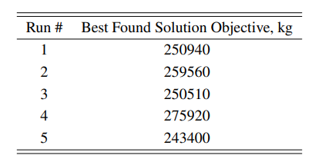
Case Study 2: Artemis Results
Notes:
And this slide shows the best objective found by different runs of the algorithm, and the number of times each vehicle was used in the solution of the best run.

Slide 22
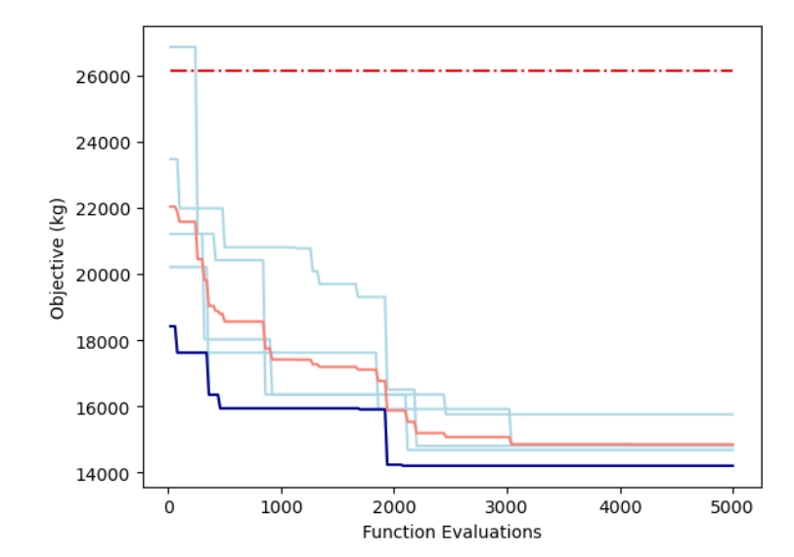
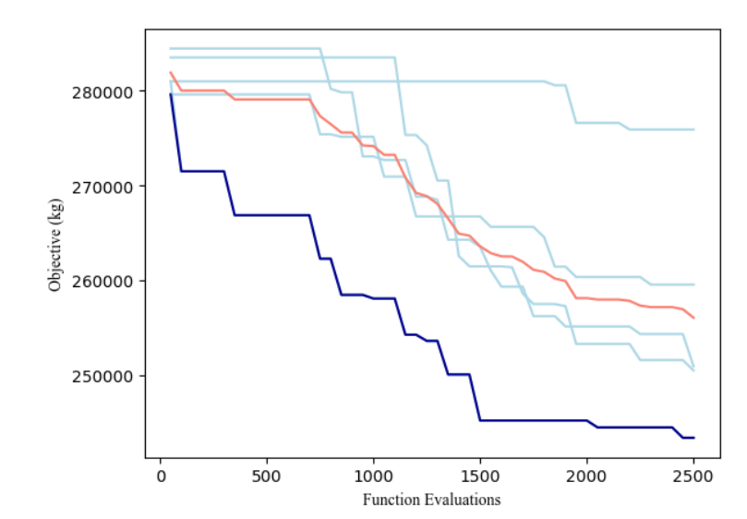
Solution Improvement Rates
Figure (left): Progress of the objective improvement in the CLPS campaign analysis, showing each run in light blue, the estimated real-world solution (dashed red), the mean objective (orange), and best solution (dark blue).
Figure (right): Progress of the objective improvement in the Artemis phases 1 - 2 campaign analysis, using a population size of 50.
Notes:
This slide shows the speed with which the algorithm converged to a solution for each case study. Whilst the CLPS study indeed appears to have converged on a good solution, the Artemis analysis appears to still be decreasing and with more time allowed, likely would have improved further. However, in both cases, large improvements were found compared to the initial guesses.

Slide 23
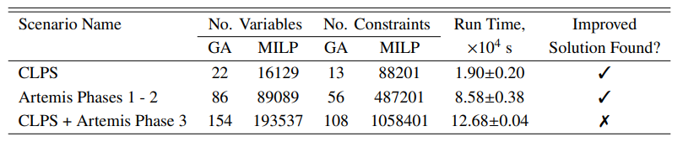
Solution Improvement Rates
Notes:
Here we compare the computation time versus numbers of variables and constraints for each problem. Clearly, the complexity of the problem greatly increases the computation time. We also tried a more complex case that we call “Artemis Phase 3” which could not find improvements to the initial guesses in the indicated amount of time.

Slide 24
Conclusions
To conclude, the method created successfully finds improved campaign plans that minimise the overall launch mass.
However, due to an un-informed genetic algorithm being used, a lot of time is spent making steps into infeasible regions of the decision space. This slows down the process.
Future work will produce a tailor-made genetic algorithm that explores the decision space in a more informed way, and spend more time exploring the feasible spaces.

